Slide 1
Antimicrobial stewardship program
邱政洵 教授
Department of Pediatrics
Chang Gung Children’s Hospital
Taoyuan, Taiwan
Notes:
Ladies and gentlemen,
It’s my pleasure being here to share the experience of implementing Computerized antibiotic stewardship program in our hospital

Slide 2
Antibiotic Stewardship
抗生素管理
透過管理的力量與方法，整合不同專業 (醫師 藥事 醫檢 護理 感控 資訊)，將抗生素的使用最佳化，有效治療病人之外，減少不必要的使用，減少藥物可能造成的短期及長期的傷害，維護病人與社會的健康。

Slide 3
行政與管理的認知: 抗生素管理: 三贏 (病人 醫院 醫療人員)
Antibiotic stewardship programs are a “win‐win” for all involved:
- A University of Maryland study showed one antibiotic stewardship program saved a total of $17 million over 8 years.
- Antibiotic stewardship helps improve patient care and shorten hospital stays, thus benefiting patients as well as hospitals.

Slide 4
Healthcare facility administrators and payers: ASP
行政與管理的認知: 抗生素管理
Make appropriate antibiotic use a quality improvement and patient safety priority.
Focus on reducing unnecessary antibiotic use, which can reduce antibiotic-resistant infections, Clostridium difficile infections, and costs, while improving patient outcomes.
Emphasize and implement antibiotic stewardship programs and interventions for every facility – regardless of facility setting and size.

Slide 5
Strategic plans against the spread of the resistance
Surveillance
Infection Control
Prudent antibiotics use
Antibiotic stewardship (ABS)
Notes:
We are so big a hospital, therefore the strategies against the spread of the resistance is a very important issues.
We believe a sustainable comprehensive antimicrobial stewardship program, along with strict infection control measures, and periodical surviellance are necessary to reduce the secondary spread of the resistant organisms in a hospital.

Slide 6
Common strategies to control the spread of different resistant bacteria: Hand washing and ABS are most crucial and universally important
Strategy | MRSA | CoNS | VRE | ESBL | MDR-Ab | MDR-Pa
Hand-washing | ++ | ++ | ++ | ++ | ++ | ++
Contact isolation | +/- | +/- | ++ | +/- | ++ | ++
Environmental cleaning | + | + | ++ | + | ++ | ++
Antibiotic stewardship | ++ | ++ | ++ | ++ | ++ | ++
C. difficile : antibiotic stewardship
Reduction of resistance rate: antibiotic stewardship
Notes:
This are the common strategies to control the spread of different resistant bacteria
We can see hand washing and antibiotic stewardship are the effective ways to control the resistant bacteria

Slide 7
Two key strategies to make
ABS success
Prospective audit of antimicrobial use with intervention and feedback to the prescriber (A-I)
Formulary restriction and pre-authorization requirements for specific agents (B-II)
CID 2007; 44:159
Notes:
The publication of CID journal in 2007 already told us the two key strategies in ABS program are
Prospective audit and Formulary restriction
Prospective audit means ID doctors give intervention and feedback to the prescriber
Formulary restriction means pre-authorization is required for when prescribing specific antibiotics

Slide 8
Supplemental strategies
Guidelines & clinical pathway A-I
Streamlining or de-escalation A-II
Dose optimization A-II
Education A-III
IV to oral switch A-III
Antimicrobial order form B-II
Combination therapy C-II
Antimicrobial cycling C-II
CID 2007; 44:159
Notes:
In addition to the previous strategies, others like
Guidelines & clinical pathway A-I
Streamlining or de-escalation A-II
Dose optimization A-II
Education A-III
IV to oral switch A-III
Antimicrobial order form B-II
Combination therapy C-II
Antimicrobial cycling
are also some supplemental methods will be used in hospital.

Slide 9


Antimicrobial Stewardship: a complex process in a simplified scheme
症狀
診斷
Surveys
Empirical Tx
Process and outcome measurements
prescription
Front-end review
Agree or suggest to modify
dispensing
Back-end review
follow -up
Yes
patients
De-escalation
Shift to oral agents
Modify regimen?
No
Yes
Infection Control
No

Slide 10
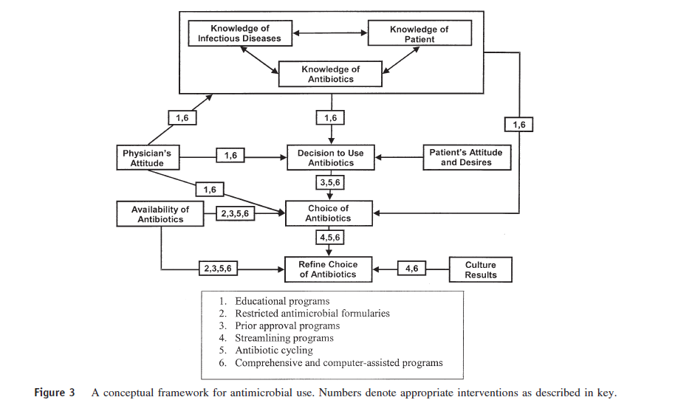
The “backbone’ for the ASP infrastructure:
1, 2, 3, 4 (6)
Streamlining = de-escalation
= de-escalation
Fishman N. Am J Med 2006

Slide 11
Interventions in ABS
Front-end approach
ID approval for restricted antibiotics
CPOE (computerized prescriber order entry) warning system
Back-end approach
ADR report
Re-evaluation after culture
PD/PK consideration
Monitor and feedback
Medication profile and prescription review mechanism
Debra A. Goff, Pharm.D
Notes:
All of the above strategies of ABS can be divided into Front-end and back-end approach. Front-end approach means the intervention is made before the antibiotic is received. Back-end approach means the intervention is made after the antibiotic has been received.

Slide 12
Interventions in ABS
Front-end approach
ID approval for restricted antibiotics
CPOE warning system
Back-end approach
Medication profile and prescription review mechanism
Notes:
so, the approach like ID approval for restricted antibiotics, CPOE warning system, or Medication profile and prescription review mechanism all are belong to the front -end method.

Slide 13

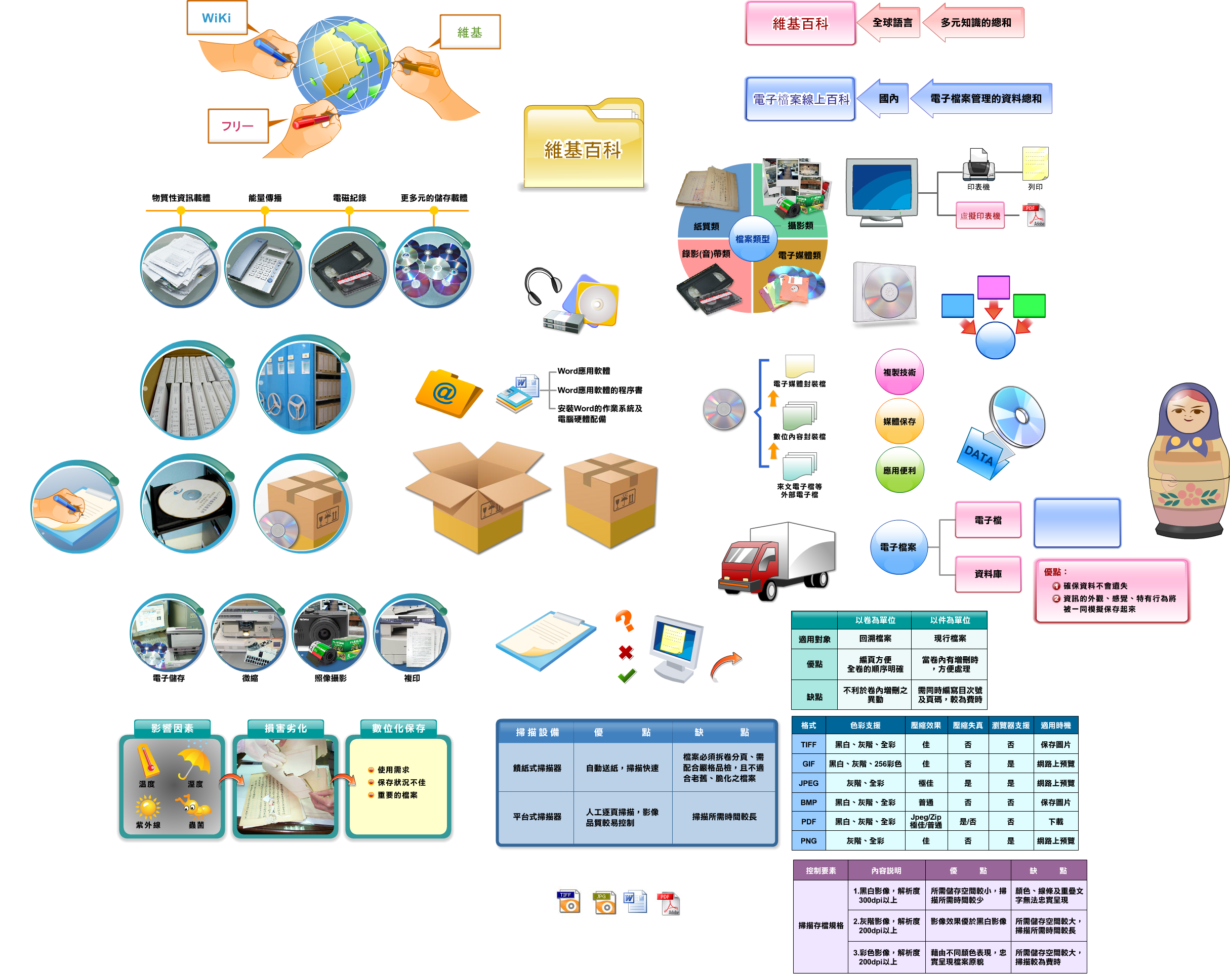
A hospital-wide computerized antimicrobial approval system (HCAAS) in CGMH (>3,500 beds) set up to guide antibiotic use since late 2004.
Notes:
This system was implemented on one of the branches first, then implemented on others after the system looks stable.

Slide 14
Antimicrobials under stewardship
  General hospitalized patient
    The 2nd and 3rd line antimicrobials
  Intensive care units
    All intravenous antimicrobials
  One patient who received 3 and more intravenous antimicrobials
Notes:
We set up some criteria to manage the use the antimicrobials:
Under these situations, antimicrobials will need approve by the ID doctors:
General hospitalized patient
The 2nd and 3rd line antimicrobials
Intensive care units
All intravenous antimicrobials
One patients who received 3 and more intravenous antimicrobials
The list included drug classes of 3rd-generation and 4th-generation cephalosporins, aminoglycosides (amikacin), carbapenems, oxacephems, monobactams, extended-spectrum penicillins, fluoroquinolones, glycopeptides, oxazolidinones and antifungal antimicrobials.

Slide 15
IT-Infrastructure implemented
HIS (Hospital Informatics System):
electronic chart record system
LIS (Laboratory Informatics System): Microbiology, hematology, biochemistry, all other lab data
PACS:
an integrated image system for X-ray, CT, MRI, and others
Notes:
The infrastructure of the informatics technology in the approval system including:
HIS (Hospital Informatics System):
electronic chart record system
LIS (Laboratory Informatics System): Microbiology, hematology, biochemistry, all other lab data
PACS:
an integrated image system for X-ray, CT, MRI, and others

Slide 16
Front-end approach
Computerized Antimicrobial Approval System
2010 March
Prescriber
ID Physician
Pharmacist
Microbiologist
Prescribing restricted antimicrobial through CPOE system
Provide necessary clinical data by the prescriber
Generate request message to ID physician through hospital Informatics system
Modify the regimens by the prescribers
Disapprove
Online review in 48 hours
Approve
Dispensing
Positive blood culture results with sensitivity results
2010 March
Submit a consultation sheet
ID consultation
Positive sterile site culture results with sensitivity results
(CSF/DTS/PC)
Prescribe antimicrobials recommended by ID physician
Recommend appropriate antimicrobial regimens
2014 August
Notes:
This is the flow chart of our approval system.
The prescriber was required to provide necessary data to support why need to use antibiotics
All of the above information enters into HCAAS automatically and a reminding message would be sent to the ID physician through mobile phone if the prescription was not reviewed within 48 hours,
In this 48-hour buffer period, the antimicrobial prescribed was dispensed by the unit-dose delivery (UDD) system automatically to the ward and administered to the patient.
Should a decision of disapproval be made, the antimicrobial would be discontinued by the UDD system in pharmacy after 48 hours, and the prescriber would be notified immediately to modify the regimens.
6.In 2010, we added a new function in this system, the information of the patient with Positive blood culture results will re-enter the system once again, ID doctors need to review the antibiotic therapy once again.

Slide 17
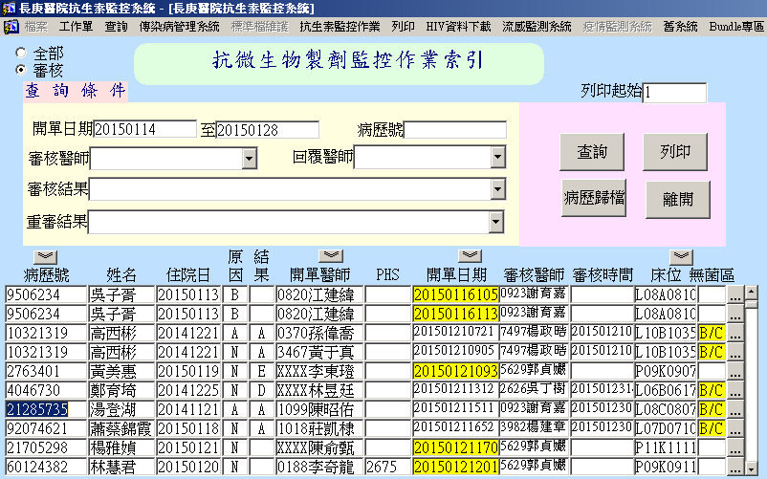
Online Review Interface
ID physician
Patient with (+) blood culture result
Individual Patient information
Notes:
This is the front page of the approval system
This is the name of the ID doctor
Here is individual patient information and Patient with (+) blood culture result will be listed on the top with yellow color

Slide 18
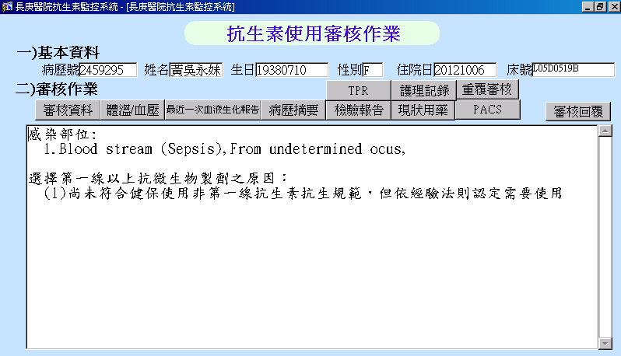
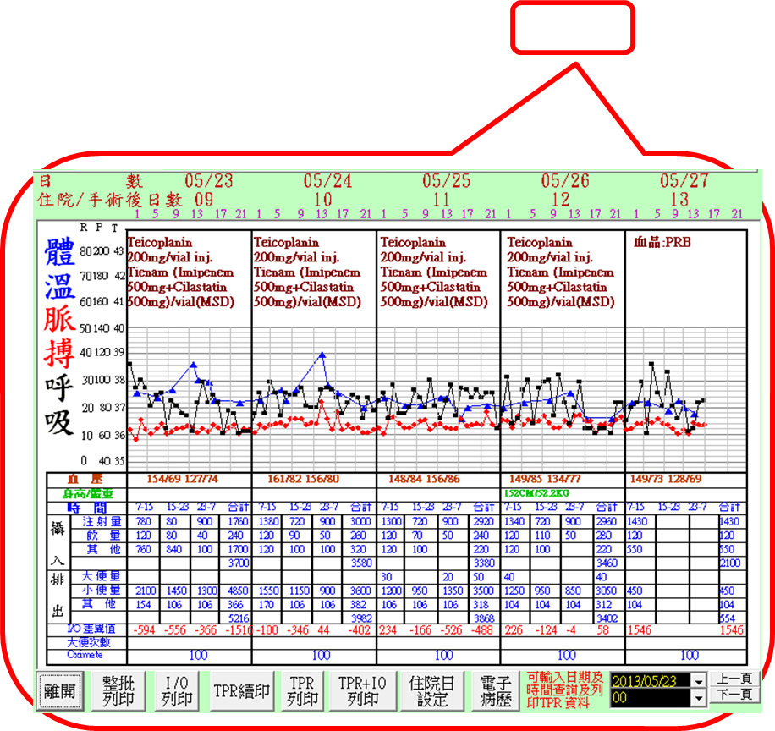
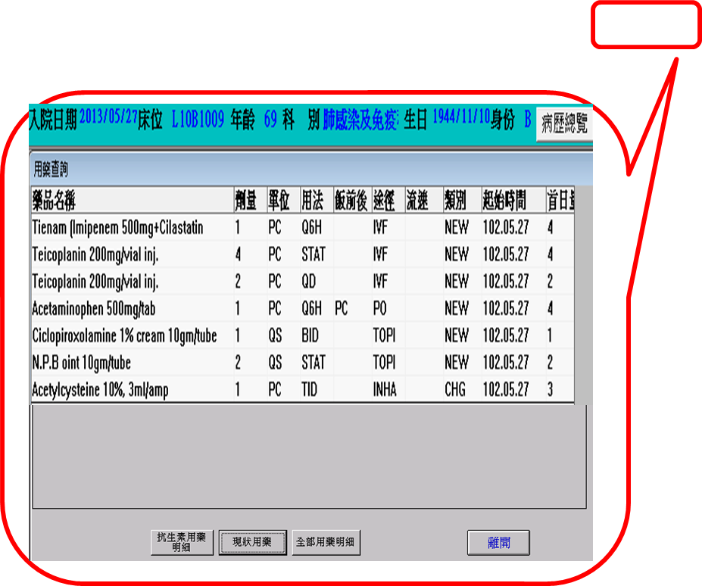
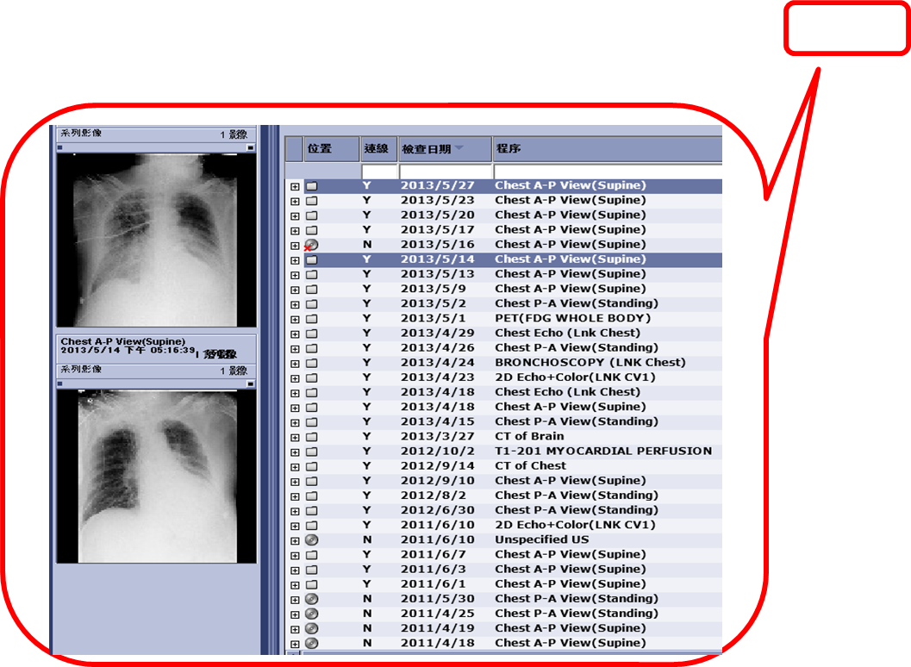

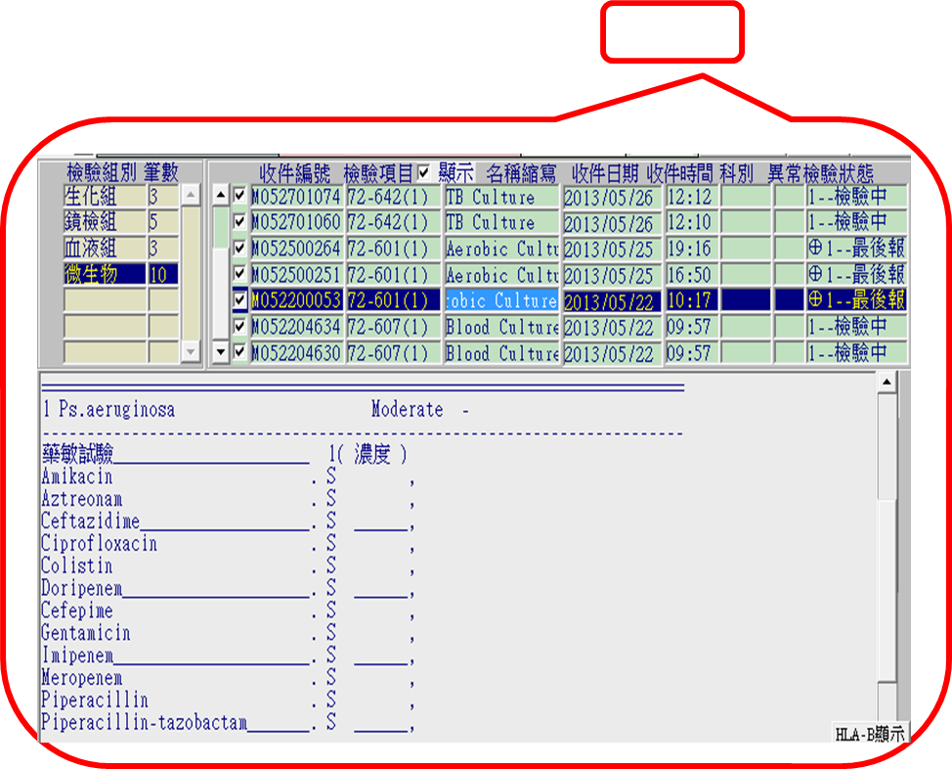
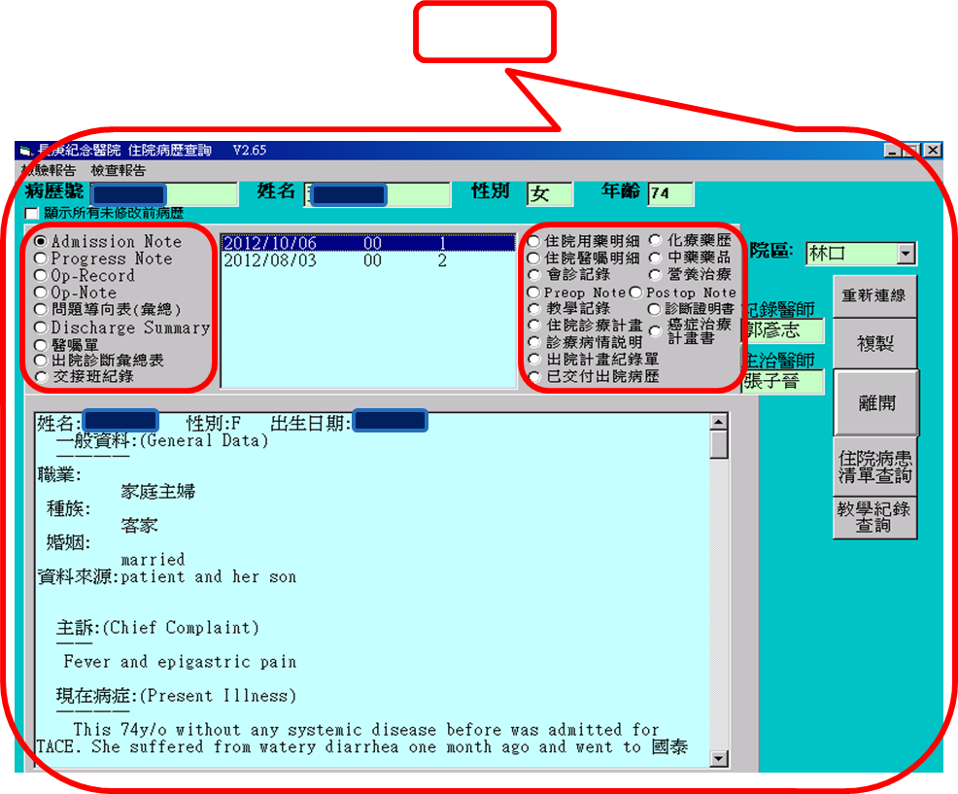
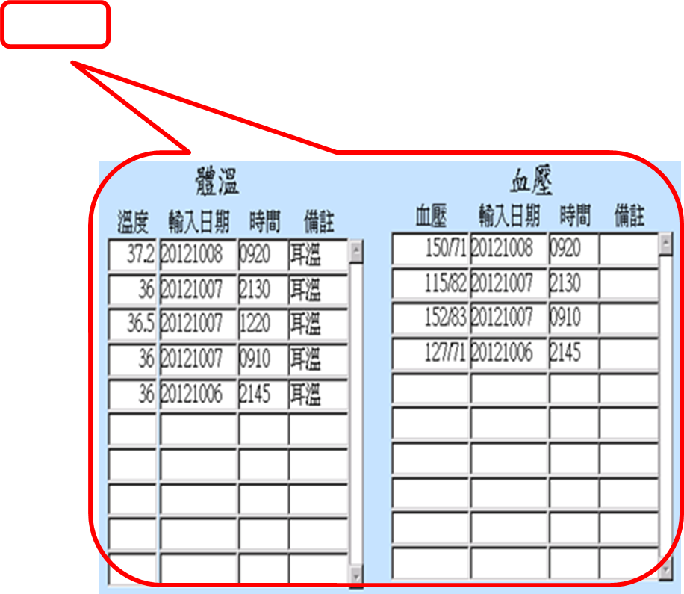
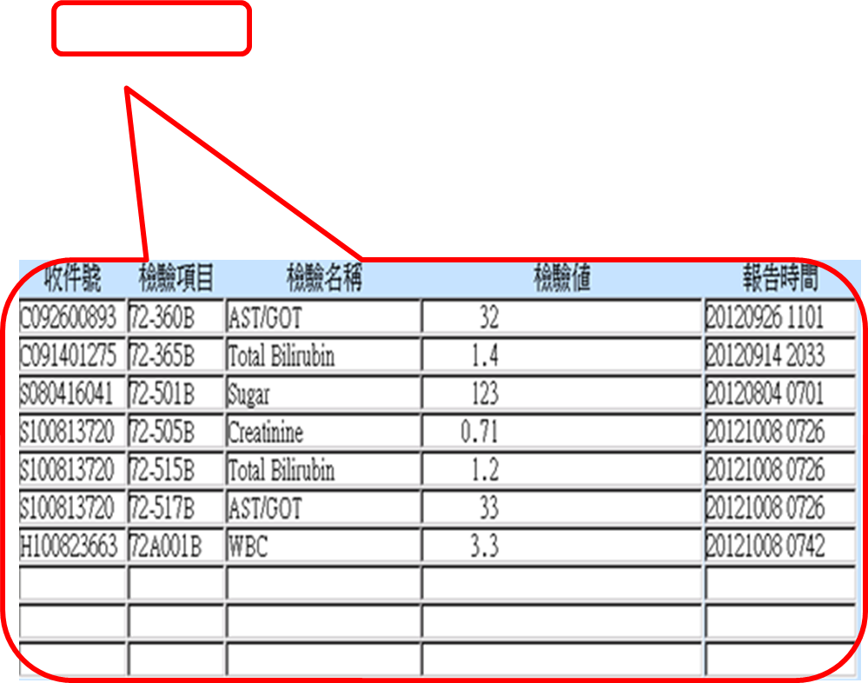
Integrated Health Information System
Infection Source
Rationale on Antimicrobial agent selection
CT, PET, X-ray, Echo
Chart Overview
Microbiologic and Susceptibility Results
Current Medications
TPR, BP, I/O
Temperature
Blood Pressure
Biochemistry Lab Data
Notes:
This is the description of the prescriber.
When ID doctor making the approval, he/she needs clinical data to support him/her to make a optimal decision, so we linked all electronic chart of the pateint in the approval system, like:

Slide 19
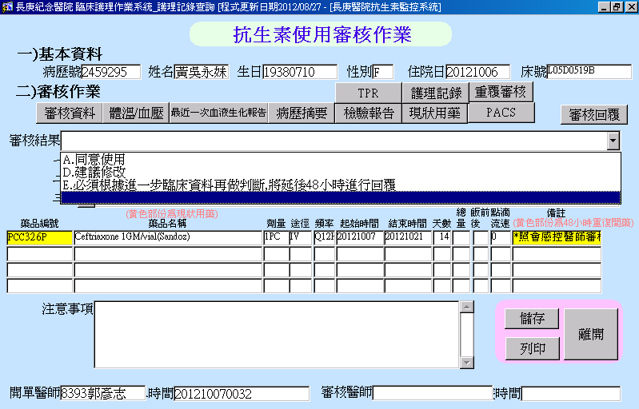
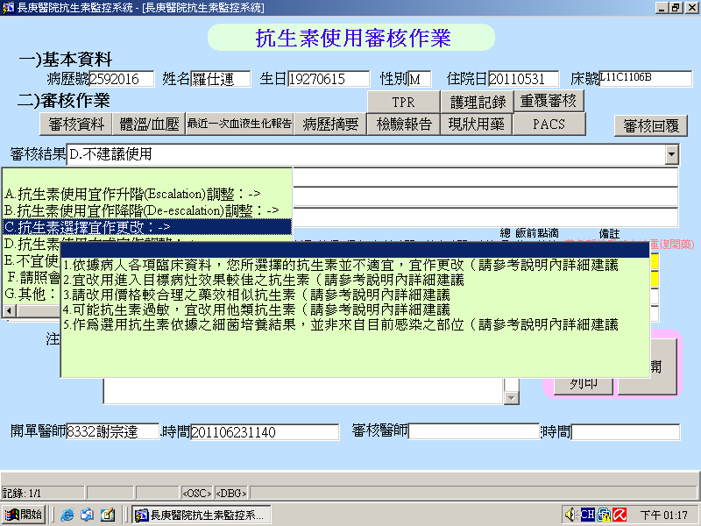
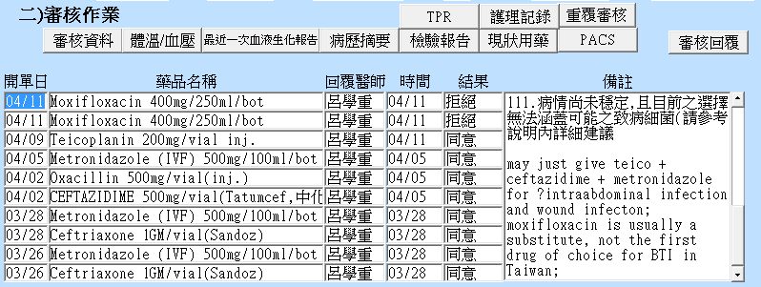
Bidirectional Communication Platform
Review Results
Disapproval Reason
Recommend Regimen, Treatment Duration
Notes:
This is the approval page of one patient
If the ID physician make a disapproval, he/she need to state the reason why disagree with this therapy and can write down the opinion or suggestion in the box
Then the physician will receive a text message to know the antibiotic is disapprove by the ID physician
They can check the reason and opinion in system to make some adjustment of the therapy

Slide 20
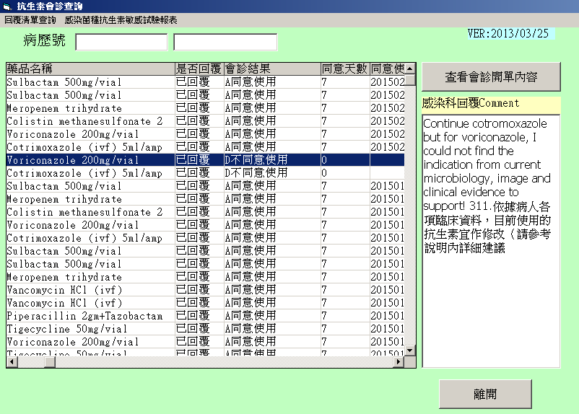
Front-end approach
ID consult and feedback record link to the pharmacy system
Electronic chart front page in CGMH
Notes:
All the ID consultation contents and feedback record will link to the pharmacy system
So that the pharmacists can review the record when verifying the prescription

Slide 21

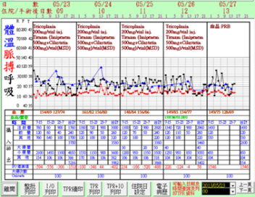
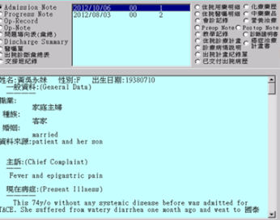
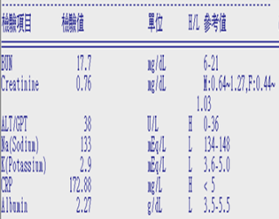
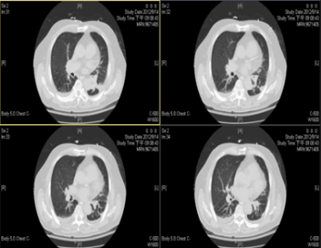
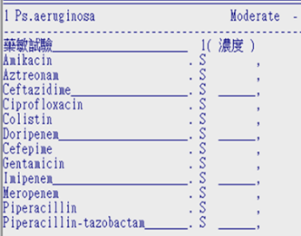
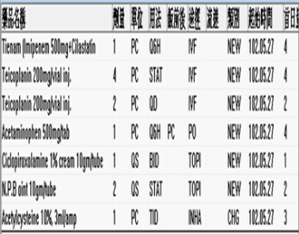
Patient-centered Care
Medical Chart
TPR, BP, I/O
Lab Data
PAC
Microbiology
Medication
Notes:
We believe the core concept of the ABS program is patient-center, and integration of the different information resources .

Slide 22
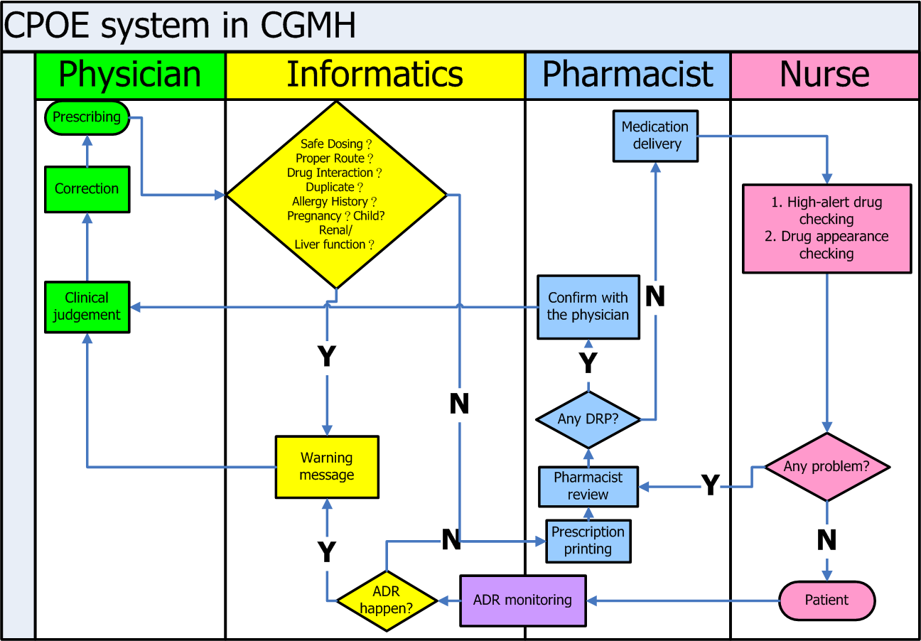
CPOE and medication delivery system in CGMH
CPOE and medication delivery system in CGMH
Notes:
In addition to the antibiotic approval system, every prescription will be verified pharmacists also.
I would like to share the experience of our computerized order entry system
This is the overview picture of our prescribing system
When the doctor prescribes a prescription, the computer will verify the contents automatically, like dose checking, administration route, drug duplication, even special population contraindication , such as pregnancy woman, children, or patient with allergy history, renal or liver dysfunction.
The computer will generate a warning dialogue while the above situation appears.
If the doctor ignore the warning, the prescription will be verified by the pharmacists once again.
The pharmacist will discuss with the doctor if any potential drug-related problem exists.
The doctor may correct the prescription if any suggestion is accepted.
On the other hand, we provide sufficient information to the nurse or patient for the purpose of safety issue.

Slide 23
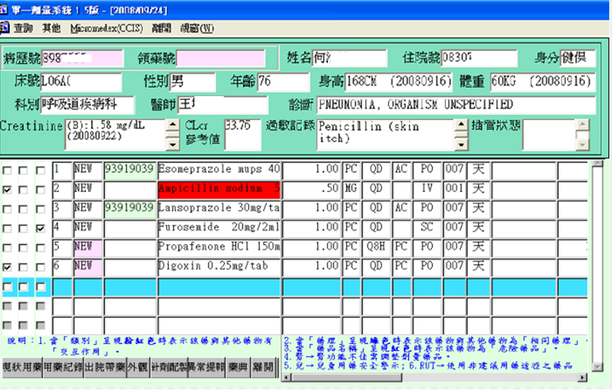
Front-end approach
Medication profile reviewing system in Pharmacy
High-alert medication warning
Diagnosis
Allergy history
Renal function
Pharmacist review system in CGMH
Notes:
This is the display of the medication profile reviewing system of Hospitalized patients.
It provides comprehensive information of the patient, like allergy history, diagnosis, renal function, chart review, drug appearance, Drug Reconstitution Method and online formulary .

Slide 24
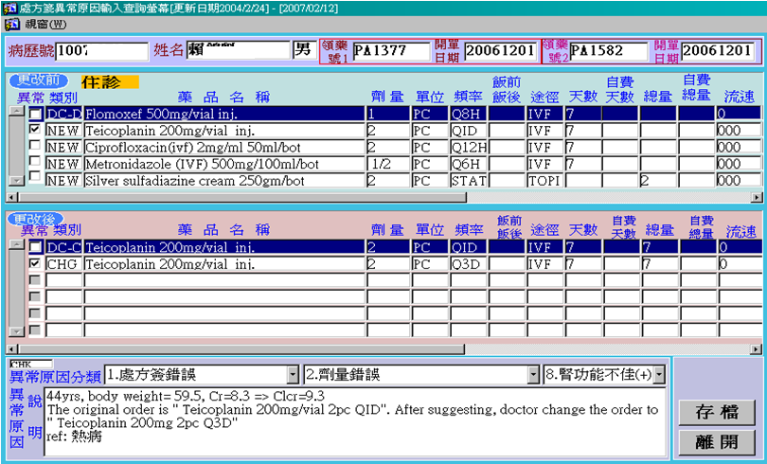
Front-end approach
Prescribing error reporting system
Medication error reporting system in CGMH
Notes:
If any prescribing error is identified by the pharmacist, it will be reported on the computerized reporting system.
This is the original prescription before correction
This is the correct prescription after doctor accepting the suggestion from the pharmacist
The types of the error, an the reference of evidence should be given by the reporter.

Slide 25
Evaluation of prescribing error in antibiotics
Notes:
From example
I would like to show you the information in last year.
In our hospital, there were more that 6 thousands prescribing error hold up by the pharmacist.
Among this error up to 27% are antibiotics.
Most of the error is dosage problem, like renal dysfunction patient need dosage adjustment

Slide 26
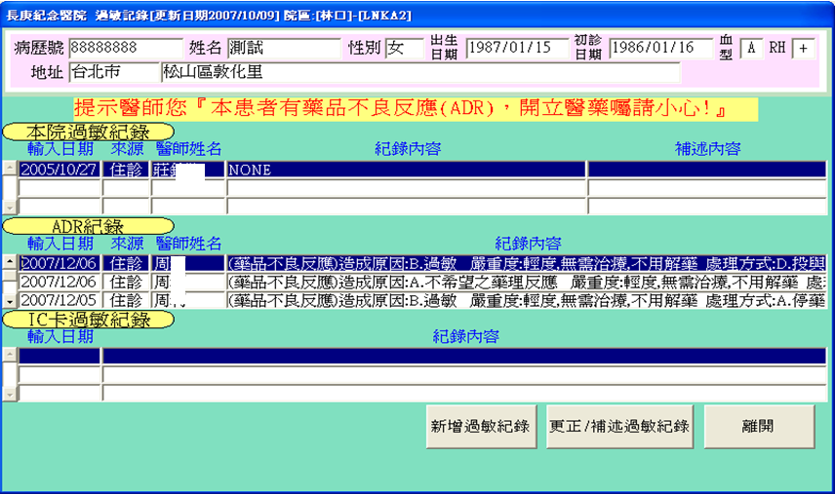
Front-end approach
Allergy history and adverse drug reaction chart warning system
Electronic chart front page in CGMH
Notes:
If there is allergy or ADR happened before,
These will be linked to the electronic chart to give warning dialogue

Slide 27
Interventions in ABS
Front-end approach
ID approval for restricted antibiotics
CPOE warning system
Back-end approach
ADR report
Re-evaluation after positive culture
PD/PK consideration
Monitoring and feedback
Medication profile and prescription review mechanism
Notes:
The other kind of approach is back end approach, like ……………

Slide 28
Promote antibiotic best practices – a first step in antibiotic stewardship:
1. Ensure all orders have dose, duration, and indications
2. Get cultures before starting antibiotics
3. Take an “antibiotic timeout,” reassessing antibiotics after 48-72 hours; not “reflex” style for prescription

Slide 29
Back-end approach
Re-evaluation after positive blood and sterile site culture
Computerized Antimicrobial Approval System in CGMH
Notes:
Re-evaluation of positive culture is a kind of back-end approach

Slide 30
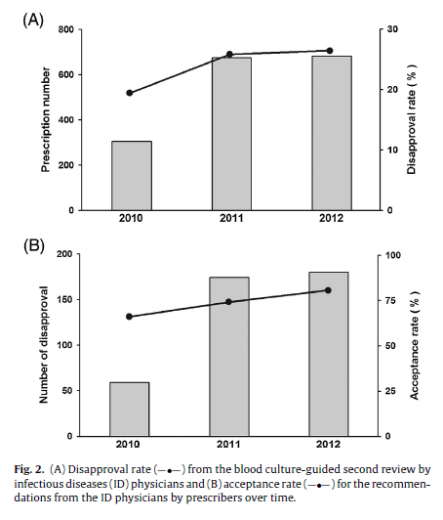
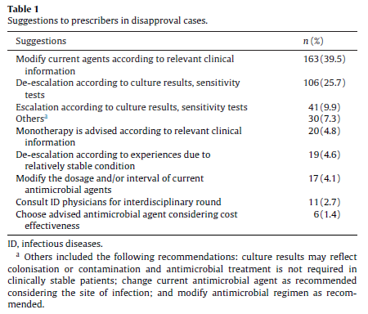
Wang SY, et al. Int J Antimicrob Agents 2014

Slide 31
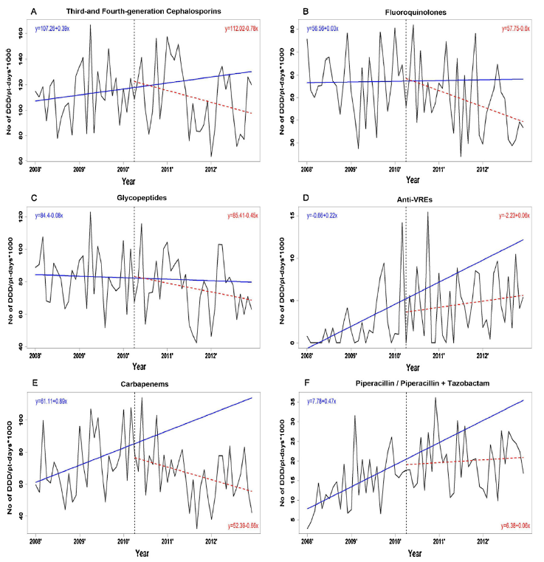
Wang SY, et al. IJAA 2014

Slide 32
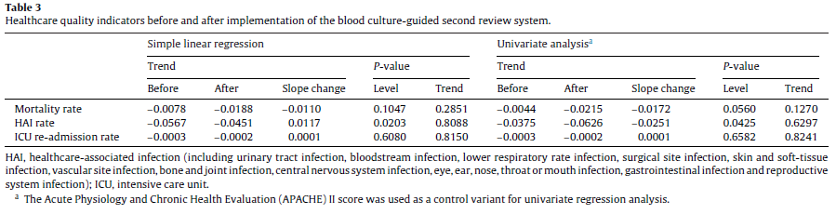
Wang SY, et al. IJAA 2014

Slide 33
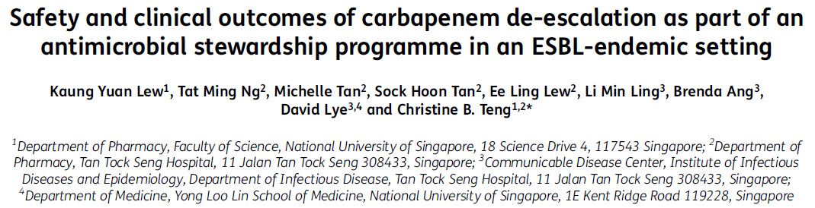
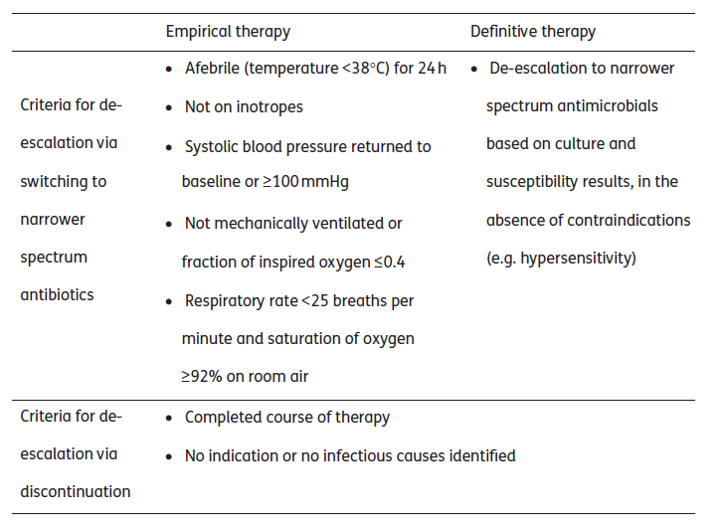
JAC 2014

Slide 34
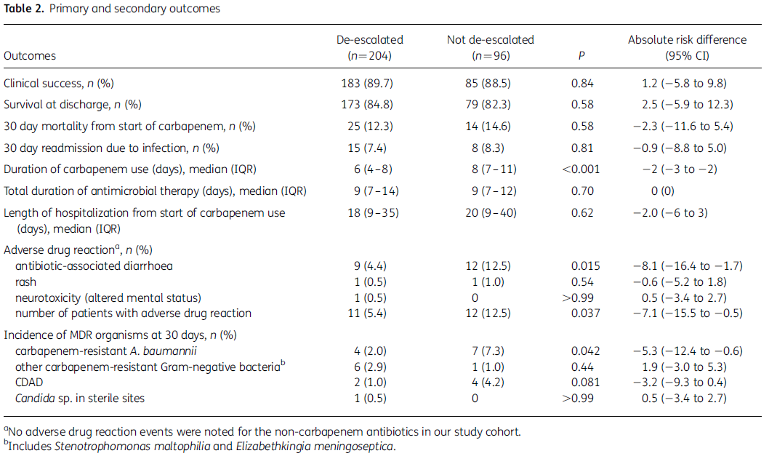
JAC 2014

Slide 35
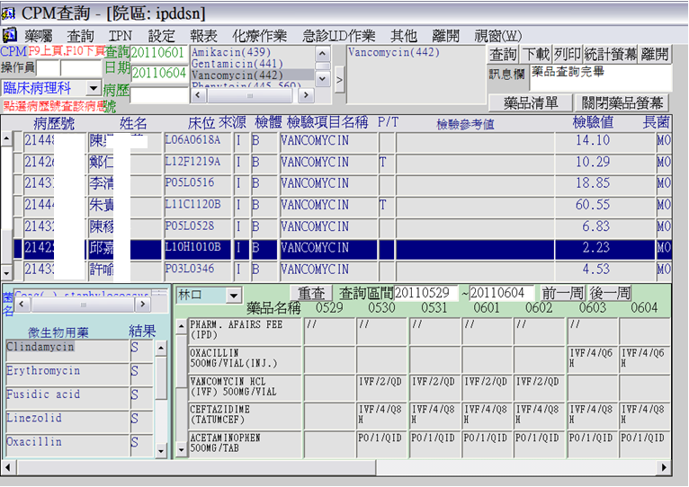
Back-end approach
Clinical Pharmacokinetics Monitoring (CPM) System
Monitor items
Lab data
Medication profile
susceptibility
CPM System in CGMH
Notes:
This slide shows the display of the pharmacokinetics monitoring system.
Hers is the drug item which need to be monitored and results of the drug concentration in blood.
The bottom tables provide the medication history and the susceptibility results.

Slide 36
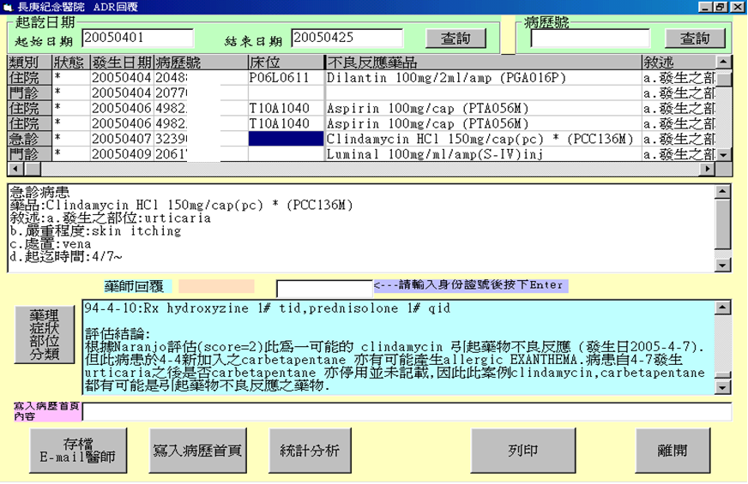
Back-end approach—
ADR reporting system
ADR reporting System in CGMH
Notes:
This is the screen of the ADR reporting system,
Here is the evaluation and reply by the pharmacist.

Slide 37
The most ADR-inducing antibiotics
Notes:
We have more that 1000 cases of ADR last year in our hospital, 25% of them are induced by antibiotics.
Vancomycin, Cephalosporins, quinolones were more likely to induced ADR.
Most of the problem is skin allergy.

Slide 38
“Low-Hanging Fruits” Antimicrobial Stewardship Initiatives
ASP Activity | Reference | Setting | Description of ASP Intervention | Cost Savings/Avoidance
Intravenous-to-oral conversion | Davis et al 2005 [10] | Detroit Receiving Hospital and University Health Center | Prospective pharmacy intervention involving sequential intravenous/oral therapy for patients with pneumonia | Drug acquisition cost savings of $110/patient
 | Lau et al 2011 [18] | Johns Hopkins Hospital | Evaluated budget impact of voriconazole, pantoprazole, chorothiazide, levetiracetam in patients eligible for oral medication | Potential annual cost reduction of $1 166 759.70
Therapeutic substitution | 2010 | The Ohio State University Wexner Medical Center | Substituted brand-name vancomycin capsules for flavored vancomycin solution compounded by pharmacy | Annual cost savings of $218 877
Batching IV antimicrobials | 2010 | The Ohio State University Wexner Medical Center | Maintenance doses of daptomycin were made from single-use 500-mg vials by batching orders at standardized times | 370 vials saved over 4 months ($83 991)
 |  |  |  | Annual cost savings of $250 000
Formulary restriction | White et al 1997 [22] | Ben Taub General Hospital Houston | Prior ID authorization required for restricted antimicrobials | Total intravenous antimicrobial expenditures decreased by 32% ($863 100)
 |  |  |  | Antibiotic cost per patient-day decreased from $18.00 to $12.90
 | Po et al 2012 [3] | Banner Estrella Medical Center | Implemented computer physician order entry ASP restrictive template for linezolid | Linezolid use fell from 28 defined daily doses/1000 patient-days to 7 defined daily doses/1000 patient-days over 25 months; cost data not reported
Abbreviations: ASP, antimicrobial stewardship program; ID, infectious diseases; VA, Veterans Affairs.
CID 2012

Slide 39
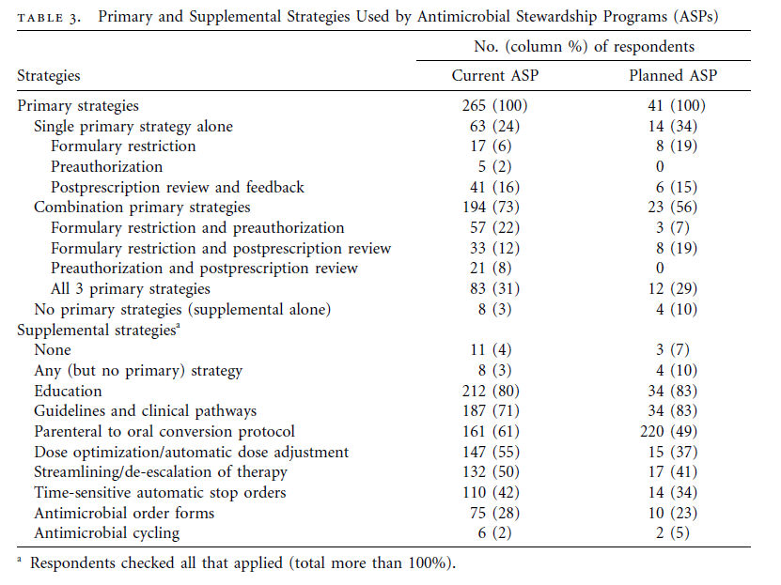
Low hanging fruits
ICHE 2011; 32 (4): 367

Slide 40

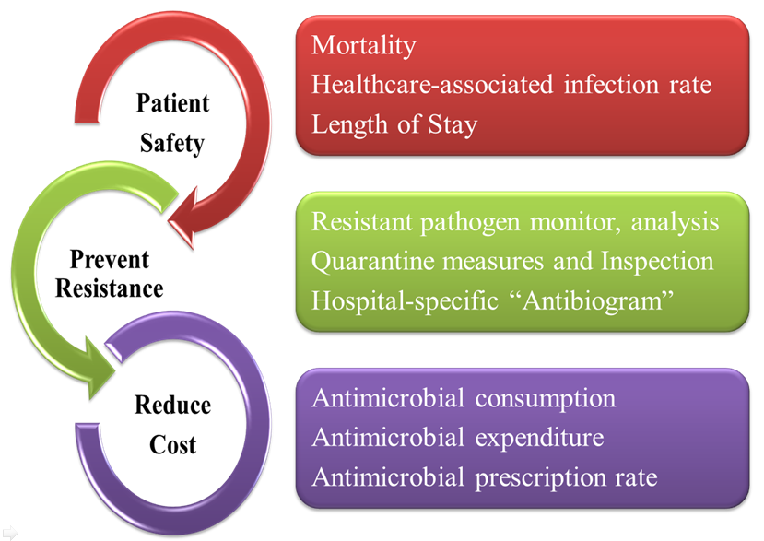
Back-end approach
Monitoring and feedback
Notes:
The last back-end approach is Monitor the outcome of the stewardship and feedback
The quality indicator use to monitor antimicrobial stewardship including …………..

Slide 41
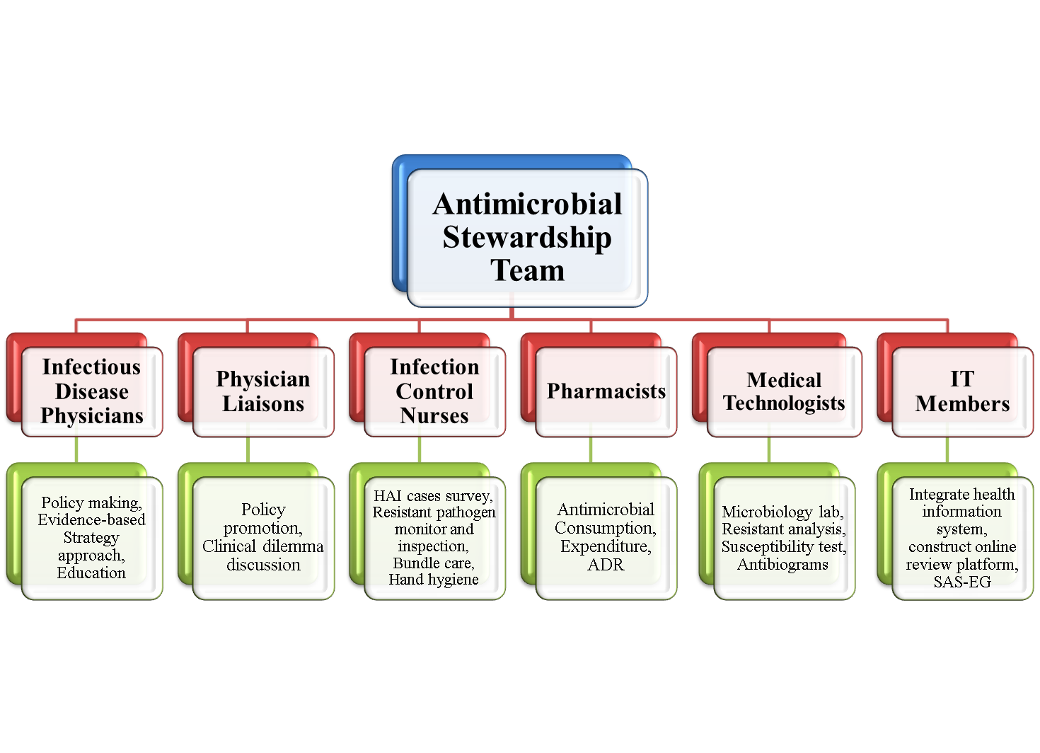
CGMH ASP Team and Responsibility
Notes:
We need a team to monitor all these indicators and need to do some improvements when any problem exists.
This is the framework of our ASP team and the responsibilities of each professionals.

Slide 42
Outcome Measurements
Process measurements
- Consumption of a specific antimicrobial or class of antimicrobials
- Cost change
Outcome measurements
- Clostridium difficile infection
- Reduce or prevent resistance or other
unintended consequences of antimicrobial use
IDSA Guidelines 2007

Slide 43
結論
理念的澄清
資源的分配要在重點上
勿焦點模糊
目標不可偏差
實務面的障礙：
- 人力與人才
- 缺乏Computer-assisted system
- 缺乏大規模與第一線開方醫師全面互動的實戰經驗

Slide 44
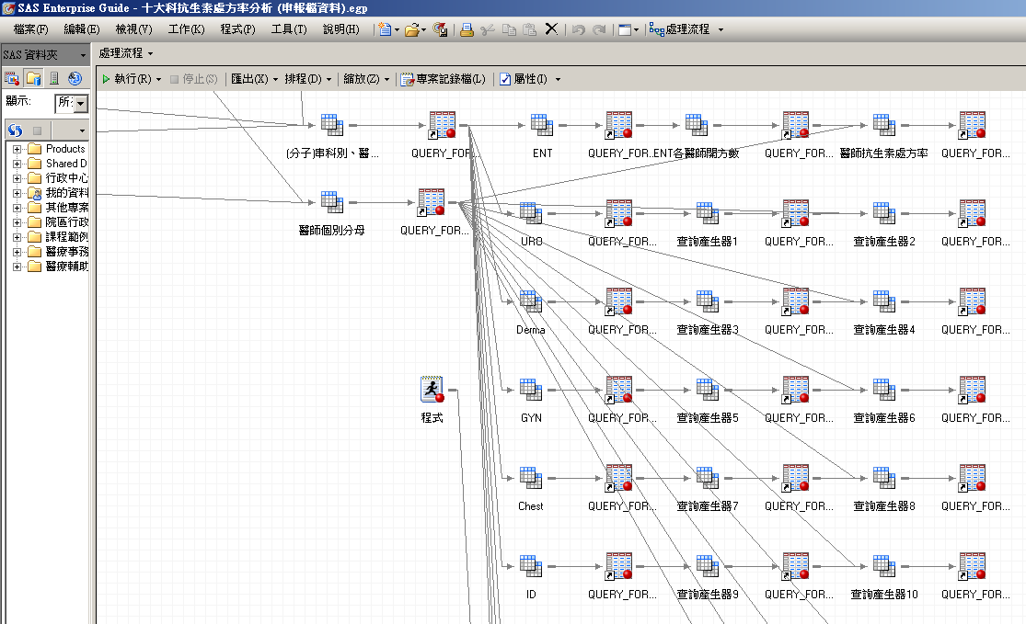
行政與管理的支持
SAS EG system
人才 人力
系統
  建立流程
  投入必需之軟硬體
3. 經費
4. 高階主管全力支持

Slide 45
Antibiotic stewardship in your facility will:
Decrease antibiotic
resistance
Decrease C. difficile
infections
Decrease costs
Increase good patient
outcomes

Slide 46
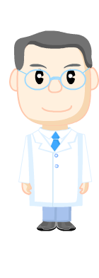
Thank you
Notes:
Thank you very much for your attention.

Slide 47
抗生素管理：
長庚經驗分享
黃景泰 醫師
林口長庚紀念醫院 內科部感染醫學科主任
廈門長庚紀念醫院 內科部感染醫學科召集人

Slide 48
大綱
1. 抗生素發展的現況
8. 特定診斷之抗生素使用
2. 抗生素管理計劃
9. 微生物學檢查
3. 目標導向的抗生素管理
10. 抗生素的副作用
4. 抗生素處方能見度
11. 期程管制
5. 抗生素處方基本管理
12. 長庚醫院的抗生素管理平台
6. 抗生素使用的升階與降階
13. 抗生素的使用文化
7. 抗生素的降階治療
14. 良好的抗生素管理

Slide 49
1. 抗生素發展的現況

Slide 50
抗生素發展的現況
1940 ~ 1962
  > 20 new classes of antibiotics marketed
1962~
  Only 2 new classes reached the market
Br J Pharmacol. 2011 May;163(1):184-94

Slide 51
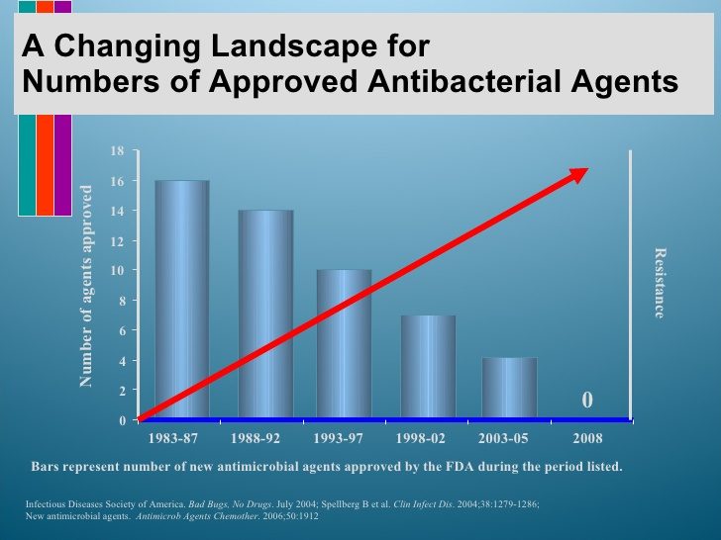
抗生素發展的現況
Clin Infect Dis. 2004 May 1;38(9):1279-86

Slide 52
2. 抗生素管理計劃

Slide 53
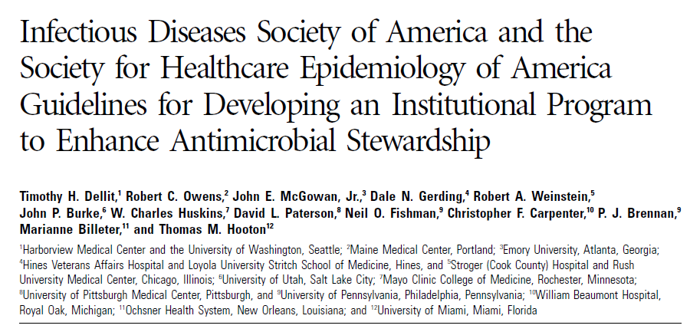
機構之抗生素管理計劃
INSTITUTIONAL ABS PROGRAM
Clin Infect Dis 2007; 44: 159-77
Notes:
Evidence
Formulary restriction, education….
Comprehensive stewardship program

Slide 54
抗生素管理計劃的組成
Crit Care Med 2010; 38(Suppl.):S315-S323
Notes:
Evidence
Formulary restriction, education….
Comprehensive stewardship program

Slide 55
抗生素管理
(ASP, Antimicrobial Stewardship Program)
Optimize Patient Safety
Decrease or Control Costs
Reduce Resistance
Notes:
Evidence
Formulary restriction, education….
Comprehensive stewardship program

Slide 56

抗生素管理醫師與抗生素處方醫師

Slide 57
抗生素管理醫師的角色
務必需要
  像空服員一樣
    和藹可親
  像管家一樣
    體貼入微
  像侍酒師一樣
    深得您心
萬萬不可
  警察抓小偷
  強力操控
  監視

Slide 58
3. 目標導向的抗生素管理
Goal-Oriented
Antibiotics Stewardship

Slide 59
抗生素管理的目標
處方能見度
處方基本管理
降階治療
特定診斷之抗生素使用
微生物學檢查
抗生素的副作用
期程管制

Slide 60
4. 抗生素處方能見度
Visibility

Slide 61
抗生素處方能見度
避免絕無必要之使用
  處方要有一定的能見度(Visibility)
    審查
      時機(Timing)
      穿透性(Penetrance)
    醫療記錄
      完整的感染相關記錄

Slide 62
成本
總成本
最佳者
檢驗成本
不良品耗費的成本
0
檢驗數

Slide 63
5. 抗生素處方基本管理

Slide 64
抗生素的處方管理
劑量
給藥間隔
個別病患特殊考量
  體重
  腎臟功能
  肝臟功能

Slide 65
6. 抗生素使用的升階與降階
Escalation & De-escalation

Slide 66
抗生素的升階與降階
細菌
Host
細菌
Host
Escalation
De-escalation

Slide 67
抗生素的升階與降階
細菌
Host
細菌
Host
Escalation
De-escalation

Slide 68
抗生素的升階與降階
細菌
Host
細菌
Host
Escalation
De-escalation

Slide 69
7. 抗生素的降階治療
De-escalation

Slide 70
抗生素的降階治療
先決條件
  （1）病情已趨於穩定
  （2）明確的微生物學證據
    證實為敏感性細菌
      血液培養
      其他無菌部位培養
    無法證實有抗藥性細菌
      MRSA

Slide 71
8. 特定診斷之抗生素使用

Slide 72
無症狀膿尿菌尿
同時滿足
  （1）沒有尿路症狀
  （2）沒有全身症狀

Slide 73
Prevalence
Clin Infect Dis. 2005:40 (1 March) • 643

Slide 74
無症狀膿尿菌尿
不需要使用抗生素治療
  例外
    （1）孕婦
    （2）泌尿道手術
Clinical Infectious Diseases 2005; 40:643–54

Slide 75
上/下呼吸道感染
呼吸道感染
  上呼吸道感染(URI)
    不需要使用抗生素
  不能排除下呼吸道感染
    (R/O Pneumonia)
  下呼吸道感染(Pneumonia)

Slide 76
CPIS
Body Temperature
  36.5°C≤BT≤38.4°C = 0 point
  38.5°C≤BT≤38.9°C = 1 point
  38.9°C≤BT or BT≤36.0°C = 2 points
WBC
  11,000≥ WBC ≥ 4,000 = 0 point
  >11,000 or <4,000 = 1 point
  Band ≥ 50% + 1 point
Tracheal secretions
  ( - ) = 0 point
  Non-purulent = 1 point
  Purulent = 2 points
Oxygenation: PaO₂/FIO₂(mm Hg)
  > 240 or ARDS = 0 point
  ≤ 240 and no ARDS = 2 points
Pulmonary Radiography
  No infiltrate = 0 point
  Diffuse/Patchy = 1 point
  Localized = 2 points
Progression of Pulmonary Infiltrate
  No = 0 point
  Yes = 2 points
  (after CHF and ARDS excluded)
Culture of Tracheal Aspirate
  ( - ) or rare or light = 0 point
  Moderate or heavy = 1 point
  Gram stain (+) +1 point
*ARDS defined as：
PaO2/FIO2≤200
PAWP ≤18 mm Hg
Acute bilateral infiltrates
Am Rev Respir Dis 1991;143:1121-1129

Slide 77
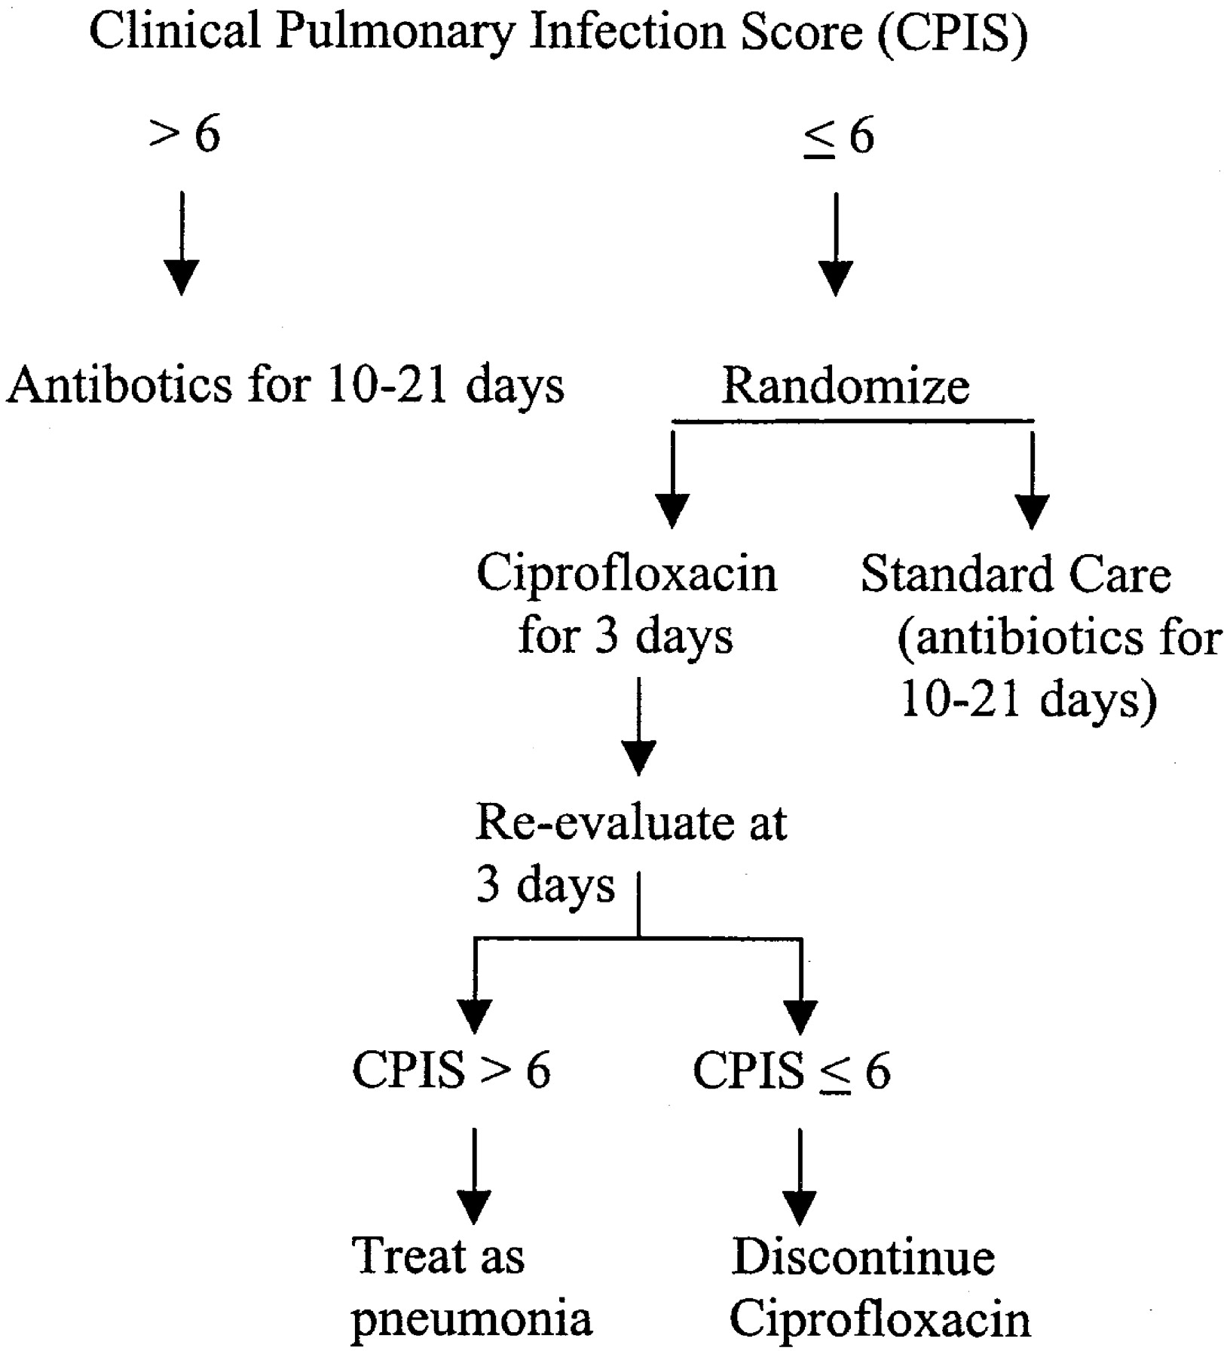
Am J Respir Crit Care Med 2000;162:505-511

Slide 78
9. 微生物學檢查

Slide 79
微生物學檢查
使用抗生素前必須進行
  配合病情變化做為抗生素調整之基礎
      血液培養
      相關部位檢體培養

Slide 80
微生物學檢查
  相關部位檢體培養
    沒有懷疑肺炎不得做痰液培養
    沒有泌尿道症狀的小便培養
      無症狀膿尿菌尿
  留意避免追打不必要消滅之細菌
Am J Respir Crit Care Med 2005;171:388-416

Slide 81
微生物學檢查
檢查結果需要正確判讀
  無菌位置(Sterile Site)檢體
    血液
    其他無菌位置
      CSF、DTS、SY
  非無菌位置(Non-sterile Site)檢體
    Urine
    Sputum
    Skin

Slide 82
微生物學檢查
檢查結果需要正確判讀
  無菌位置(Sterile Site)檢體
    感染 vs 污染(contamination)
  非無菌位置(Non-sterile Site)檢體
    感染 vs 移生(colonization)

Slide 83
微生物學檢查
血液培養的正確判讀
  生長時間
    快 vs 慢
  陽性套數
    一套 vs 多套
  菌種
    通常為污染
      Coagulase(-) staphylococcus（Non-aureus）
      Bacillus, Diphtheroid, or other GPB
      Micrococcus

Slide 84
10. 抗生素的副作用

Slide 85

抗生素的副作用
過敏
  藥物疹(Drug rash)
  嗜伊紅性白血球增加(Eosinophilia)
  藥物熱(Drug fever)
    Spiral escalation

Slide 86
抗生素的副作用
抗生素相關腹瀉Antibiotics associated diarrhea
  艱難梭孢桿菌感染 C. difficile infection
    偽膜性大腸炎Pseudomembranous colitis

Slide 87
抗生素的副作用
抗藥性細菌的出現
  MDRAB
  Candida and other yeasts
  Enterococcus/VRE
  Stenotrophomonas
  KPC

Slide 88
11. 期程管制

Slide 89
抗生素使用之期程管制
使用期程鮮少需要超過7-14天
  特別感染
    骨骼
    心臟血管
    內臟膿瘍
  特殊考量
    宿主免疫功能
    異物植入

Slide 90
12. 長庚醫院的抗生素管理平台

Slide 91
長庚醫院的抗生素管理平台
建構在醫療照顧資訊系統之上
  全面而完整的病人資料

Slide 92
長庚醫院的抗生素管理平台
線上抗生素管理
  效率
    即時
    新事證出現可再重新評估
      臨床狀況的變化
      檢驗檢查結果
        培養結果、特別是血液培養結果
  互動性與教育性

Slide 93
長庚醫院的抗生素管理平台
處方醫師
管理醫師
管理
Prescription of Sanctioned Regimens
1. 2nd line or above
2. Combination of ≧ 3 antibiotics
Providing information on clinical assessment
Pharmacist Review
48 hr mercy period
Review List
Dispense
≦ 48 hr
*Text message
*Dispensing DC in 48 hrs
NOT
OK
Online
Stewardship
OK
Dispensing cont’d
Bedside evaluation indicated
Formal ID Consultation Request
ID Consult with Bedside Evaluation
New Prescription
Recommendation
Since 2004
Notes:
Evidence
Formulary restriction, education….
Comprehensive stewardship program

Slide 94
長庚醫院的抗生素管理平台
病人安全為最高考量
  處方權
    所有醫師有所有抗生素藥物的處方權
  抗生素管理的防呆機制
    48小時的免審空間
    允許重新開立不被同意之抗生素處方

Slide 95
13. 抗生素的使用文化

Slide 96
抗生素的使用文化
不是把病人身上的細菌殺乾淨
  不是有細菌就是有感染
  身上的細菌
    永遠殺不完！
    永遠殺不乾淨！

Slide 97
抗生素的使用文化
Colon： 10¹¹⁻¹²cfu/g
-Anaerobes 99.9%
-Aerobes
*E. coli & other enteric rods 10⁶⁻⁸cfu/g

Slide 98
抗生素的使用文化
不需要用、不要用
  要根據臨床判斷
    不是有細菌就是有感染
  不能根據細菌培養
    盲目的尿液培養
      無症狀菌尿
    盲目的痰液培養
      呼吸道內的移生菌(colonization)

Slide 99
抗生素的使用文化
能降階、趕快降階
  臨床狀況改善
  微生物證據支持
能停、趕快停
  7-14天的切實檢討

Slide 100
14. 良好的抗生素管理

Slide 101
良好的抗生素管理
共識至上
  處方醫師與抗生素管理醫師
    病人安全
    實證醫學

Slide 102
良好的抗生素管理
動態管理
  臨床病情演變
  細菌培養結果

Slide 103
良好的抗生素管理
要件
  便利完善的工具平台
  領導階層的全力支持
  實質的誘因

Slide 104
良好的抗生素管理
終極目標
  動態、及時升階或降階讓抗生素使用最優化
    最初的經驗性使用
      有需要的話“Hit right ! Hit hard!”
    抗生素管理醫師及時檢視並且追蹤抗生素使用的合理性
      降階 De-escalation
      升階 Escalation
    良好的互動循環以達成對抗生素使用的共識
      抗生素處方醫師
      抗生素管理醫師

Slide 105
良好的抗生素管理
更好的未來
  外部稽核
    抗生素管理計劃
  國際合作

Slide 106
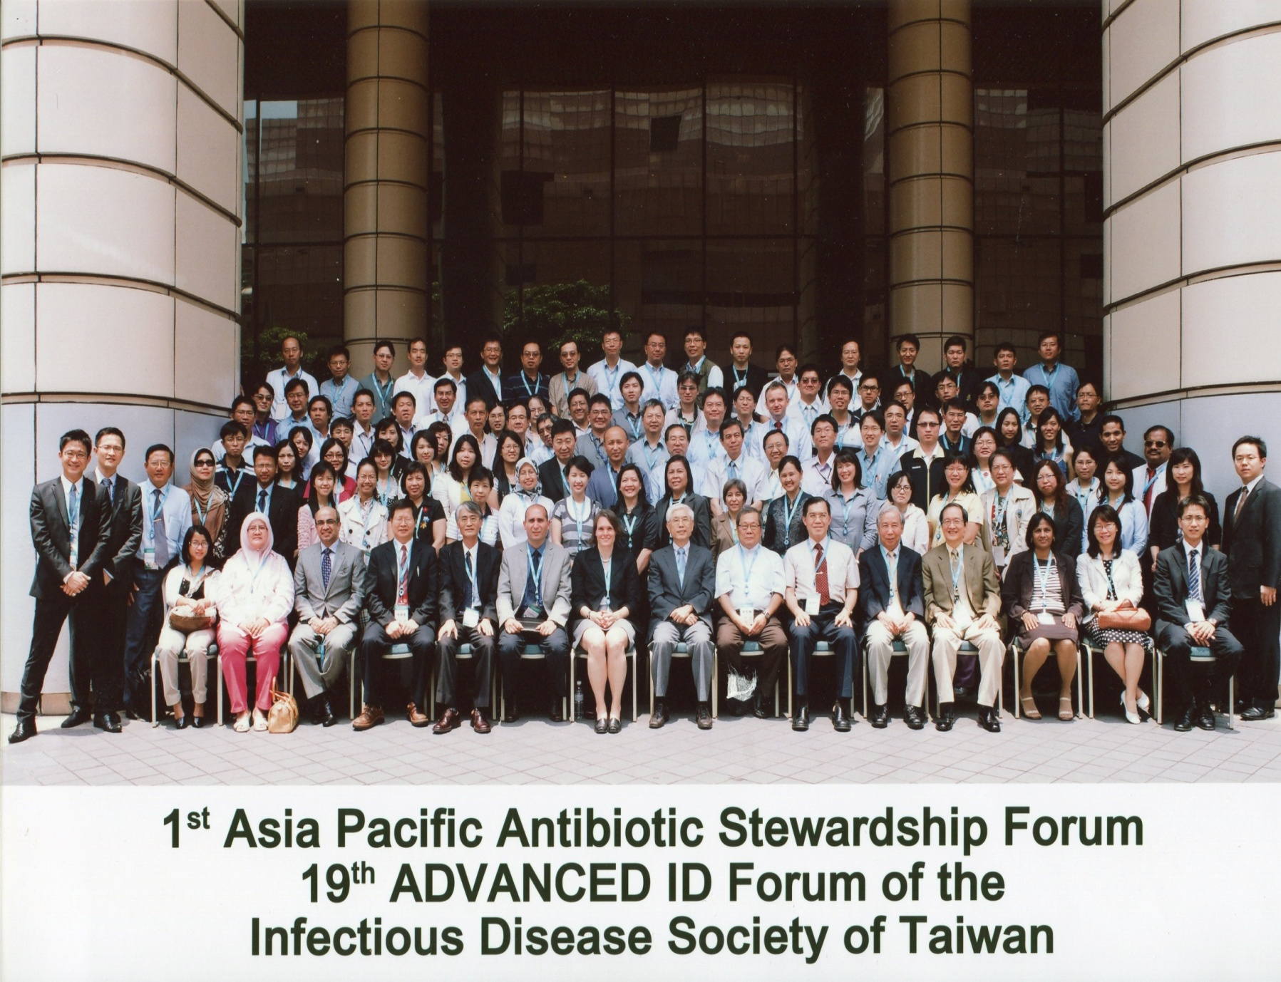
June 10, 2011
Notes:
Evidence
Formulary restriction, education….
Comprehensive stewardship program

Slide 107
敬請指教

