Slide 1
人類免疫缺乏病毒(Human Immunodeficiency Virus, HIV)鑑別診斷、治療與感染管制
林錫勳 醫師
義大醫院/義守大學

Slide 2
課程大綱
愛滋病的簡介
人類免疫缺乏病毒
(Human Immunodeficiency Virus, HIV)鑑別診斷
Acute HIV infection
Chronic HIV infection
AIDS
治療
感染管制

Slide 3
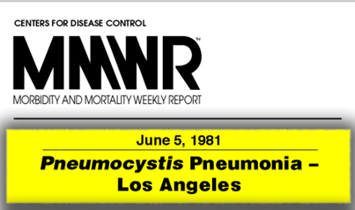

愛滋病的簡介
1981/6－MMWR：洛杉磯有5名男同志得到罕見的肺囊蟲肺炎(PCP) >> Gay-related immunodeficiency disease (GRID) >> AIDS
1983－HIV被證實為AIDS的致病原
1984/12－台灣發現第一例患者（美國入境的病患）
1985－發展出愛滋病毒的檢驗方法
1989－美國FDA通過第一項治療愛滋病藥物AZT
1996－Highly Active AntiRetroviral Therapy (HAART)，俗稱“雞尾酒療法”問巿
1997/4－台灣免費提供HAART
2008－諾貝爾生理醫學獎頒給人類免疫缺乏病毒發現者
Notes:
圖片來源

Slide 4
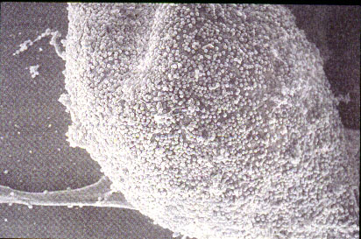
人類免疫缺乏病毒

Slide 5
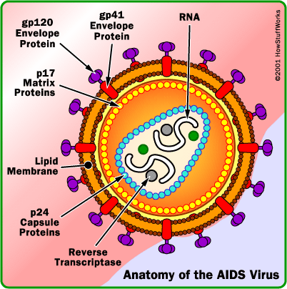
人類免疫缺乏病毒結構圖
WWW. Ourdunya. com

Slide 6
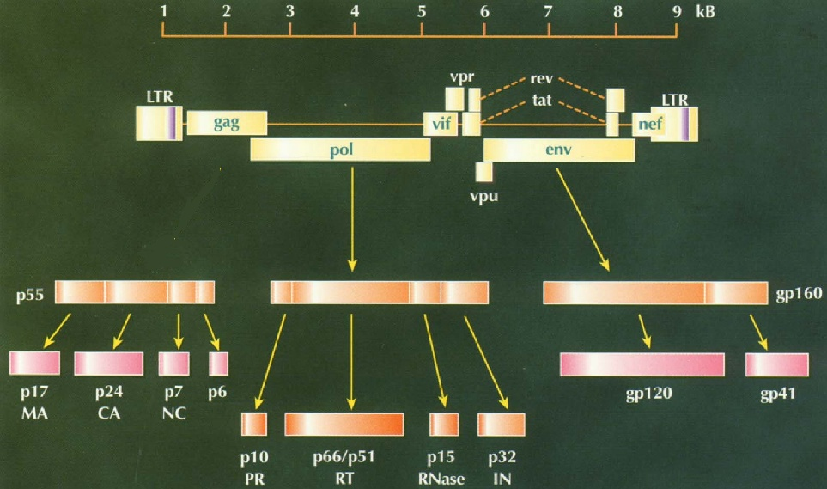
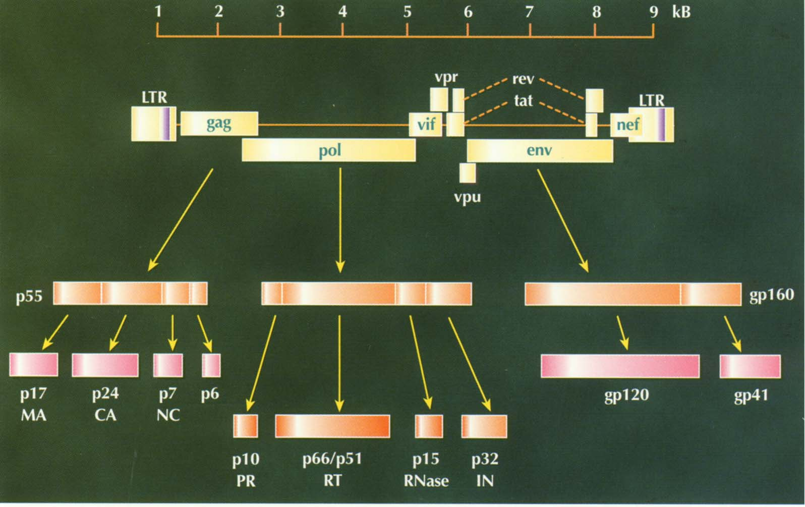
HIV-1之基因庫圖
核心抗原(gag)
酵素(pol)
外殼抗原(env)
Virology-online.com

Slide 7
簡介
人類免疫缺乏病毒
(Human Immunodeficiency Virus, HIV)鑑別診斷
Acute HIV infection
Chronic HIV infection
AIDS
治療
感染管制

Slide 8
Three stages of HIV infection
Acute HIV Infection
Chronic HIV Infection (asymptomatic HIV infection or clinical latency)
AIDS (acquired immunodeficiency syndrome)

Slide 9
Acute HIV Infection
Acute HIV infection is the earliest stage of HIV.
2 to 4 weeks after a person is infected with HIV.
Flu-like symptoms, such as fever, headache, and rash.
In this acute stage of infection, HIV multiplies rapidly and spreads throughout the body.
The virus attacks and destroys the infection-fighting CD4 cells of the immune system.
HIV can be transmitted during any stage of infection, but the risk is greatest during acute HIV infection.

Slide 10
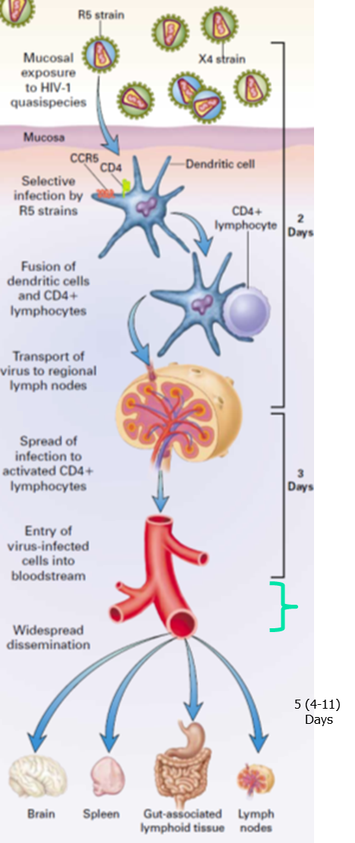
Early Events in
Transmucosal HIV-1 Infection
NEJM. 1998,339:33-9
Apple Daily. 2011 Aug 28

Slide 11
Acute Retroviral Syndrome S/S
急性反轉錄病毒感染症候群的臨床症狀
發燒 96%
淋巴結腫大病變 74%
咽頭炎 70%
皮疹 70%
肌肉或關節痛 54%
血小板低下 45%
白血球低下 38%
腹瀉 32%
頭痛 32%
噁心及嘔吐 27%
肝功能異常 21%
肝脾腫大 14%
體重下降 13%
口腔念珠菌病 12%
神經病變 12%

Slide 12
HIV的傳染途徑
性交：陰道性交、肛交、口交
血液：輸血、扎針、刺青、器官移植、精液捐贈
母子傳染：經胎盤、經產道、經授乳
任何體液均含愛滋病毒：但只有血液、精液、陰道分泌液可傳染
12

Slide 13
愛滋病毒感染的診斷
(符合以下任何一項即可診斷)
愛滋病毒抗體篩檢陽性（即兩次免疫酵素法陽性）且確認檢驗（如西方墨點法）陽性。
以下任何一項愛滋病毒檢驗陽性
愛滋病毒培養
愛滋病毒抗原p24
愛滋病毒反轉錄聚合酵素鏈鎖反應
(RT-PCR)偵測HIV-1抗原

Slide 14
愛滋病毒的檢驗
篩檢
  酵素免疫法 (ELISA)、顆粒凝集法 (PA)
確認
  西方墨點法 (Western blot)
  病毒量 (Viral load)
Pol
Env
Gag
160
120
68
55
52
41
40
34
25
18
病患
160
120
68
55
52
41
34
25
18
WHO criteria: 2 Env ± Gag ± Pol
14
Notes:
Reactive (S/CO=12.23)
Env: 120, 160
Gag: 18, 25, 55
Pol: 34, 52, 68
± Gag ± Pol

Slide 15
“Window Period”
空窗期
Period of time after becoming infected when an HIV test is negative
＞90% of cases
  Test positive within 3 months of exposure
＜10%
  Test positive within 3-6 months of exposure
15

Slide 16
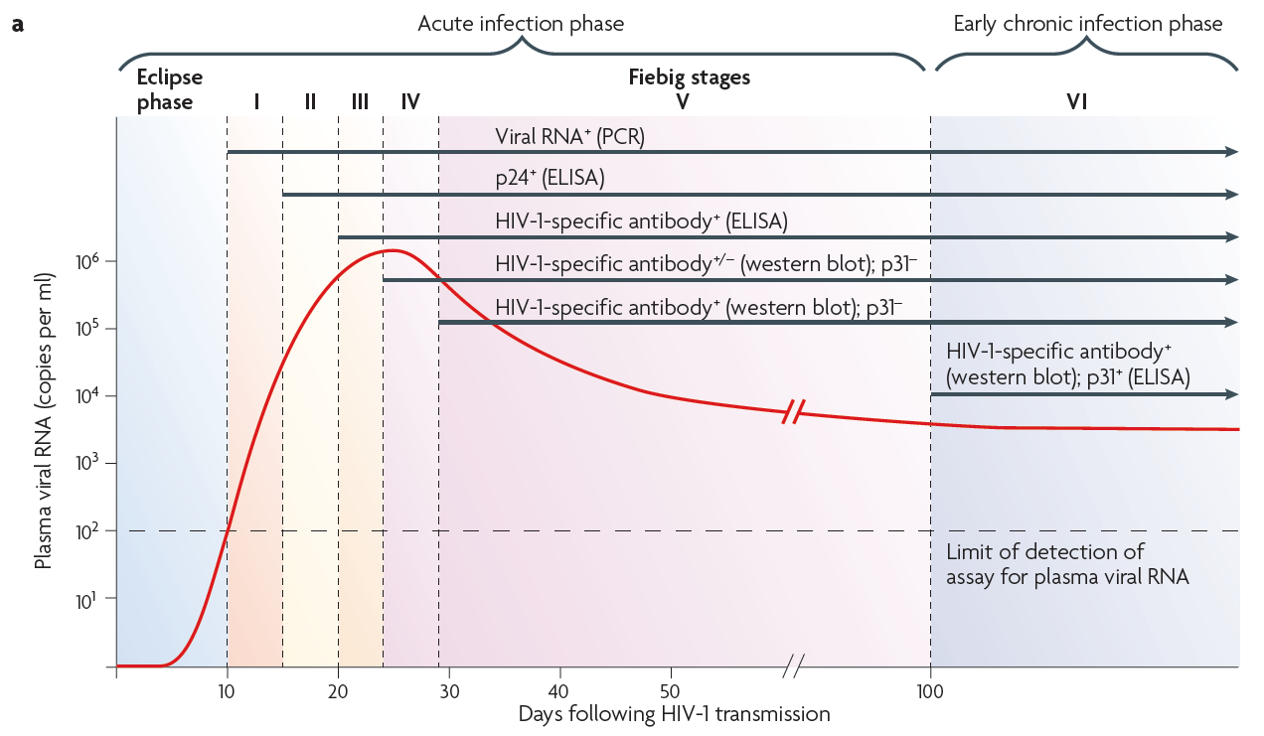
Defining of Acute HIV-1 Infection
From Nature Immunology Review 2010; 10 ; 11-23

Slide 17
Chronic HIV Infection
The second stage of HIV infection is chronic HIV infection (also called asymptomatic HIV infection or clinical latency).
HIV continues to multiply in the body but at very low levels.
May not have any HIV-related symptoms, but they can still spread HIV to others.
Without treatment with HIV medicines, chronic HIV infection usually advances to AIDS in 10 to 12 years.

Slide 18
AIDS
AIDS is the final stage of HIV infection.
Because HIV has destroyed the immune system, the body can’t fight off opportunistic infections and cancer. (Examples of opportunistic infections include pneumonia and tuberculosis)
AIDS is diagnosed when a person with HIV has a CD4 count of less than 200 cells/mm³ and/or one or more opportunistic infections.
Without treatment, people with AIDS typically survive about 3 years.

Slide 19
Clinical Categories of HIV Infection
Category C: Conditions listed in the AIDS surveillance case definition
Candidiasis of bronchi, trachea, or lungs
Candidiasis, esophageal
Cervical cancer, invasive
Coccidioidomycosis, disseminated or extrapulmonary
Cryptococcosis, extrapulmonary
Cryptosporidiosis, chronic intestinal (>1 month's duration)
Cytomegalovirus disease (other than liver, spleen, or nodes)
Cytomegalovirus retinitis (with loss of vision)
Encephalopathy, HIV-related
Histoplasmosis, disseminated or extrapulmonary
Isosporiasis, chronic intestinal (>1 month's duration)
Kaposi's sarcoma
Toxoplasmosis of brain
Lymphoma, Burkitt's (or equivalent term)
Lymphoma, primary, of brain
Mycobacterium avium complex or M. kansasii, disseminated or extrapulmonary
Mycobacterium tuberculosis, any site (pulmonarya or extrapulmonary)
Mycobacterium, other species or unidentified species, disseminated or extrapulmonary
Pneumocystis jiroveci pneumonia
Pneumonia, recurrenta
Progressive multifocal leukoencephalopathy
Salmonella septicemia, recurrent
Wasting syndrome due to HIV
Herpes simplex: chronic ulcer(s) (>1 month's duration); or bronchitis, pneumonia, or esophagitis
Source: MMWR 42(No. RR-17), December 18, 1992

Slide 20
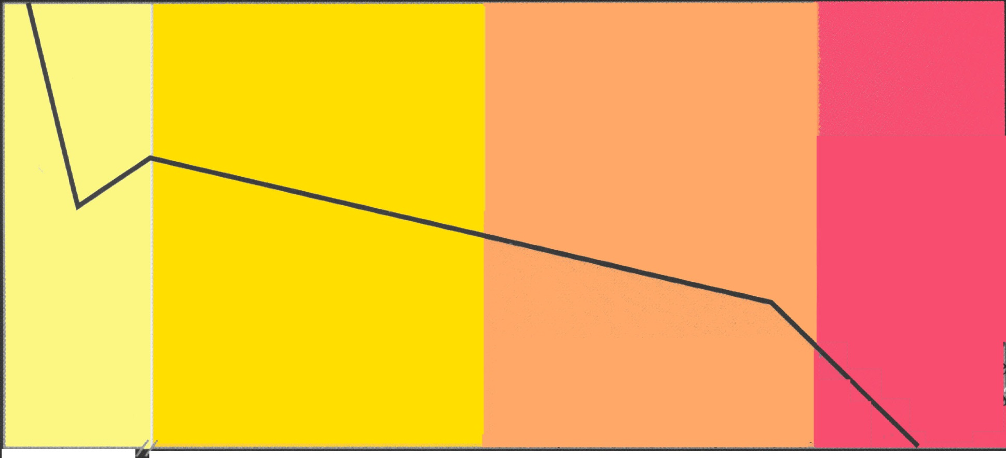
人類免疫缺乏感染在不同CD4相關的感染
  急性期 早期 中期 末期
  (CD4 > 500) (500 >CD4 >200) (CD4 <200)
1000
Guillain-Barre syndrome
Chronic demyelinating neruopathy
Idiopathic thrombocytopenia
Reiter’s syndrome
Polymyositis
Sjögren’s syndrome
Bell’s palsy
Tinea, onychomycosis
Gingivitis
Seborrhoeic dermatitis
Molluscum contagiosum
Herpes zoster
Tuberculosis
Sinusitis
每毫升淋巴球數目
500
Fever
Myalgia
Arthralgia
Adenopathy
Malaise
Rash
Meningo-
encephalitis
Herpes simplex
Cryptosporidiosis
PCP
Toxoplasmosis
Cryptococcosis
MAC
CMV
Oral candidiasis
Hairy leukoplakia
200
Kaposi’s sarcoma
Non-Hodgkin’s lymphoma
Cervical intraepithelial neoplasia
Primary CNS lymphoma
0
10 週 5 年 10 年 13 年
20
Hakim JG, et al. SSMJ, 2009

Slide 21
肺囊蟲肺炎(Pneumocystis carinii pneumonia, PJP, PCP)

Slide 22
AIDS with Penicillosis: Penicillium marneffei, Neck lymph node biopsy: Mycobacterium avium complex, CD4: 40
22

Slide 23
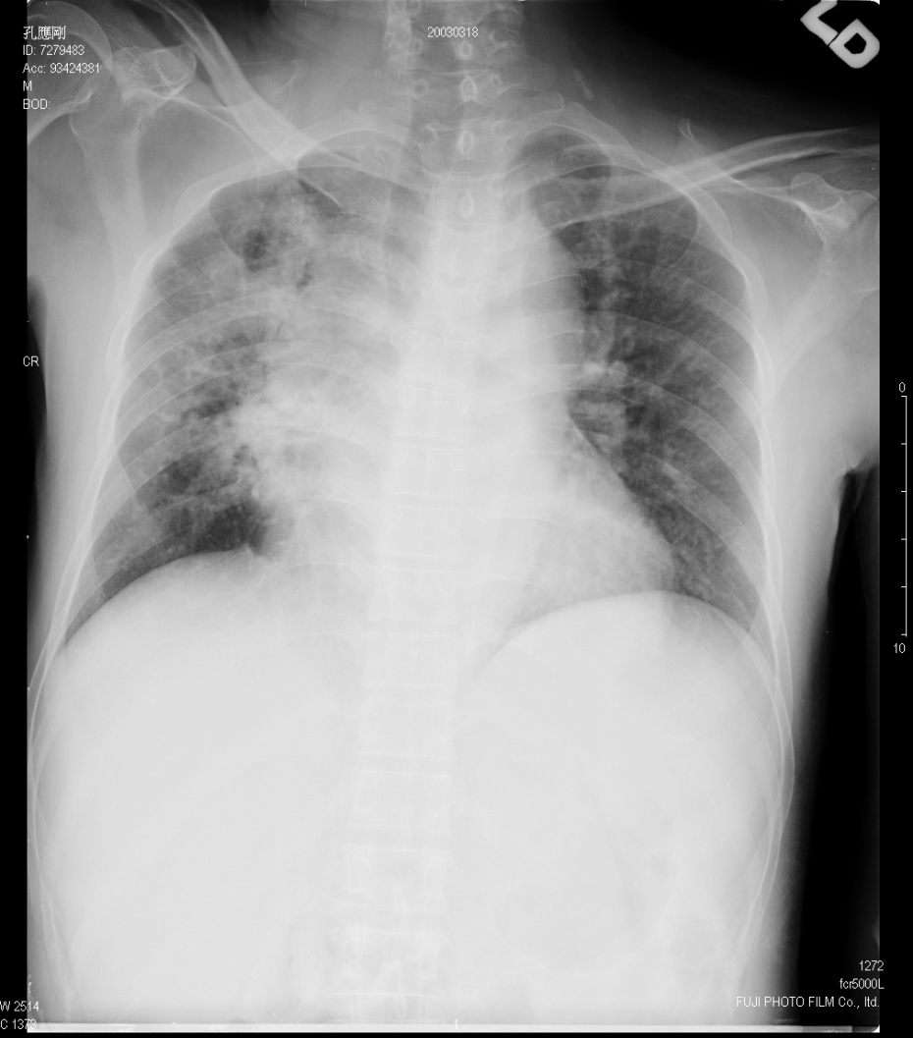
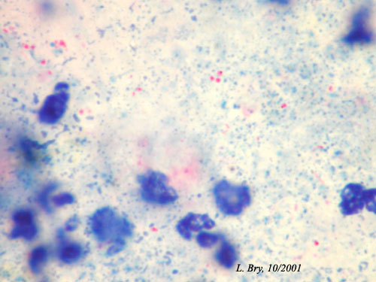
瀰漫性Rhodococcus equi 感染包括
肺炎、菌血症、骨隨侵犯、腦膜炎
23

Slide 24
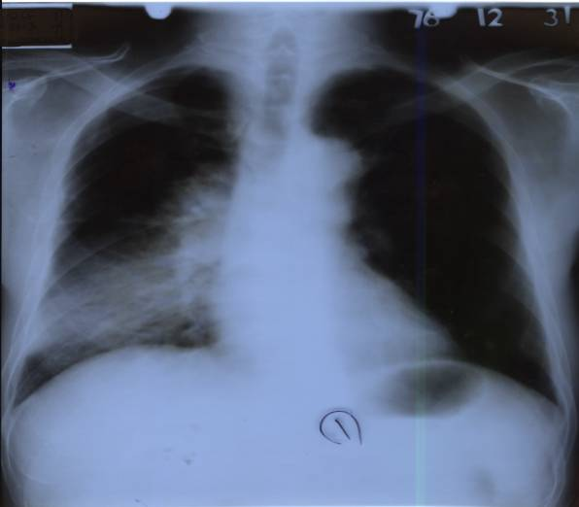
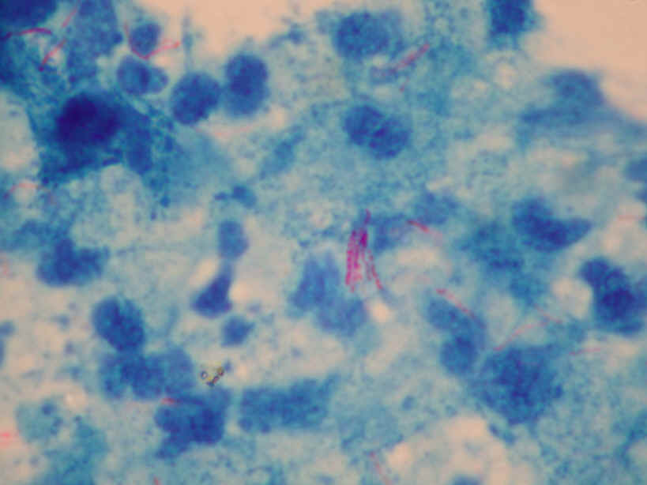

右下葉肺結核, HIV +
24

Slide 25
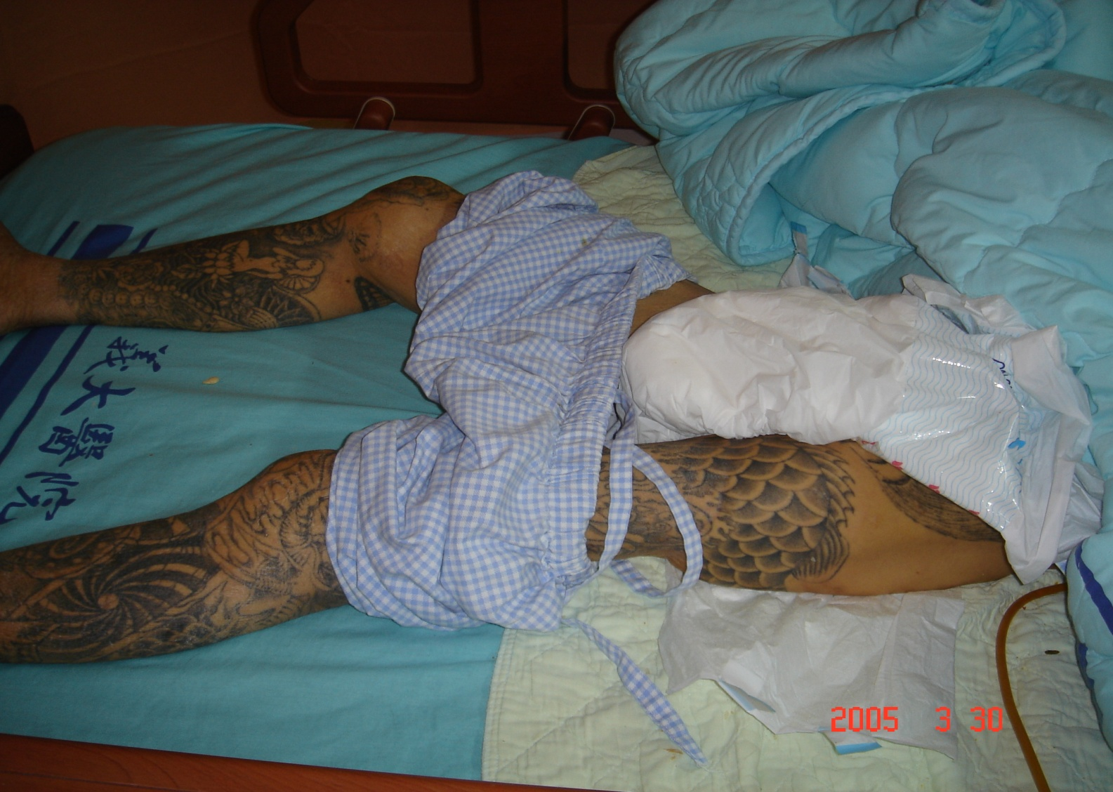
Injection drug user (IDU): infectious spondylitis; HIV+, HCV+, HBsAg+, HDV+
25

Slide 26
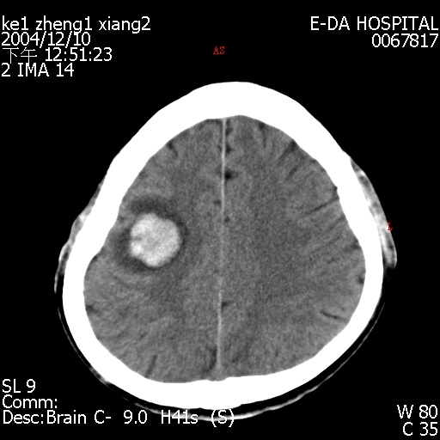
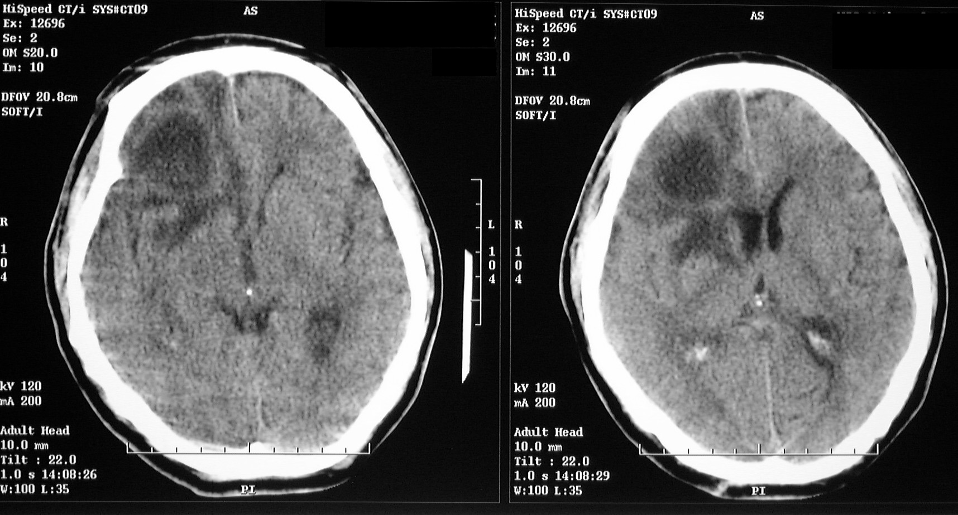
腦膿瘍, injection drug user (IDU), HIV+
26

Slide 27
Generalized virological and immunological course of HIV infection
Virology-online.com

Slide 28
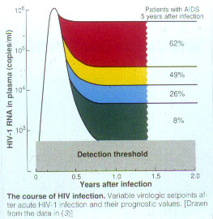
Mellors JW et al, Science. 1996

Slide 29

黃俊凱醫師製作
29

Slide 30
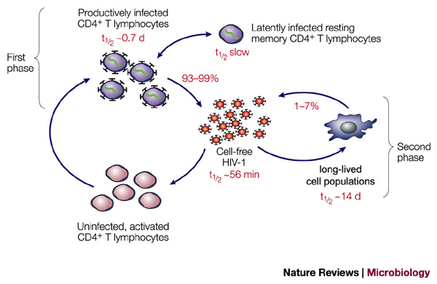
HIV viral dynamics and CD4 cell Life cycle
Simon V and Ho D. Nature Reviews Microbiology. 2003

Slide 31
簡介
人類免疫缺乏病毒
(Human Immunodeficiency Virus, HIV)鑑別診斷
Acute HIV infection
Chronic HIV infection
AIDS
治療
感染管制

Slide 32
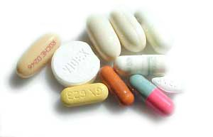
抗愛滋病毒藥物
◆核甘類反轉錄脢抑制劑(NRTIs)
Zidovudine (AZT) Didanosine (ddI) Abacavir (ABC) Stavudine (d4T) Zalcitabine (ddC) Tenofovir *
Lamivudine (3TC) Emtricitabine
◆非核甘類反轉錄脢抑制劑(NNRTIs)
Nevirapine (NVP) Efavirenz (EFZ) Rilpivirin
Etravirenz
◆蛋白脢抑制劑(PIs)
Saquinavir (SQV) Indinavir (IND) Amprenavir
Ritonavir (RIT) Nelfinavir(NFV) Lopinavir/r
Atazanavir Darunavir/r
◆整合酶抑制劑(Integratease inhibitor)
Raltegravir Dolutegravir Elvitegravir
◆CCR5-receptor antagonist ◆接合抑制劑(Fusion inhibitor)
Maraviroc Enfuvirtide (T-20)
32

Slide 33
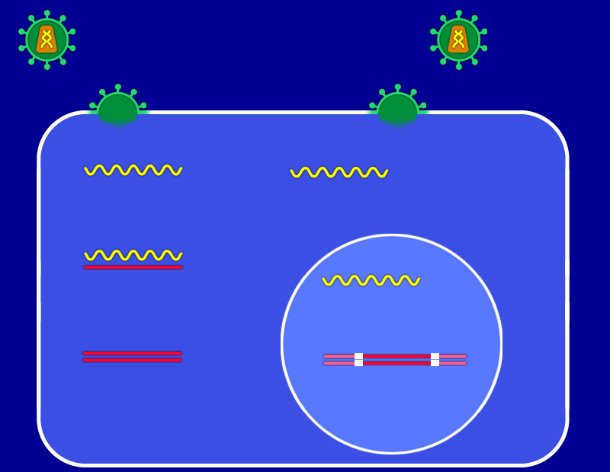
HIV病毒（反轉錄病毒）生活史
愛滋病毒
融合、進入
蛋白酶
RNA
RNA
Proteins
反轉錄酶
RT
RNA
RNA
DNA
DNA
RT
DNA
DNA
DNA
DNA
Provirus
嵌合酶
CD4淋巴球
33
Notes:
3TC, lamivudine; ABC, abacavir; COBI, cobicistat; CrCl, creatinine clearance; DHHS, US Department of Health and Human Services; DTG, dolutegravir; EVG, elvitegravir; FTC, emtricitabine; HLA, human leukocyte antigen; IAS, International Antiviral Society; RAL, raltegravir; TDF, tenofovir.
If we look at the most recent antiretroviral therapy treatment guidelines from the US Department of Health and Human Services and from the IAS-USA, both guidelines panels recommend all three of the integrase strand transfer inhibitors as appropriate for first-line antiretroviral therapy. raltegravir, is recommended for use together with tenofovir/FTC. Elvitegravir is recommended as the fixed-dose combination of elvitegravir, cobicistat, tenofovir, and FTC in patients with normal renal function. And dolutegravir is recommended for use either with tenofovir/FTC or with abacavir/3TC. These recommendations predated the approval of the fixed-dose combination of dolutegravir with abacavir/3TC. And, of course, when using abacavir, the regimen is recommended only for patients who are negative for HLA-B*5701.

Slide 34
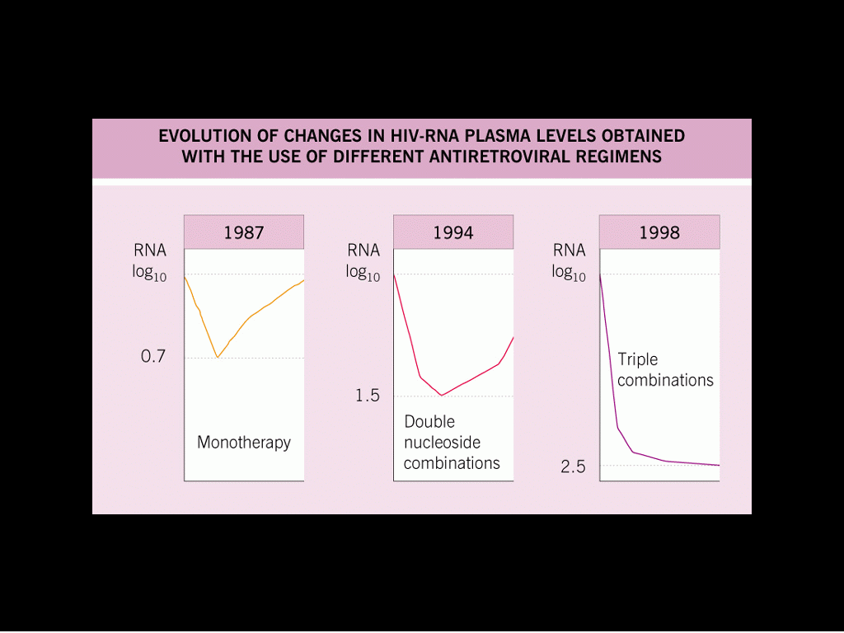
為何需使用組合式治療?
Highly Active Anti-Retroviral Therapy
(HAART，高效能抗病毒藥物治療)
34
www.medscape.com

Slide 35
高效能抗病毒治療(HAART)
NNRTI
2 NRTIs
+
/
PI ± r
以兩種NRTI為主幹，加上一種NNRTI, PI (可用ritonavir增強藥物動力學) 或II為主的合併療法。
II
35

Slide 36
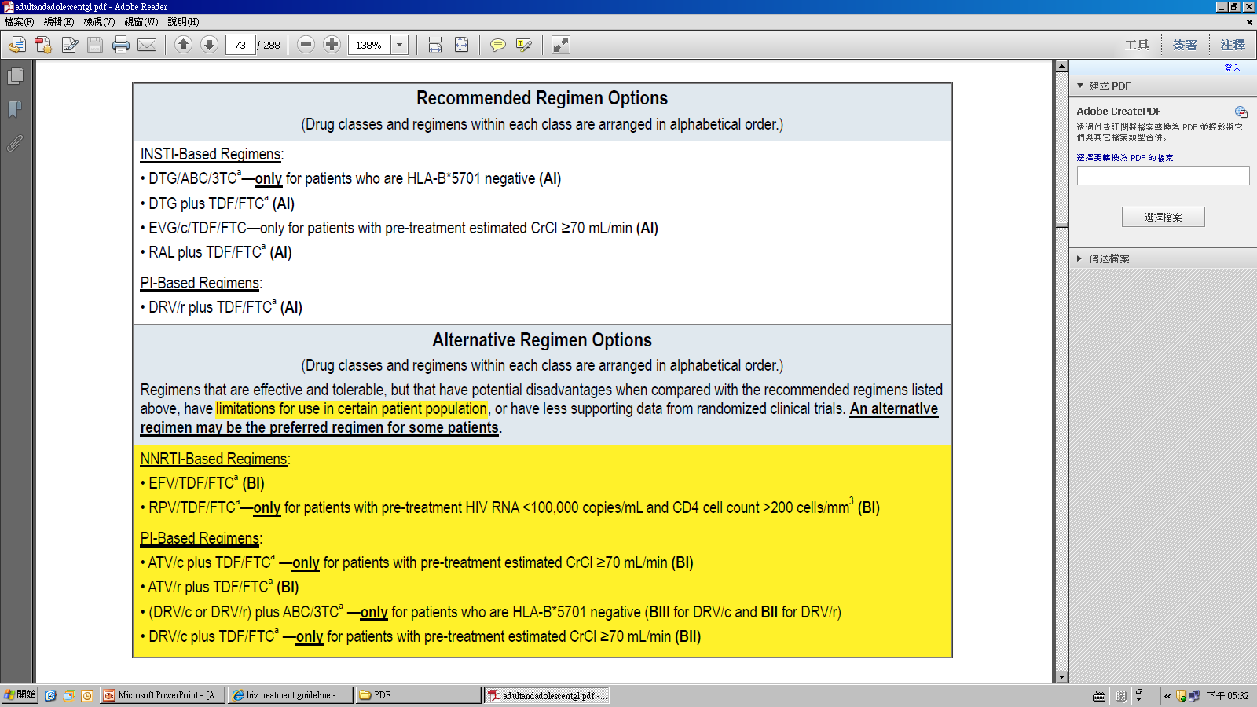
DHHS Guideline April 8, 2015
36

Slide 37
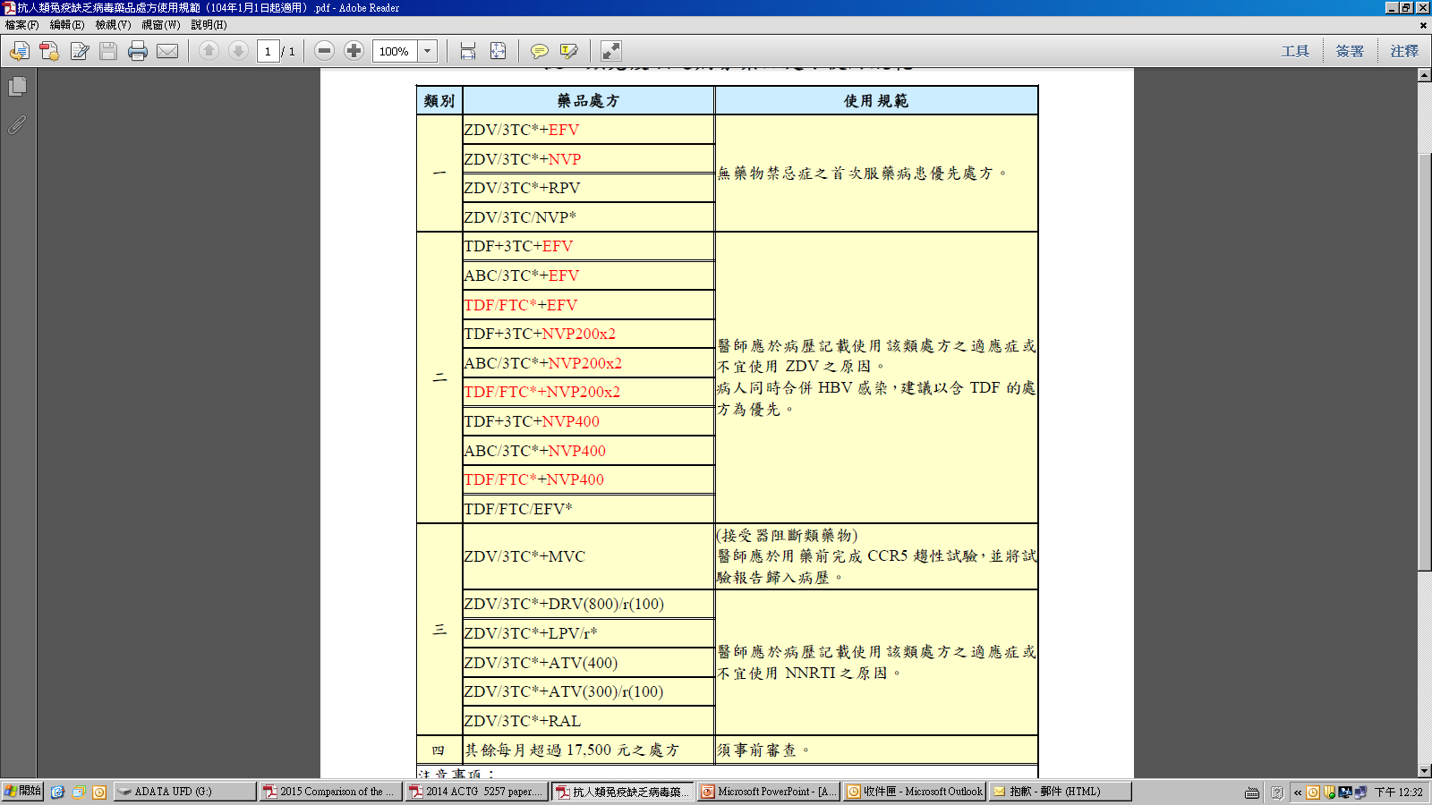
台灣CDC
抗人類免疫缺乏病毒
藥品處方使用規範
37

Slide 38
抗病毒藥物治療的目標
Maximally and durably suppress HIV viral load
Restore and/or preserve immunologic function
Reduce HIV-related morbidity
Prolong duration and quality of survival
Prevent HIV transmission: Pre-exposure prophylaxis (PrEP), Post-exposure prophylaxis (PEP)
38

Slide 39
AIDS mortality and protease inhibitor (PI) use
Deaths
Deaths per 100 person-years
Therapy with a PI (% of patient-days)
Use of PIs
1994
1995
1996
1997
1998
Year
Palella et al. N Engl J Med 1998
39
Notes:
AIDS mortality rates declined significantly following the introduction of protease inhibitors (PIs). The reductions in mortality were related to the introduction of highly active antiretroviral therapy (HAART), and in particular PI treatment.
Mortality benefits are related to treatment intensity. As patients were switched away from no antiretroviral (ARV) therapy or monotherapy to more aggressive treatments, mortality rates declined.

Slide 40
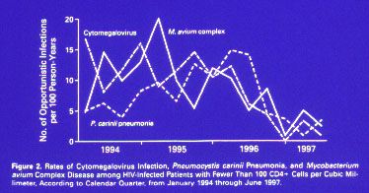
機遇性感染的機率隨著高效能抗病毒藥物使用下降
Palella et al. N Engl J Med. 1998
40

Slide 41
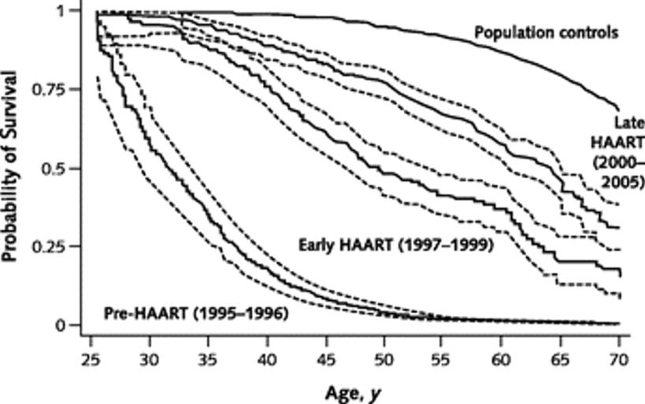
不同時期之存活率
Lohse N et al. Ann Intern Med 2007; 146: 87-95
41
©2007 by American College of Physicians
Notes:
41
Survival from age 25 years.Cumulative survival curve for HIV-infected persons (without hepatitis C coinfection) and persons from the general population. Persons with HIV infection are divided into 3 calendar periods of observation. Dashed lines indicate 95% CIs. HIV = human immunodeficiency virus; HAART = highly active antiretroviral therapy.

Slide 42
With the availability of the START and TEMPRANO trial results, the Panel’s overall recommendation remains the same: ART is recommended for all HIV-infected patients regardless of pre-treatment CD4 count. However, the strength of the recommendation will be changed to AIª (strong recommendation based on data from randomized controlled trials) for all patients.
The INSIGHT START Study Group, NEJM, 2015
42

Slide 43
HIV Prevention Trials Network (HPTN) 052
Partner-Linked HIV-1 Transmissions Analysis
HIV serodiscordant adult couples - N=1,763 couples
(ART-naïve, HIV-infected partner, CD4 between 350-550)
Multivariate Analysis | HR | 95% CI
Rx Early Therapy (>350) vs. Delayed Therapy | 0.04 | 0.01–0.28
Baseline condom use (100% vs. <100%) | 0.33 | 0.12–0.91
Male sex vs. female sex | 0.73 | 0.33–1.65
Baseline CD4 count (per 100 CD4 increment) | 1.24 | 1.00–1.54
Baseline viral load (per unit log₁₀ increment) | 2.85 | 1.51–5.41
0.3
Linked transmissions
Delayed arm: n=27
Early arm: n=1
0.2
Cumulative Probability
0.1
Delayed
Early
0
0
1
2
3
4
5
Years since randomization
Number at Risk
Early 893 658 298 79 31 24
Delayed 882 655 297 80 26 22
早期抗病毒治療可以降低96%的感染風險給性伴侶
早期治療可以減少41%臨床疾病的風險
43
Adapted from Cohen MS, et al. N Engl J Med 2011;10.1056

Slide 44
Partners PrEP: Reduction in HIV
Acquisition With PrEP
Primary Efficacy Outcome, mITT* Analysis | TDF (n = 1584) | TDF/FTC (n = 1579) | Placebo (n = 1584)
HIV acquisitions, n | 18 | 13 | 47
HIV incidence/100 PY | 0.74 | 0.53 | 1.92
Efficacy vs placebo, % (95% CI) | 62 (34-78) | 73 (49-85) | --
P value | .0003 | < .0001 | --
    *mITT analysis includes HIV acquisitions not detected at enrollment.
Baeten J, et al. N Engl J Med. 2012;367:399-410.
44

Slide 45
簡介
人類免疫缺乏病毒
(Human Immunodeficiency Virus, HIV)鑑別診斷
Acute HIV infection
Chronic HIV infection
AIDS
治療
感染管制

Slide 46
標準防護措施
(Standard Precautions)
接觸到血液丶體液丶滲出物丶分泌物及破損之皮膚和黏膜等均採取此標準防護措施 。
對象為所有病人
46

Slide 47
HIV Transmission to
Healthcare Workers
Source of exposure | HIV%
Needlesticks or cuts | 0.3-0.4
Intact skin contact | <0.1
Splashes in mucous membrane (eyes, nose, and mouse) | 0.1
David M. Bell. The American Journal of Medicine. 1997
47

Slide 48
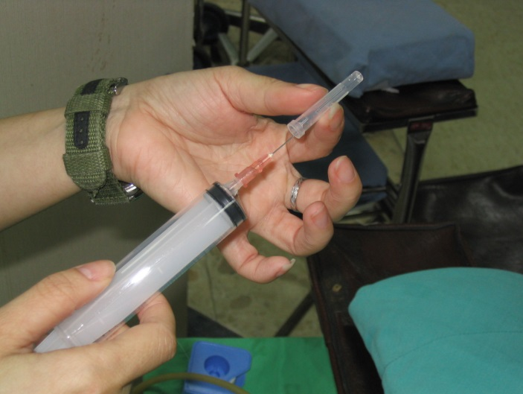
不回套或單手回套
  「回套」是造成針扎的重要原因。有鑑於此，美國職業安全衛生署(OSHA)於其「血源性致病菌」法規中明定不可回套；若在無法避免情況下，則須以機械輔助並採取單手回套方式。而國內研究亦指出單手回套確實可明顯降低針扎發生次數。
X
不得已時的單手回套法
O
48

Slide 49
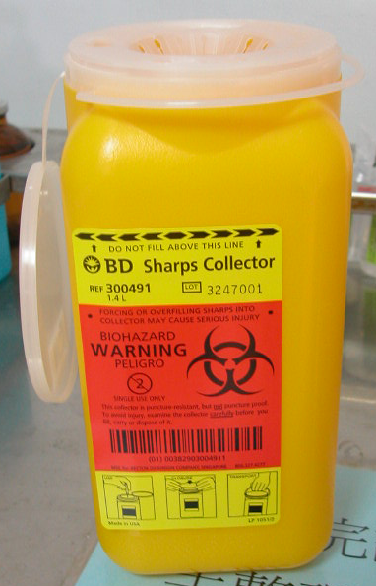
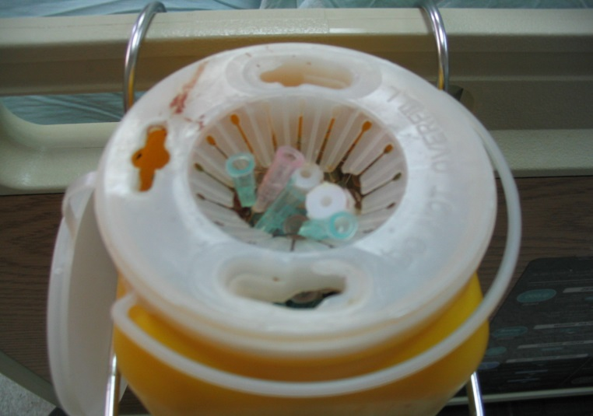
防穿刺的針器收集筒
針頭屬感染廢棄物，不可丟於一般垃圾桶內。收集筒應加以標示並分類處理，且其材質應具備防穿刺能力。
針頭容器存量八分滿時，使用單位應將盒蓋蓋上，不可溢出。
X
49

Slide 50
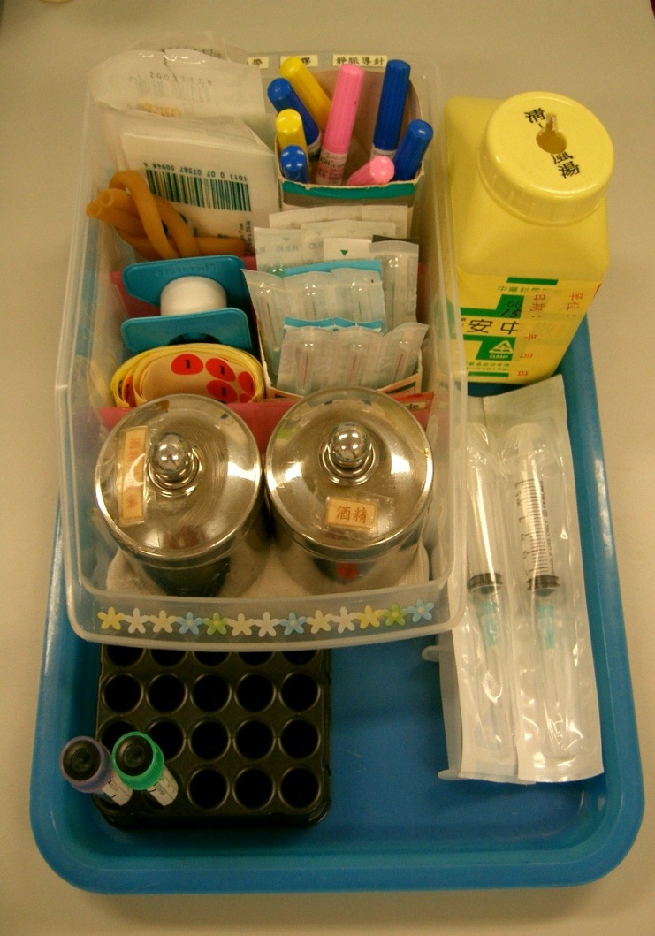
立即處理使用過針器
迷你針頭收集盒
「用完針頭但尚未放入收集盒或回套時」是污染性針扎事件中僅次於「回套」動作者，此代表的即是針器使用者未能立即處理用過的針器，使其夾雜於被單、床褥或工作檯上，而造成針器使用者或清潔人員與洗衣房工作人員的扎傷。
50

Slide 51
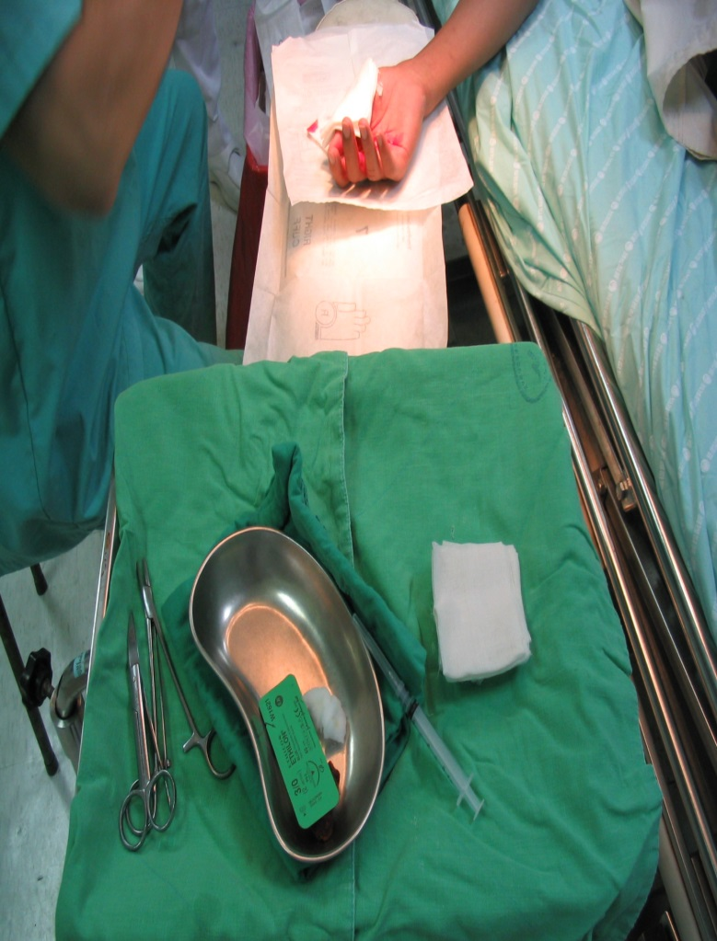
手不接觸手技巧
Hand free technique
當刷手人員及手術者在傳遞器械時，刷手人員及手術者絕不在同一時間接觸同一器械，器械應放在刷手人員及手術者之安全地帶如彎盆(Neutral zone)來傳送以預防尖銳物品扎傷。
51

Slide 52
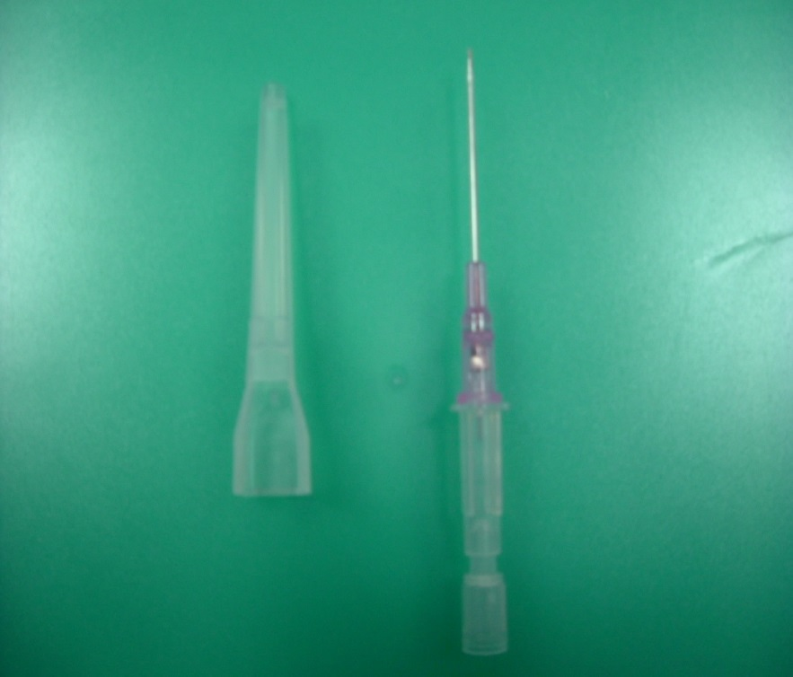
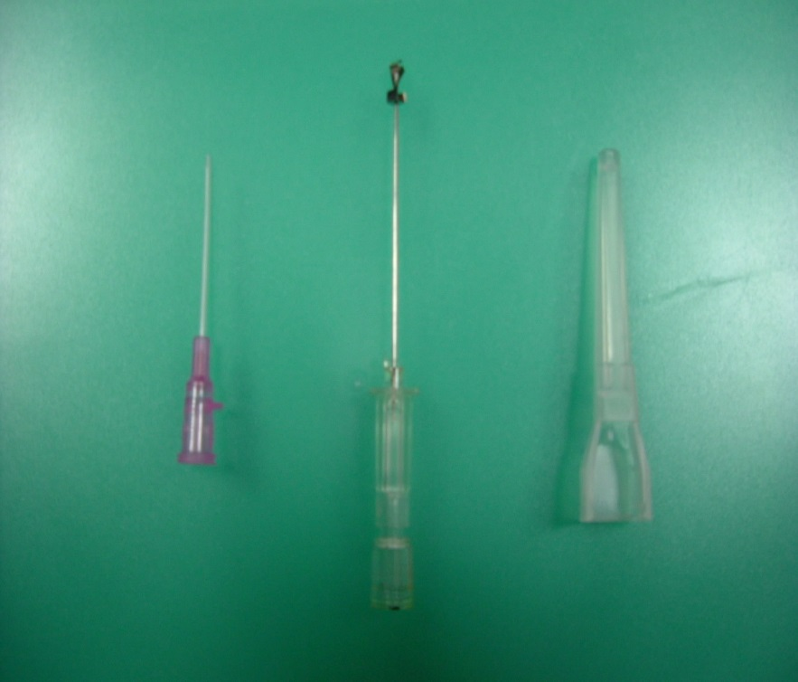
各式的安全針具
注意刺傷
自動保護
52

Slide 53
HIV 防治措施
傳染性低
受感染後是否使用Zidovudine (AZT)，使用AZT可使感染率減少81% 。
“避免受傷才是最佳防治之道 “
53

Slide 54
Risk factors of seroconversion after
occupational exposure to HIV-infected blood
Risk factors Odds ratio
Deep injury 15
Visibly patient’s blood 6.2
Intra-arterial (IA) or
Intra-venous (IV) procedure 4.3
Patient died of AIDS in 2 mons 5.6
NEJM 1997;337(21):1485-90
54

Slide 55
Occupational Postexposure
Prophylaxis (PEP)
Started ASAP; complete of a full 4-week regimen (28-day)
Contain 3 (or more) antiretroviral drugs for all occupational exposures to HIV
If a newer fourth-generation combination HIV p24 antigen–HIV antibody test is utilized for follow-up HIV testing of exposed HCP, HIV testing may be concluded 4 months after exposure; if a newer testing platform is not available, follow-up HIV testing is typically concluded 6 months after an HIV exposure.
55

Slide 56
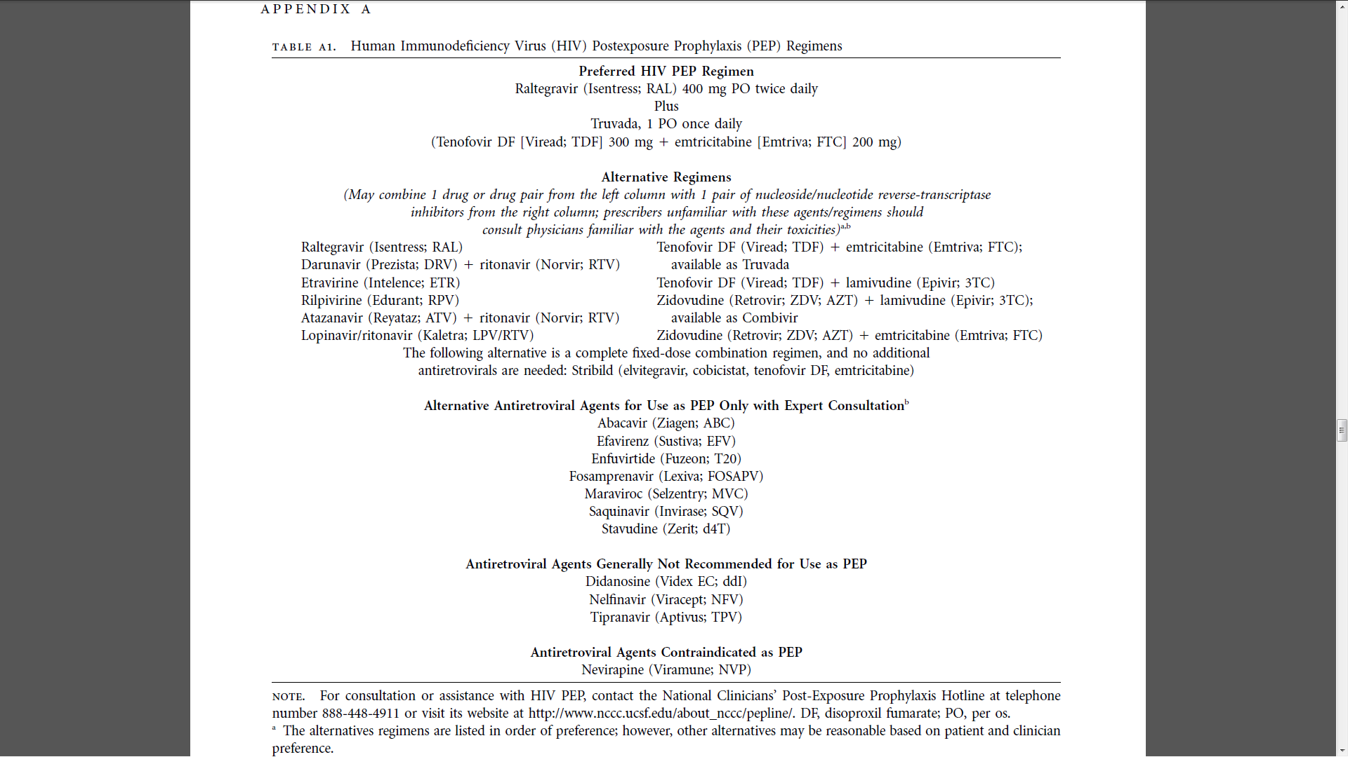

USCDC/SHEA
2013
56

Slide 57

結語
鑑別診斷：急性感染、慢性感染、AIDS
治療：
愛滋病毒感染是一個可以控制的疾病
愛滋病毒是一個可以預防的疾病
鼓勵全民篩檢
鼓勵早期治療
感染管制：標準防護措施、避免針紮
H
E
A
R
T
57

Slide 58
課程結束

