Slide 1
侵襲性肺炎鏈球菌感染症(IPD)
鑑別診斷、治療與感染管制
主講人：邱政洵
Cheng-Hsun Chiu, MD, PhD
Department of Pediatrics
Chang Gung Children’s Hospital
Chang Gung University College of Medicine
Taoyuan, Taiwan

Slide 2
課程大綱
1. Worldwide epidemiology of 19A
2. Current epidemiology in Taiwan
3. AOM
4. Why 19A has been emerging?
5. 2nd Generation PCV for 19A

Slide 3
1. Worldwide Epidemiology of 19A

Slide 4

Rates of Invasive Pneumococcal Disease among Children <5 Years, 1998-2008
2008 vs. baseline
All Serotypes: -79%
PCV7 Types: -99%
Type 19A: +233%
PCV7 intro-duction
資料來源：CDC, ABCs, 2008
Notes:
4
4

Slide 5
Age-Specific Incidence of 19A IPD,
1998-2005
Relative changes in rates represent results of the 2 test comparing rates in 2005 to pre-PCV7 average rates during 1998-1999
資料來源：Moore et al, JID, 197: 1016 –27, 2008

Slide 6
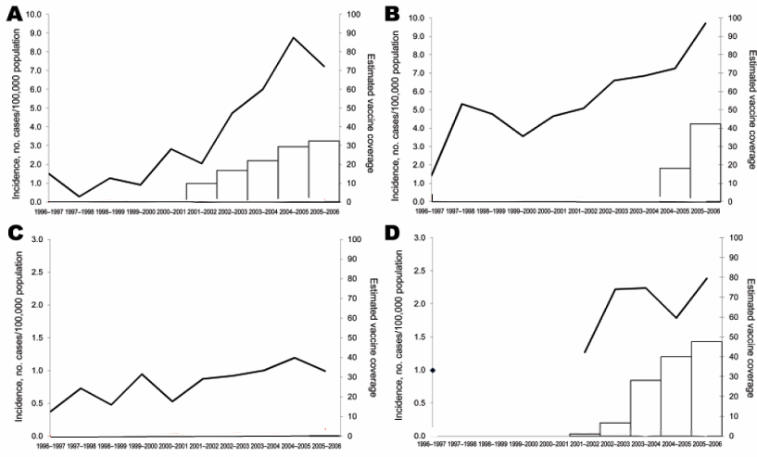
Incidence of Pediatric IPD among Children <5 Years by Serotype 19A
Incidence <5 years
Vaccine coverage
Spain
Belgium
17%
20%
18%
10%
Incidence per 100,000
Estimated vaccine coverage (%)
UK
France
25%
<5%
5%
Years
資料來源：Hanquet et al, Emerg Infect Dis, 16; 1428-39, 2010

Slide 7
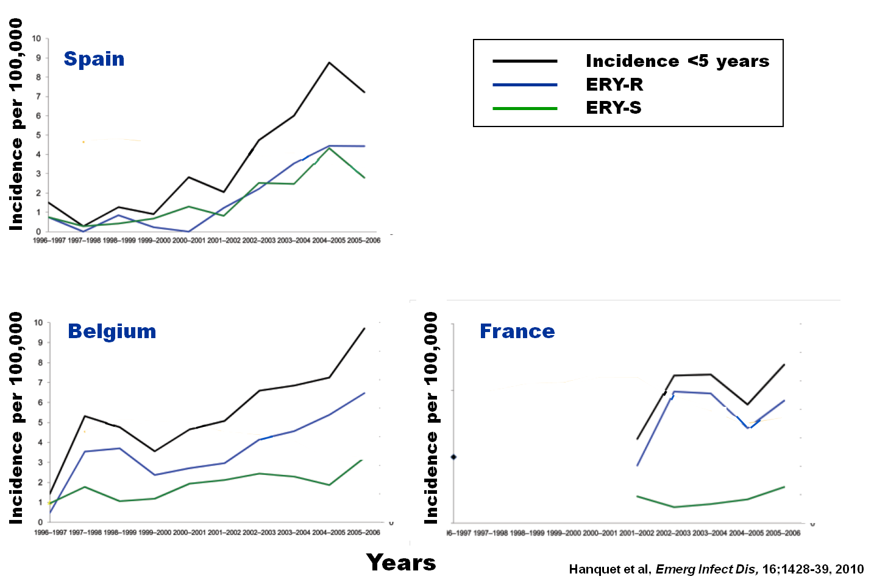
Incidence of Serotype 19A IPD in
Children <5 Years by Breakdown of
ERY-R Versus ERY-S Infections
Years
資料來源：Hanquet et al, Emerg Infect Dis, 16; 1428-39, 2010

Slide 8
Global 19A Pandemic
China
Clin Infect Dis 2010;50:741-4
Taiwan
Vaccine 2009;27:5513-8.
Korea
Emerg Infect Dis 2008;14:275-81
Canada
BMC genomics 2009;10:642
USA
J Infect Dis 2008;197:1016
Spain, Belgium,England and Wales, France
Emerg Infect Dis 2010;16:1428-39
Notes:
Emergence of serotype 19A is a global problem. The increase of serotype 19A was thought to be related to PCV7 vaccination and selective pressure driven by o antibiotic usasge.

Slide 9
Site of Infection Related to Serotype of IPD PCV7 and PCV13 Serotypes 2001-2008
“pneumonia serotypes”
1, 3, 5, 7F, 14, 19A
資料來源：Kaplan et al, Pediatrics, 125:429–436, 2010

Slide 10
Nasopharyngeal Carriage of S. pneumoniae
Serotypes in Children <5 Years old, Community Acquired Alveolar Pneumonia vs. Healthy Controls* (Figures in Parenthesis-ORs)
Positive Significant (CAP vs. Controls)
Negative Significant (CAP vs. Controls)
Non- Significant
14 (3.1)
19A (1.8)
19F
6B (0.5)
1 (19.0)
5 (5.7)
9V (1.8)
23F
UNTYPABLE
6A (0.4)
33F
15B/C
% of NP carriage of S. pneumoniae in AP
7F (3.4)
11A, 15A
21
22F (4.4)
18C
34
3
16F
*adjusted for age ethnicity and antibiotic treatment (1 month before culture obtained)
4
38
23A (0.2)
35B (0.1)
% of NP carriage of S. pneumoniae in healthy controls
資料來源：Greenberg D. et al PIDJ 2011

Slide 11
Nasopharyngeal Carriage of S. pneumoniae
Serotypes Included in the Various Conjugated
Vaccines in Children <5 Yeas old, Community
Acquired Alveolar Pneumonia vs. Healthy Controls*
Significant O.R.
13VT
1.6 (1.3-2.0)
Non-Significant O.R.
% of NP carriage of S. pneumoniae in CAAP
7VT
1.3 (1.1.-1.6)
*adjusted for age ethnicity and antibiotic treatment (1 month before culture obtained)
% of NP carriage of S. pneumoniae in healthy controls
資料來源：Greenberg et al PIDJ 2011

Slide 12
Invasive Pneumococcal Disease (IPD)-Associated Hemolytic-Uremic Syndrome (HUS)
UK
USA
9V
6A
N=6
Pre-PCV7
19A
14
Distribution of proportion of HUS attributable to pneumococcal infection (P-HUS) in seven tertiary referral units, UK
6A
12F
N=12
19A
14
Pre-PCV7
N=6
19A
Post-PCV7
3
Prepared by R. Dagan
資料來源：Waters et al, J Pediatr 151:140-4, 2007
Copelovitch et al, Pediatr, 125: e174–e182, 2010

Slide 13
Disease Potential of the
Serotypes for IPD
Serotype | Invasive index Lagos¹ | OR Hanage² | OR Shouval³ | OR Brueggemann⁴ | OR Hsieh⁵
1 | 3.2 | ND | 24.7 | 9.6 | ND
5 | >10 | ND | 9.4 | ND | ND
4 | 5.5 | 1.7 | ND | 12.1 | ND
19A | 2.6 | 2.9 | 1.3 | 1.1 | 14.9
14 | 4.1 | 4.1 | 0.7 | 8.8 | 17.3
18C | 4.1 | 3.3 | 2.3 | 5.8 | ND
7F | 1.8 | 2.5 | ND | 4.7 | 4.7
9V | 1.5 | 1.6 | 1.7 | 1.5 | 0.6
6B | 1.2 | 1.6 | 0.7 | 0.6 | 1.9
6A | 0.5 | 0.5 | 0.6 | 0.7 | 0.7
19F | 0.6 | 0.7 | 1.2 | 0.6 | 1.0
23F | 0.3 | 0.6 | 0.9 | 0.4 | 0.8
3 | 0.7 | 0.5 | <0.1 | 0.3 | 2.1
¹Lagos et al, J Infect Dis. 198:1809-17, 2008
²Hanage et al, Infect & Immun, 73:431–435, 2005
³Shouval et al, Pediatr Infect Dis J, 25:602-7, 2006
⁴Brueggemann et al, J infect Dis 187:1424-32, 2003
⁵Hsieh et al, Vaccine, 27:5513-8, 2009
ND = no data

Slide 14
2. Current Epidemiology in Taiwan

Slide 15
IPD Epidemiology in Taiwan under Partial PCV7 Vaccination in 2007
IPD has become a reportable disease since 2008.
資料來源：Y.-C. Hsieh et al. Vaccine 27 (2009) 5513
Notes:
2007年10月 IPD 列為通報疾病

Slide 16
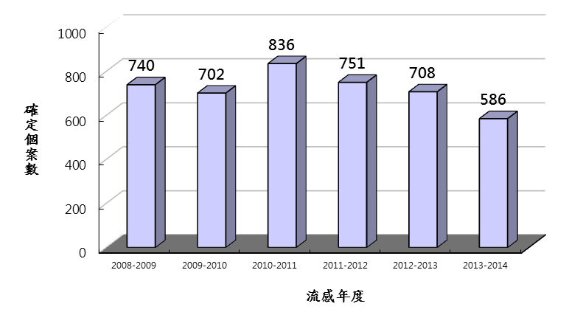
歷年侵襲性肺炎鏈球菌感染症
確定個案數
資料來源： Taiwan CDC通報系統資訊（資料區間2008/7/1~2014/6/30）

Slide 17
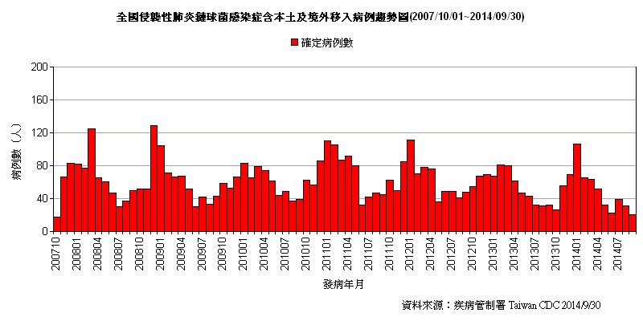
全國侵襲性肺炎鏈球菌感染症
含本土及境外移入病例趨勢圖
2007/10/01~2014/09/30
08-09
09-10
10-11
11-12
12-13
13-14
資料來源：疾病管制署 Taiwan CDC (2014/9/30)
Notes:
08-09

Slide 18
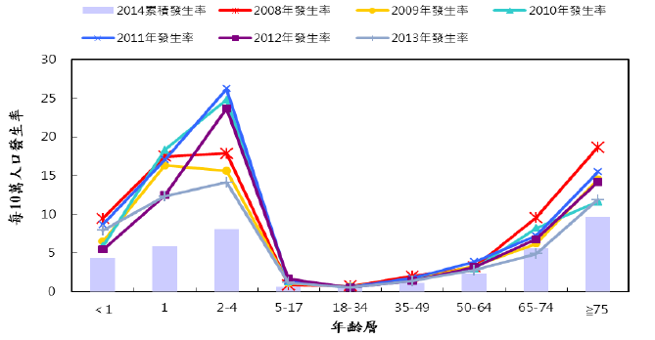
資料來源：As of Nov. 2014 Taiwan CDC

Slide 19
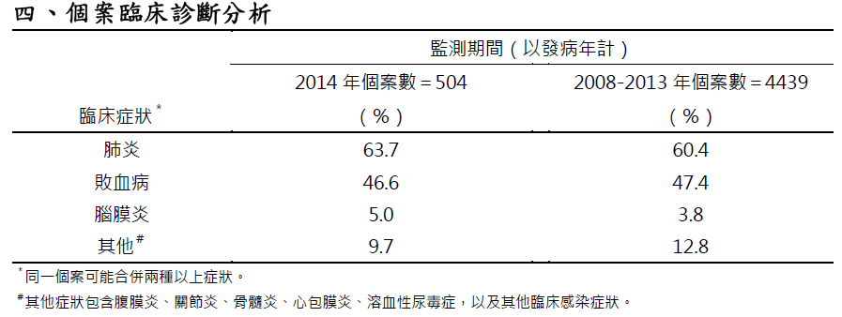
資料來源：As of Nov. 2014 Taiwan CDC

Slide 20
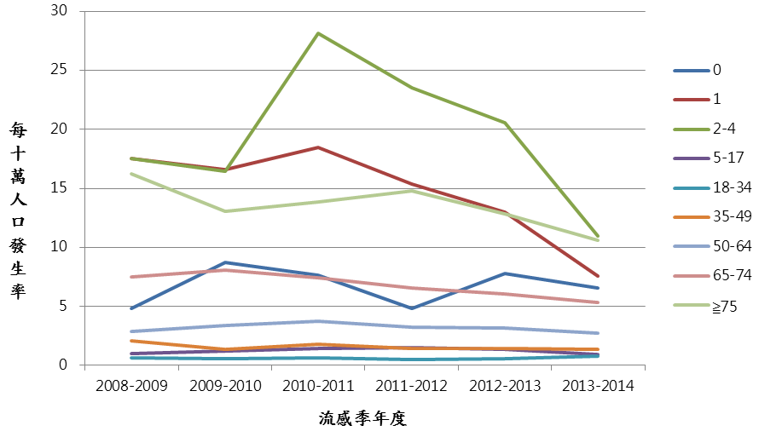
歷年IPD個案分齡發生率
（以流感年度劃分）
2008.1.1
提供75歲以上老人接種PPV23
2011.10月
自費疫苗全面改用PCV13
2013.3.1
提供2-5歲幼兒公費接種PCV13
2009.7.20
提供5歲以下特殊族群公費接種PCV7/10
2014.1.1
擴大至1歲
以上幼兒
以內政部公告之各年年底人口數為基準，
分別計算台灣各年齡層每十萬人口的發生率
資料來源：CDC通報系統資訊（個案發病日介於2008/7/1~2014/6/30）
Notes:
2011.10月
PCV13上市

Slide 21
歷年IPD分齡病例數及致死率統計表
（以流感年度劃分）
1. Ratio為該年齡層佔當年度所有IPD病例數之比例。
2. 死亡病例數資料整理自衛福部死亡勾稽檔案。2013-2014年度因尚未完成死亡勾稽，
故無致死率(CFR)資料。
3. 其他資料來源:CDC傳染病通報系統資訊（個案發病日介於2008.07.01-2013.6.30）
資料來源：CDC通報系統資訊（資料區間2008/7/1-2014/6/30 ）

Slide 22
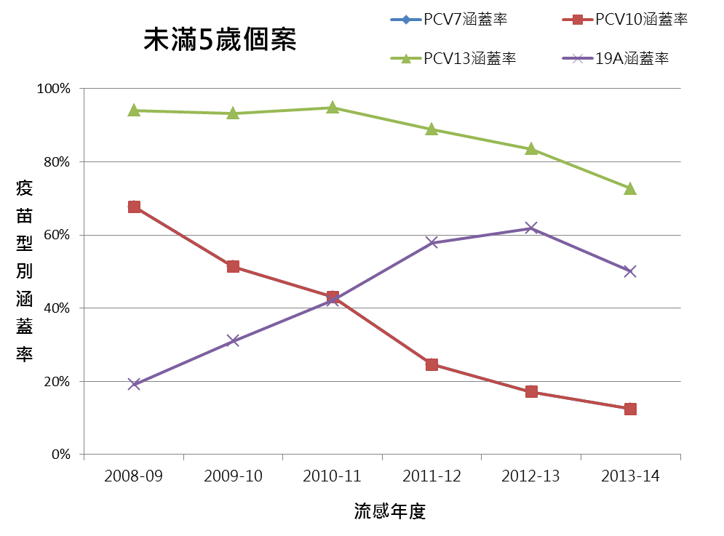
2008~2013年IPD個案
PCV及PPV涵蓋率分析
資料來源：CDC通報系統資訊（資料區間2008/7/1-2014/6/30 ）

Slide 23
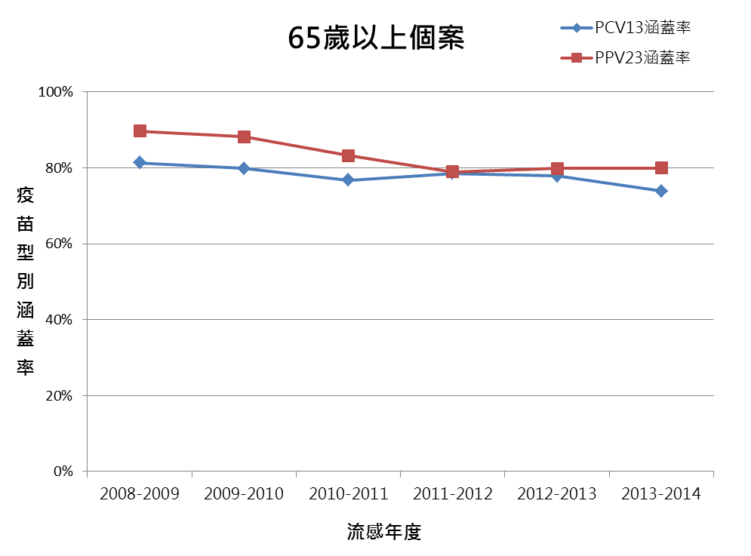
資料來源：CDC通報系統資訊（資料區間2008/7/1-2014/6/30 ）

Slide 24
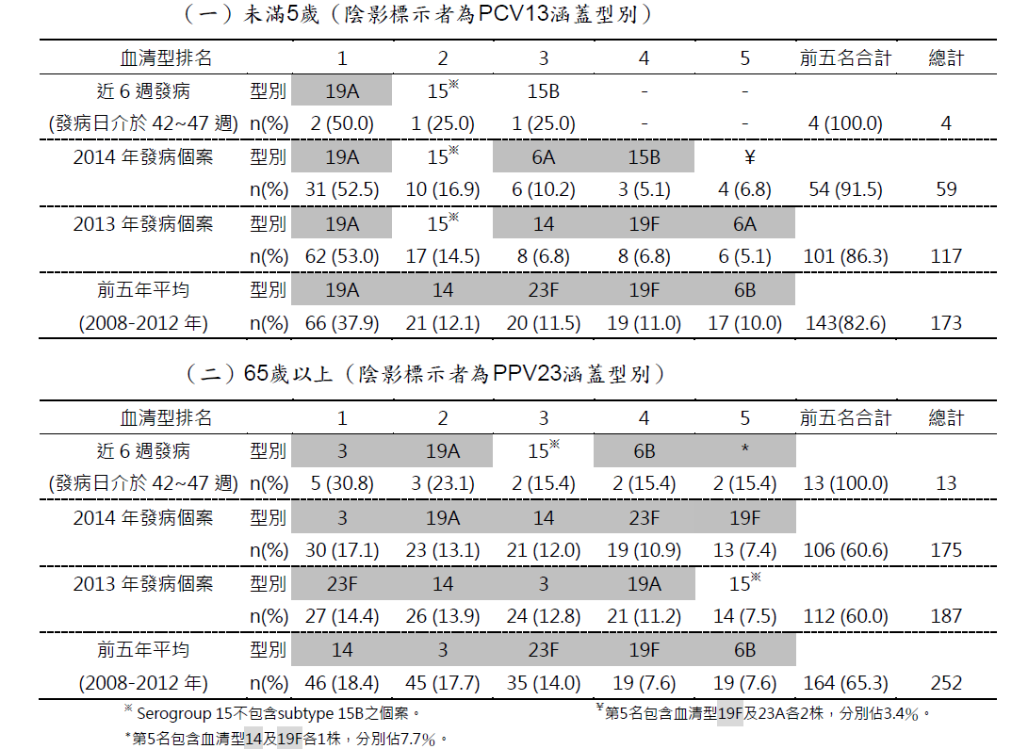
資料來源：As of Nov. 2014, Taiwan CDC

Slide 25
資料來源：As of Nov. 2014, Taiwan CDC

Slide 26
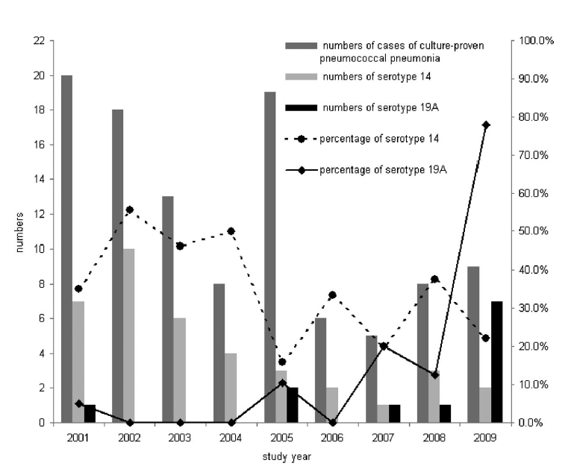
Culture-Proven Pneumococcal Pneumonia at CGCH Between 2001 to 2009
19A
資料來源：Hsieh YC et al. PIDJ 2011; 30: 740–744

Slide 27
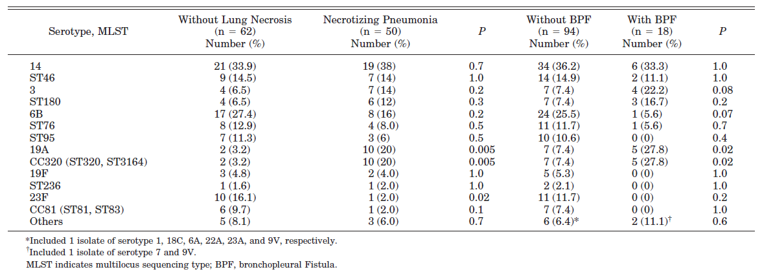
Serotype and Major MLST
Distributions of 112 Isolates
Causing Pneumococcal Pneumonia
資料來源：Hsieh YC et al. PIDJ 2011; 30: 740

Slide 28

Multivariate Analysis of Risk Factors for the Development of Bronchopleural Fistula (BPF)
Variable | OR (95% CI) | P
Female sex | 3.0 (0.8-11.3) | 0.1
Acute respiratory failure | 8.9 (2.6-30.9) | 0.001
Hemolytic uremic syndrome | 1.1 (0.2-5.8) | 0.9
Serotype 19A | 5.0 (1.2-22.1) | 0.03
Serotype 3 | 3.0 (0.6-16.6) | 0.2
Serotype 6B | 0.3 (0.03-3.0) | 0.3
資料來源：Hsieh YC et al. PIDJ 2011; 30: 740
Notes:
After adjustment, acute respiratory failure and serotype 19A infection were identified as independent risk factors for the development of BPF.

Slide 29
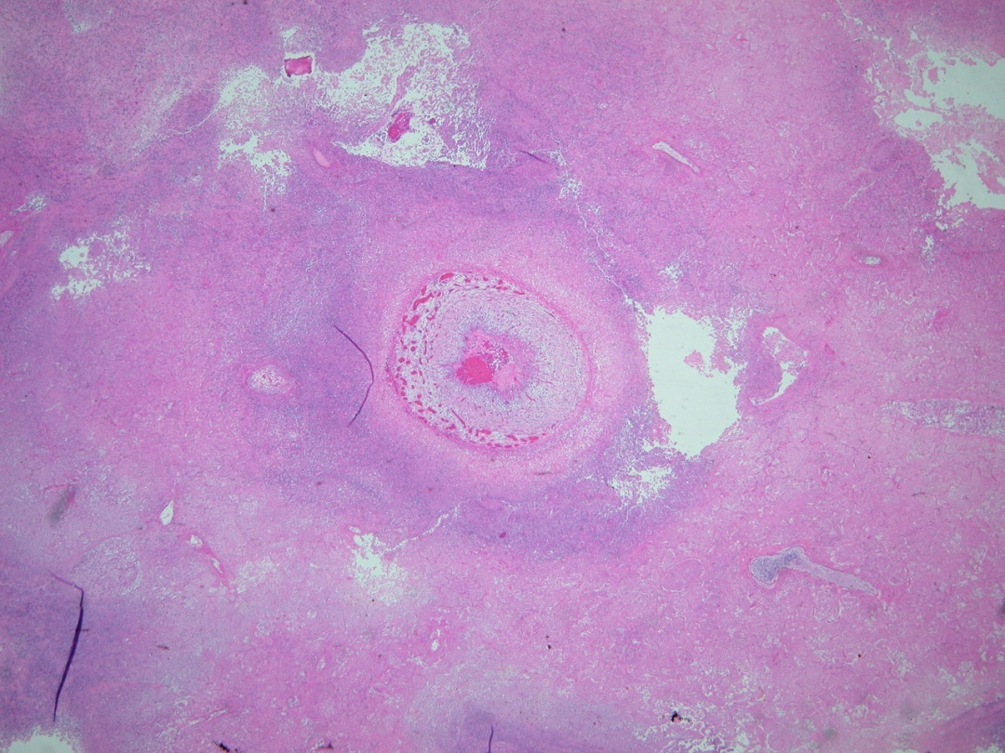
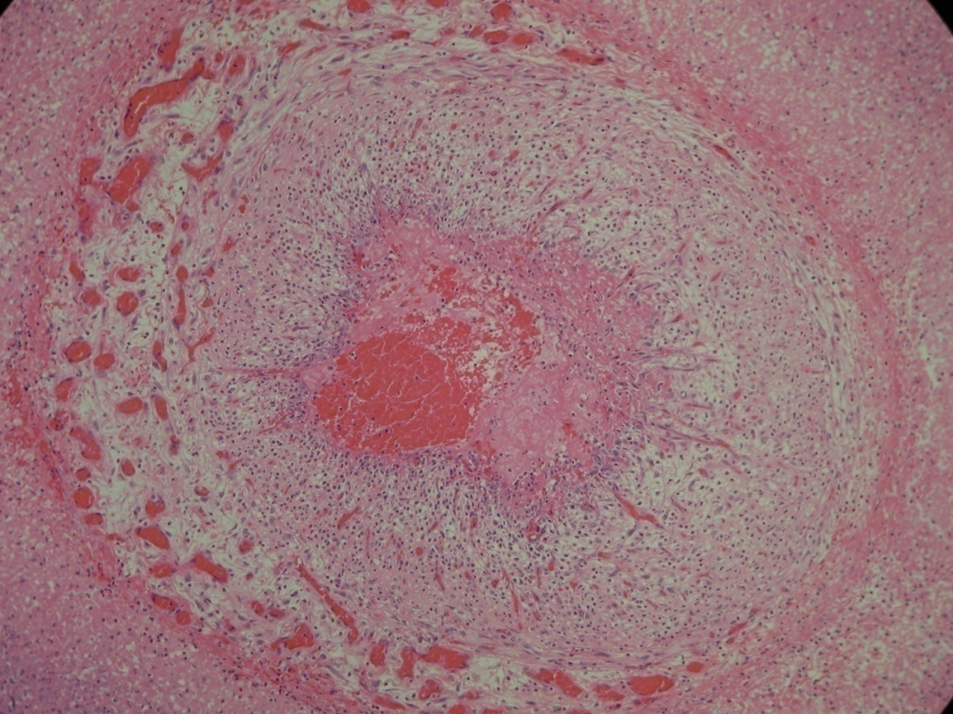
Pulmonary Infarction
資料來源：Hsieh YC et al. PIDJ 2011; 30: 740–744

Slide 30
Pleuropneumonia
1, 3, 5, 7F, 14, 19A
USA: 1, 3, 7, 14, 19A (5 rare in USA)
Taiwan: 3, 14, 19A

Slide 31
3. AOM

Slide 32
Odds Ratios for Specific
S. pneumoniae Serotypes for Developing AOM if Carried in Nasopharynx
資料來源：Shouval et al. Pediatr Infect Dis J, 25: 602–607, 2006

Slide 33
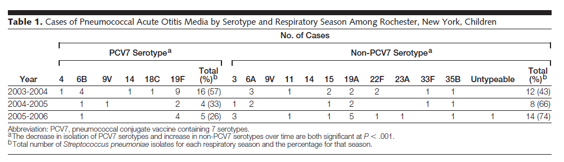
Emergence of a Multiresistant Serotype
19A Pneumococcal Strain Not Included in the 7-Valent Conjugate Vaccine as an Otopathogen in Children
資料來源：JAMA 2007; 298: 1772-78

Slide 34
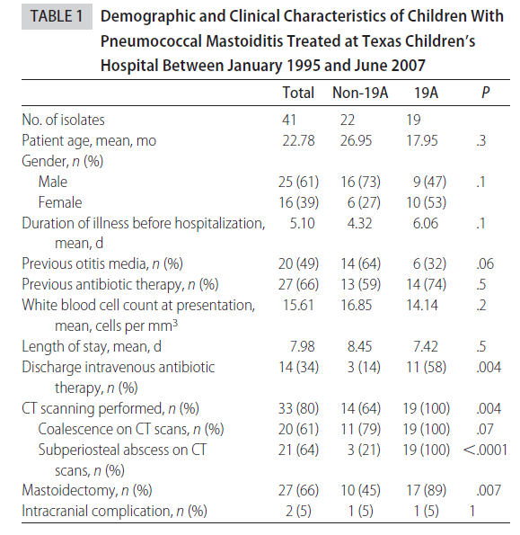
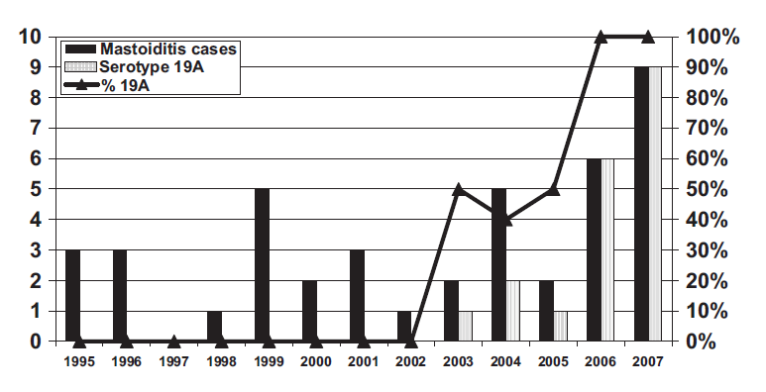
Pneumococcal Mastoiditis in Children and the Emergence of Multidrug-Resistant Serotype 19A Isolates
資料來源：Pediatrics 2008; 122: 34-39
Notes:
Texas
OBJECTIVE:
We review the impact of pneumococcal conjugate vaccine on pneumococcal mastoiditis in children at Texas Children's Hospital.
METHODS:
The medical charts (including the number of pneumococcal conjugate vaccine doses) for children with pneumococcal mastoiditis treated at Texas Children's Hospital between January 1995 and June 2007 were reviewed retrospectively. Isolates were serotyped with the capsular swelling method. Pulsed-field gel electrophoresis was performed on the 19A isolates and multilocus sequence typing on selected 19A clones.
RESULTS:
Forty-one pneumococcal mastoiditis cases were identified, and 19A (n = 19) was the most common serotype. Before the introduction of pneumococcal conjugate vaccine (from 1995 to December 1999), 0 of 12 cases were 19A. Between April 2000 and October 2006, 15 cases of pneumococcal mastoiditis occurred, and 5 were 19A. Fourteen cases of pneumococcal mastoiditis occurred between November 2006 and June 2007, all of which were 19A. Mastoiditis caused by 19A isolates was more likely to present with subperiosteal abscess and was more likely to need intraoperative mastoidectomy than was mastoiditis caused by non-19A isolates. Multidrug resistance was also common among the 19A isolates; 13 (68%) of the 19A isolates were resistant to all antibiotics tested routinely. Pulsed-field gel electrophoresis analysis placed 14 (74%) of the 19 serotype 19A isolates into a highly related group; 12 isolates were classified as closely related, and 2 were possibly related. Multilocus sequence typing analysis placed the pulsed-field gel electrophoresis cluster isolates into clonal complex 271 (sequence types 320 and 1451).
CONCLUSIONS:
At Texas Children's Hospital, 19A has become the predominant serotype causing pneumococcal mastoiditis, partly related to the emergence of multidrug-resistant clonal complex 271 strains. Subperiosteal abscesses and the need for mastoidectomy were more common in children with mastoiditis caused by serotype 19A isolates, compared with isolates of other serotypes.

Slide 35
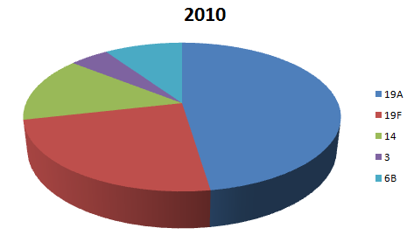
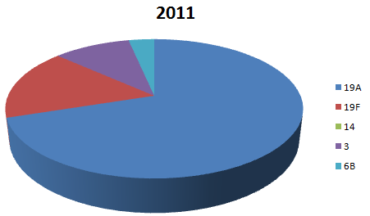
Serotype Distribution among
AOM Isolates
1
2
3
10
5
3
1
5
21
資料來源：馬偕醫院 紀鑫主任提供

Slide 36
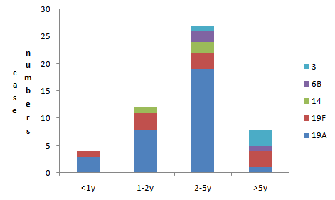
資料來源：馬偕醫院 紀鑫主任提供

Slide 37
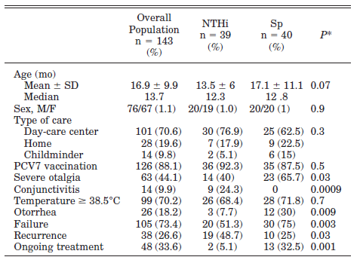
Pathogens Implicated in Acute Otitis Media Tx Failure or Recurrence After PCV& Implementation in France
Failure was defined as the persistence of AOM symptoms after at least 48 hours of antibiotic therapy or their recurrence within 4 days after the end of treatment.
資料來源：Couloigner V et al. PIDJ 2011

Slide 38
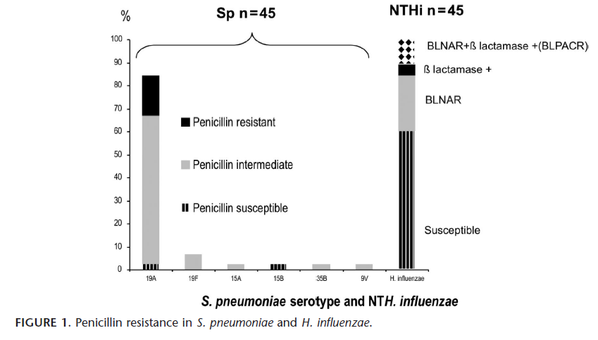
資料來源：Couloigner V et al. PIDJ 2011 Oct. 6

Slide 39
Pathogens Implicated in AOM Tx Failures after PCV7 Implementation in France
On antibiotics or stopped <4 days before
  Amox (+/- Clav) - 51%
  Cephalosporins (mainly cefpodoxime – 49%
93% of all pneumococci were PNSP
143 MEF samples*
* Including 3 with mixed NTHi + S. pneumoniae
資料來源：Francois et al, ESPID 2010, Nice, 2010

Slide 40
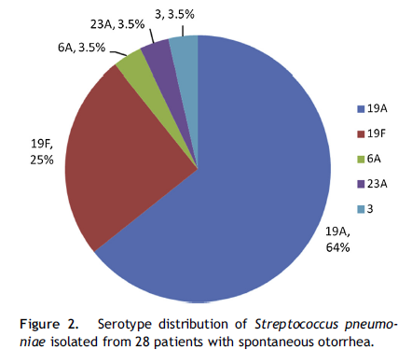
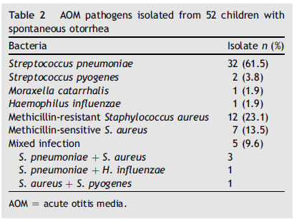
AOM with Otorrhea in
Hospitalized Children
資料來源：Chen YJ, et al. JMII 2013; 46(5): 382-8

Slide 41
4. Why 19A has been emerging?

Slide 42
Pneumococcal Conjugate Vaccine (PCV) Efficacy Against Antibiotic-Resistant Pneumococcus
Most Pen-R, Macrolide-R, Multidrug-R Is
Found in 6 Serotypes
6B, 9V, 14, 19F, 23F,
19A*
* Only includes in the PCV-13

Slide 43
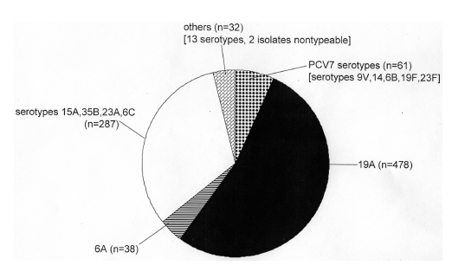
Year 2007 Distribution of 898
Penicillin-non-susceptible IPD Isolates
(of 3,511 total isolates) Recovered through Active Bacterial Core Surveillance
15A (11%),
23A (8%),
35B (8%),
6C (5%)
32%
資料來源：Gertz R et al The Journal of Infectious Diseases 2010; 201: 770–775

Slide 44
In Vitro Susceptibility of
Serotype 19A ST320 in Taiwan
Antimicrobial Agent |  | MIC (µg/ml) |  |  | % of isolates
 | range | 50% | 90% | susceptible | intermediate | resistant
Penicillin | 2-8 | 4 | 4 | 21 | 73.7 | 5.3
Rifampin | 0.06-0.25 | 0.06 | 0.125 | 100 | 0 | 0
Amoxillin | 4-8 | 4 | 8 | 0 | 63.2 | 36.8
Cefotaxime | 1-4 | 2 | 4 | 5.3 | 73.7 | 21
Levofloxacin | 1 | 1 | 1 | 100 | 0 | 0
Meropenem | 0.5-1 | 1 | 1 | 0 | 21.1 | 78.9
Vancomycin | 0.25-0.5 | 0.5 | 0.5 | 100 | 0 | 0

Slide 45
Single Clonal Expansion of
S. pneumoniae Serotype 19A in Korean Children Before PCV7 Introduction
All 19A isolates were MDR
All isolates from 2001 exhibited Sequence Type (ST) 320
% of all IPD in children < 5 yrs
A dramatic increase in rates of IPD
caused by antibiotic-resistant
serotype 19A after 1995
Before the launch of PCV7 in 2006
Year
資料來源：Choi EH et al. EID 2008
Notes:
45
But, in korea, they found a dramatic increase of IPD caused by serotype 19A before the launch of PCV7 in 2006.

Slide 46
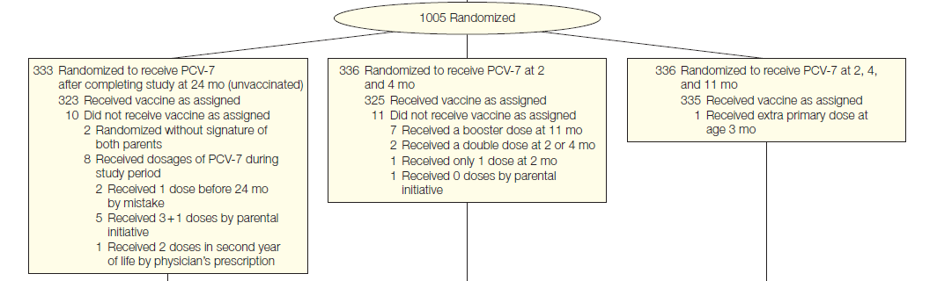
Pneumococcal Conjugate Vaccination and Nasopharyngeal Acquisition of
Pneumococcal Serotype 19A Strains
資料來源：JAMA 2010; 304: 1099-106
Notes:
CONTEXT:
The rapid increase in multiresistant serotype 19A as a cause of invasive and respiratory pneumococcal disease has been associated in time with the widespread implementation of 7-valent pneumococcal conjugate vaccination (PCV-7) in several countries. Because spontaneous fluctuations in time and antibiotic selective pressure may have induced this serotype 19A increase, controlled studies are needed to assess the role of PCV-7.
OBJECTIVE:
To examine the association of PCV-7 vaccination and nasopharyngeal acquisition of serotype 19A pneumococci, their clonal distribution, and antibiotic susceptibility.
DESIGN, SETTING, AND PATIENTS:
Post hoc per-protocol completer's analysis as part of a randomized controlled trial of nasopharyngeal Streptococcus pneumoniae carriage enrolling 1003 healthy newborns with follow-up to the age of 24 months in The Netherlands, which has low antibiotic resistance rates. The study was conducted before widespread PCV-7 implementation in infants, between July 7, 2005, and February 14, 2008. Nasopharyngeal swabs were obtained at the age of 6 weeks and at 6, 12, 18, and 24 months.
INTERVENTION:
Infants were randomly assigned to receive 2 doses of PCV-7 at 2 and 4 months; 2 + 1 doses of PCV-7 at 2, 4, and 11 months; or no dosage (unvaccinated control group).
MAIN OUTCOME MEASURE:
Cumulative proportion of children with nasopharyngeal acquisition of a new serotype 19A strain from 6 through 24 months of age.
RESULTS:
Nine hundred forty-eight children completed the study. Fifty-four nasopharyngeal serotype 19A carriage isolates from 318 in the 2-dose group, 66 isolates from 327 in the 2 + 1-dose group, and 33 isolates from 303 in the unvaccinated were collected from 6 weeks through 24 months. The cumulative proportion who tested positive for new nasopharyngeal serotype 19A acquisition from 6 through 24 months of age was significantly higher in those having received the 2 + 1-dose PCV-7 schedule (16.2%; 95% confidence interval [CI], 12.6%-20.6%) vs those who were unvaccinated (9.2%; 95% CI, 6.5%-13.0%; relative risk [RR], 1.75; 95% CI, 1.14-2.70) but not after a 2-dose schedule (13.2%; 95% CI, 9.9%-17.4%; RR, 1.43; 95% CI, 0.91-2.25). There were 28 different sequence types identified, including 6 new types. The proportion of children with new 19A acquisition who had used antibiotics in the last 6 months (18.7%) did not differ among groups. Five isolates were penicillin-intermediate susceptible and another 3 were nonsusceptible to erythromycin and azithromycin, all in the vaccine groups.
CONCLUSION:
A 2 + 1-dose PCV-7 schedule was associated with an increase in serotype 19A nasopharyngeal acquisition compared with unvaccinated controls.

Slide 47
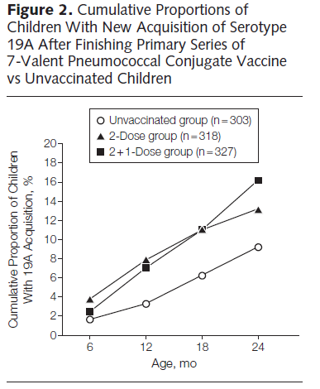
*
資料來源：JAMA 2010; 304: 1099-106.
Notes:
CONTEXT:
The rapid increase in multiresistant serotype 19A as a cause of invasive and respiratory pneumococcal disease has been associated in time with the widespread implementation of 7-valent pneumococcal conjugate vaccination (PCV-7) in several countries. Because spontaneous fluctuations in time and antibiotic selective pressure may have induced this serotype 19A increase, controlled studies are needed to assess the role of PCV-7.
OBJECTIVE:
To examine the association of PCV-7 vaccination and nasopharyngeal acquisition of serotype 19A pneumococci, their clonal distribution, and antibiotic susceptibility.
DESIGN, SETTING, AND PATIENTS:
Post hoc per-protocol completer's analysis as part of a randomized controlled trial of nasopharyngeal Streptococcus pneumoniae carriage enrolling 1003 healthy newborns with follow-up to the age of 24 months in The Netherlands, which has low antibiotic resistance rates. The study was conducted before widespread PCV-7 implementation in infants, between July 7, 2005, and February 14, 2008. Nasopharyngeal swabs were obtained at the age of 6 weeks and at 6, 12, 18, and 24 months.
INTERVENTION:
Infants were randomly assigned to receive 2 doses of PCV-7 at 2 and 4 months; 2 + 1 doses of PCV-7 at 2, 4, and 11 months; or no dosage (unvaccinated control group).
MAIN OUTCOME MEASURE:
Cumulative proportion of children with nasopharyngeal acquisition of a new serotype 19A strain from 6 through 24 months of age.
RESULTS:
Nine hundred forty-eight children completed the study. Fifty-four nasopharyngeal serotype 19A carriage isolates from 318 in the 2-dose group, 66 isolates from 327 in the 2 + 1-dose group, and 33 isolates from 303 in the unvaccinated were collected from 6 weeks through 24 months. The cumulative proportion who tested positive for new nasopharyngeal serotype 19A acquisition from 6 through 24 months of age was significantly higher in those having received the 2 + 1-dose PCV-7 schedule (16.2%; 95% confidence interval [CI], 12.6%-20.6%) vs those who were unvaccinated (9.2%; 95% CI, 6.5%-13.0%; relative risk [RR], 1.75; 95% CI, 1.14-2.70) but not after a 2-dose schedule (13.2%; 95% CI, 9.9%-17.4%; RR, 1.43; 95% CI, 0.91-2.25). There were 28 different sequence types identified, including 6 new types. The proportion of children with new 19A acquisition who had used antibiotics in the last 6 months (18.7%) did not differ among groups. Five isolates were penicillin-intermediate susceptible and another 3 were nonsusceptible to erythromycin and azithromycin, all in the vaccine groups.
CONCLUSION:
A 2 + 1-dose PCV-7 schedule was associated with an increase in serotype 19A nasopharyngeal acquisition compared with unvaccinated controls.

Slide 48
Why Serotype 19A is so Important in the Post-PCV7 era?
Prevalent in nasopharyngeal carriage before the immunization, and even more common after the wide use of PCV7
Virulent - causing both IPD and mucosal infections
Frequently antibiotic-resistant and multidrug-resistant (multitude of R and MDR clones – the serotype is well adapted to resistance)
Not cross-affected by PCV7 (containing 19F)

Slide 49
Antibiotic use
⇧ Incidence of
R-disease
⇧ Carriage of serotypes
bearing Macro-R, Pen-R, MDR
⇧ Transmission of serotypes
bearing Macro-R, Pen-R, MDR
⇧ Disease by serotypes
bearing Macro-R, Pen-R, MDR
Serotypes that will show the greatest effect are those bearing the unique combination of 3 important characteristics
Pre-existing high prevalence
High disease potential
Frequently antibiotic-R and MDR
frequent antibiotic use
⇧ detection of R-disease
drug-S serotypes cure
drug-R
serotypes  cure
Cultures
positivity rate

Slide 50
5. 2nd Generation PCV for 19A

Slide 51
Next Generation PCV
PCV10 (Synflorix)
plus 1, 5, 7F
PCV13 (Prevenar13)
plus 1, 3, 5, 6A, 7F, 19A

Slide 52
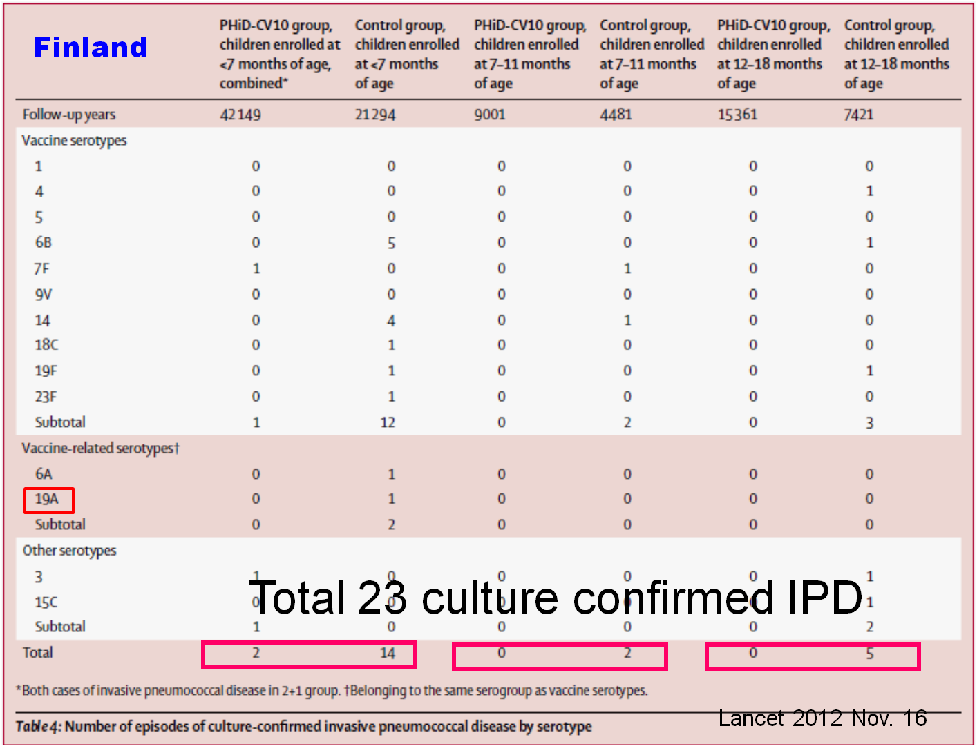

Slide 53
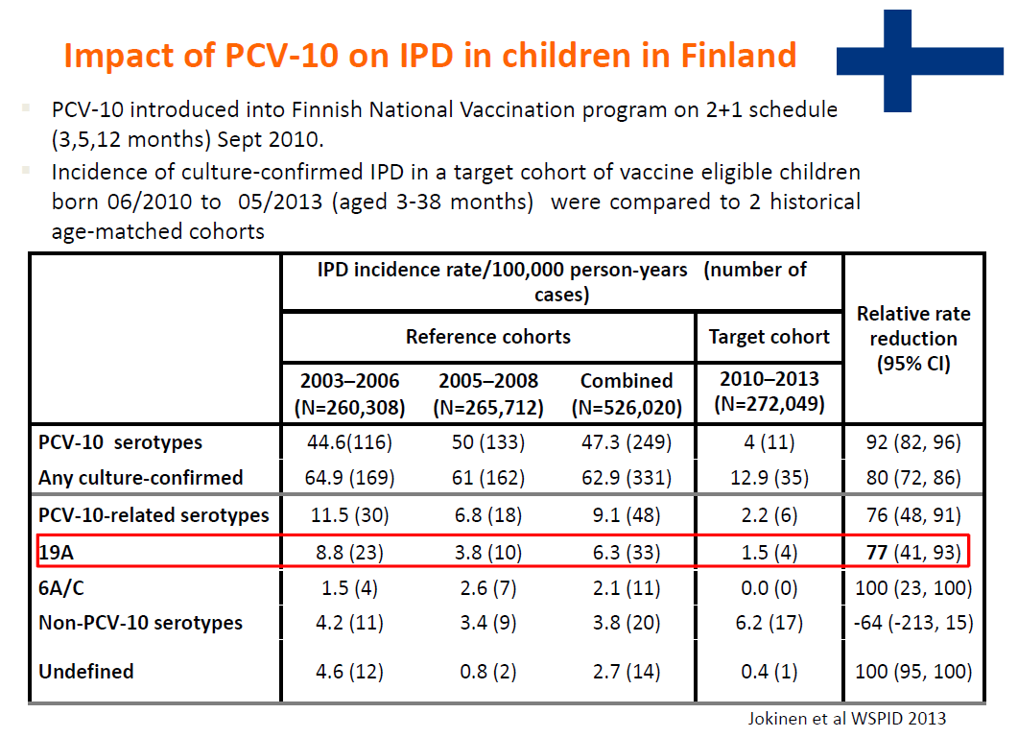

Slide 54
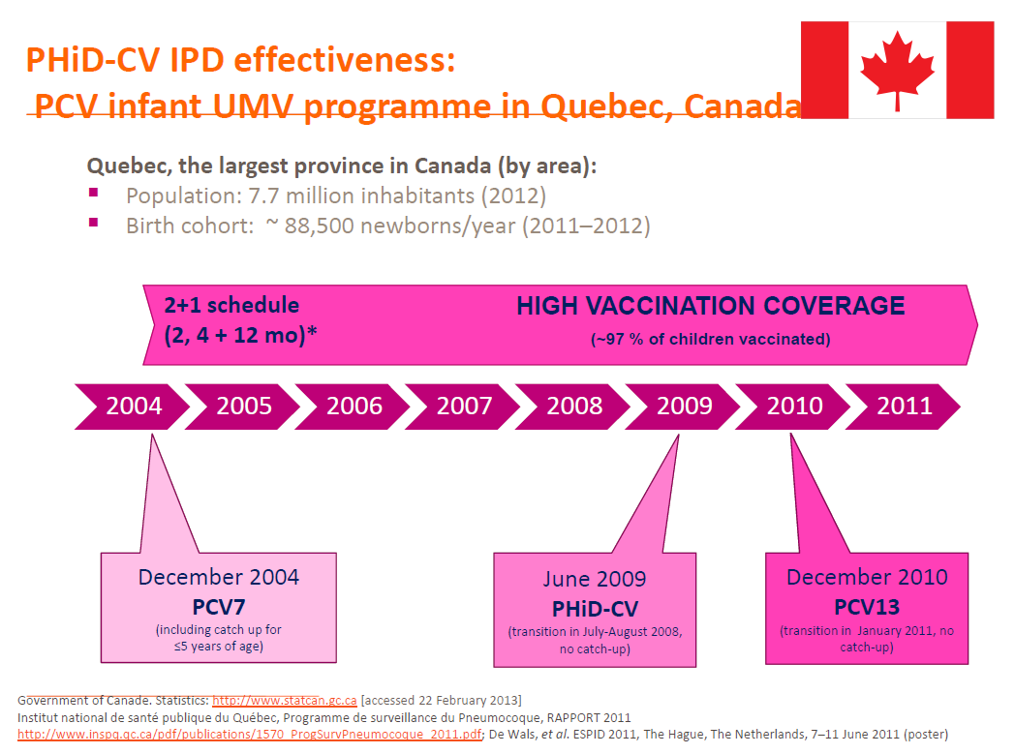

Slide 55
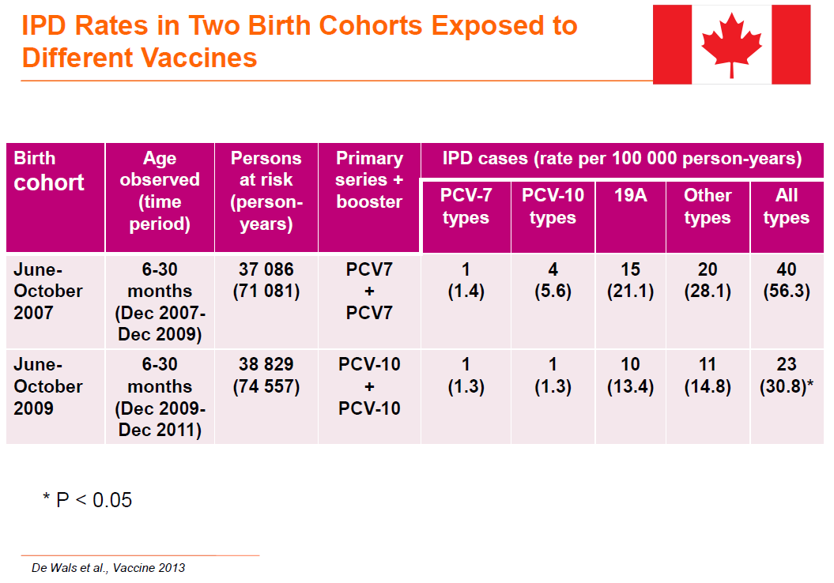

Slide 56
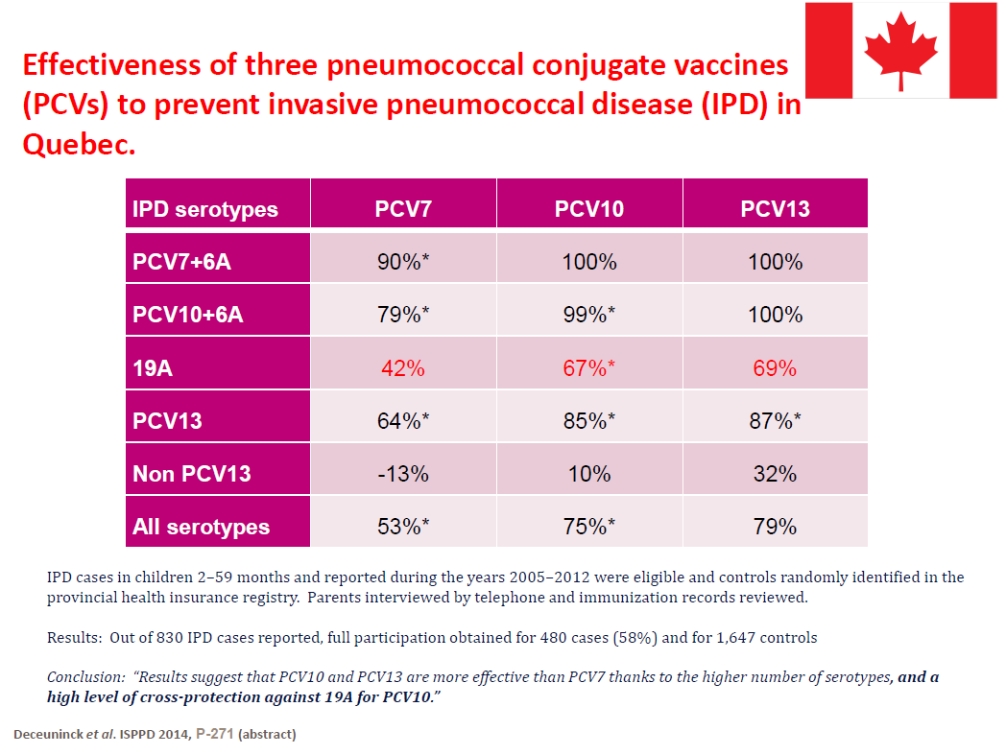

Slide 57

Summary of
Transition to PCV13
Transition from PCV7 to PCV13 can occur at any point in the vaccination schedule.
  For children aged 7 months to 5 years of age, age appropriate catch-up immunization schedules result
  in antibody levels comparable to those of a 3-dose
  primary series.
PCV13 provides coverage of 6 additional serotypes in children previously vaccinated with PCV7.
Notes:
Key Points
Since the introduction of Prevenar, the remaining disease burden in children aged 2-5 years is largely due to serotypes not included in Prevenar. Thus, there is rationale for offering expanded-valency coverage in this population through Prevenar 13 vaccination.¹
Clinical trial data indicate that a single dose of Prevenar 13 is immunogenic, which could facilitate transition from Prevenar to Prevenar 13.^{2,3}
References
Centers for Disease Control and Prevention. Invasive pneumococcal disease in children 5 years after conjugate vaccine introduction—eight states, 1998--2005. Morb Mortal Wkly Rep. 2008;57:144-148.
Prevenar 13. Summary of Product Characteristics. Wyeth Pharmaceuticals.
Data on file, Pfizer Inc.

Slide 58
Transition from
PCV7 to PCV13
Recommended transition schedule from 7-valent pneumococcal conjugate vaccine (PCV7) to 13-valent vaccine (PCV13) vaccination among infants and children, according to number of previous PCV7 doses received —
Advisory Committee on Immunization Practices (ACIP), US, 2010
Infant series Booster dose Supplemental PCV13 dose
2 mos 4 mos 6 mos ≥12 mos* 14–59 mos**
PCV7 PCV13 PCV13 PCV13 —
PCV7 PCV7 PCV13 PCV13 —
PCV7 PCV7 PCV7 PCV13 —
PCV7 PCV7 PCV7 PCV7 PCV13
資料來源：US ACIP Recommendations

Slide 59
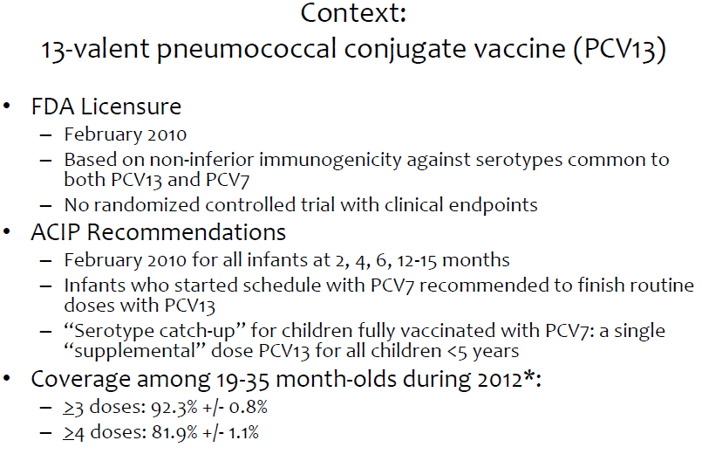
資料來源：US CDC

Slide 60
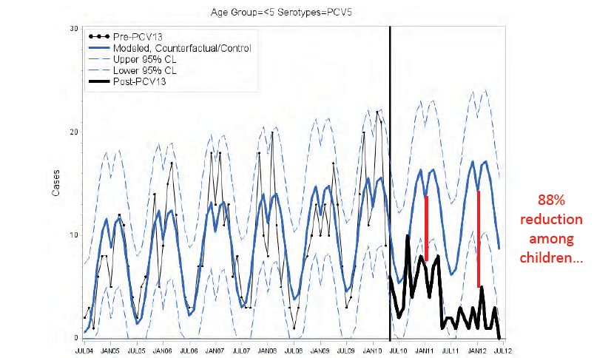
Observed vs. Expected Cases of
PCV5-type IPD among Children<5
Years old, July 2004-June 2012
資料來源：US CDC

Slide 61
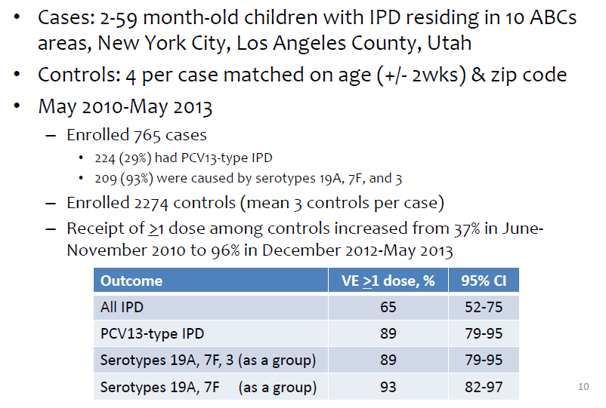
Case-Control Study of PCV13
Effectiveness: Preliminary Estimates
資料來源：US CDC

Slide 62
課程結束

