Slide 1
百日咳鑑別診斷、預防、
治療與醫院感染管制
主講人：李秉穎醫師
台大醫院小兒部

Slide 2
Bordetella Species
Gram-negative coccobacilli
Bordetella spp.
  B. pertussis：感染人類，引起典型百日咳。
  B. parapertussis：感染人類，引起副百日咳，症狀比
  典型的百日咳稍輕，DNA序列與B. pertussis很類似。
  B. bronchiseptica：主要感染其他動物，偶而感染人類。
  B. avium：只感染其他動物。

Slide 3
百日咳流行病學
未接種疫苗：每三至五年大流行一次。
全面接種疫苗：發生率減少，成人病例增加。
性別：女性之感染率與發病嚴重度較高。
無其他動物宿主，為人與人之間的傳染。
沒有抗體的個人發病率：90%
傳染途徑：飛沫傳染
某診所醫師：”現在是什麼時代了……”

Slide 4
台灣地區百日咳確定病例數
台灣疾病管制署，1993-2012
病例數

Slide 5

依年齡別之百日咳確定病例數
1993-2004
%病例
年齡
資料來源：李佳琳. 疫情報導 2006; 22:682

Slide 6
百日咳確定病例之月份分佈
1993-2004
病例數
資料來源：李佳琳. 疫情報導 2006; 22:682
Notes:
Hemophilus influenzae type b infection common in children younger than 3 to 5 years. It may cause severe diseases, including meningitis, sepsis, arthritis and some respiratory tract infections. The vaccine is conjugated to some carrier protein to improve our immune response to the polysaccharide antigen of Hib. The adverse reaction and contraindication are similar to other inactivated vaccines.

Slide 7
百日咳－臨床表徵
Pertussis：violent cough；百日咳：咳嗽很久。
潛伏期：6-20天，平均7天。
臨床分期：病程平均持續6-8星期，大多沒有明顯
發燒。
  黏膜炎期(catarrhal stage)：1-2星期，流鼻水、輕微咳嗽、輕度發燒、結膜炎。
  陣咳期(paroxysmal stage)：2-4星期，典型咳嗽。
  恢復期(convalescence stage)：1-2星期，可能咳嗽數月。

Slide 8
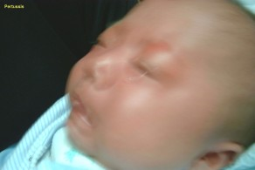
百日咳－典型咳嗽
陣發性：不發作的時候完全正常，
發作時連續5聲以上劇咳。
臉部漲紅，甚至發紺。
窒息感：嬰兒可以窒息(apnea)為表現。
咳後嘔吐，偶而咳出膿痰。
Whoop：不常見。
晚上比較容易發作。
誘發因素：壓舌檢查、打哈欠、打噴嚏、吃東西、喝水、運動、噪音等刺激。
影像來源：台大兒童醫院小兒部 李秉穎醫師

Slide 9
百日咳－其他臨床表現
身體檢查：
  呼吸音正常，但是嬰兒可有氣管炎或肺炎的呼吸音表現。
  臉部與結膜下出血。
胸部X光正常。
實驗室檢查：白血球計數增加與淋巴球增多。
恢復期：咳嗽慢慢減輕，在一年之內的其他呼吸道感染都可能誘發類似的陣咳症狀。

Slide 10
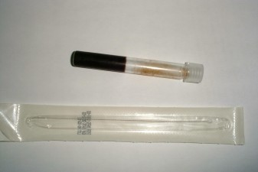
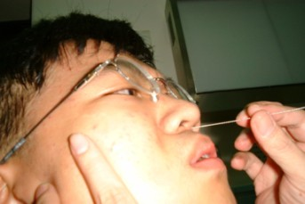
百日咳－實驗室診斷
鼻咽部細菌培養：gold standard
  需要特殊培養基
血清抗體：IgA, IgM, IgG (ELISA)
聚合酶鏈反應(polymerase chain reaction)：敏感度最高
影像來源：台大兒童醫院小兒部 李秉穎醫師

Slide 11
百日咳－細菌培養
鼻咽部細菌培養：gold standard
  鼻咽部採檢的菌量較多，敏感性較高。
  咳碟(cough plate)：目前認為不需要。
  需要特殊培養基
    Bordet-Gengou medium: starch-blood-agar.
    Synthetic medium: buffers, minerals, amino acids, growth factors.
    Enhanced by starch, beta-methyl cyclodextrin.

Slide 12
1月12天男嬰長期咳嗽(1/3)
咳嗽24天
  羅東某醫院住院，診斷：肺炎。
  痙攣性咳嗽(spasmodic cough)
    發紺(+)
    臉部漲紅(+)
  流鼻水(+)、發燒(-)
呼吸音：喘鳴(stridor；有輕微軟喉症)

Slide 13
1月12天男嬰長期咳嗽(2/3)
群聚史
痙攣性咳嗽2個月
□
大伯母：
痙攣性咳嗽(+)
□
咳嗽一週

Slide 14
1月12天男嬰長期咳嗽(3/3)
血液檢查：Hb 11.2, platelet 565 X 103, WBC 9750, lymphocyte 68%
Pertussis IgM & IgA: negative
鼻咽部採檢：Bordetella pertussis(+)
Azithromycin治療2週後，咳嗽持續。
  發紺、臉部漲紅改善。
  晚上咳嗽較明顯。

Slide 15
類百日咳疾病Pertussis-like illness
3月女嬰(1/2)
1個多月大開始咳嗽
2006.6.14：發燒3天
咳嗽併發紺、咳後嘔吐、whoop(?)
父親慢性咳嗽3月，為菸癮者。
2006.6.28住院
  WBC 17140, seg 20%, lym 67%, mono 13%,
  CRP 0.01

Slide 16
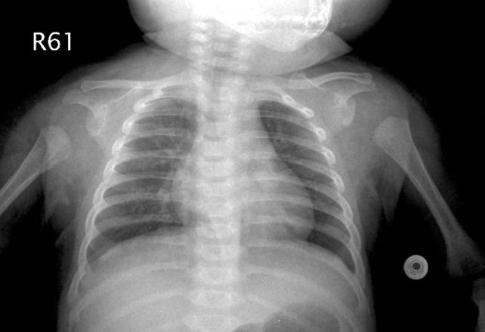
類百日咳疾病Pertussis-like illness
3月女嬰(2/2)
呼吸細胞融合病毒(respiratory syncytial virus)抗原(+)
影像來源：台大兒童醫院小兒部 李秉穎醫師

Slide 17
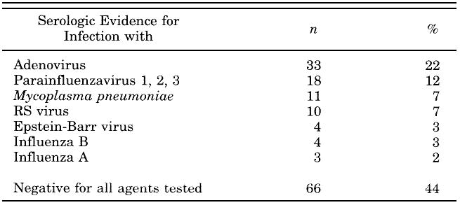
類百日咳疾病Pertussis-like illness
多種病原，德國
149咳嗽> 7天兒童，無百日咳桿菌感染證據。
資料來源：Wirsing von König CH. Pediatr Infect Dis J 1998; 17:645

Slide 18
類百日咳疾病的非典型病原
瑞典百日咳疫苗研究，1992-5
咳嗽 持續時間 痙攣性咳嗽
> 7 days 中位值 ≥ 21天
病例數 155
病原陽性 115
B. pertussis 56% 51 days 82%
B. parapertussis 2% 38%
M. pneumoniae 26% 23 days 26%
C. pneumoniae 17% 26 days 38%
資料來源：Hallander HO. Scand J Infect Dis 1999; 31:281

Slide 19
Pertussis-like syndrome
C. pneumoniae; Japan, 1994
Epidemic of a pertussis-like illness in a junior high school
136 students with severe cough
  Pneumonia 1, bronchitis 9, URI 126
Mean duration of cough: URI 17.4 days, pneumonia 30 days
C. pneumoniae (serology or PCR): 40/46
(87%) (+)
資料來源：Hagiwara K. Pediatr Infect Dis J 1999; 18:271

Slide 20
Pertussis-like syndrome
C. trachomatis?¹
C. trachomatis pneumonia: 10–20% of infants born to women with infection.
Onset: usually between 1 and 3 mo
S/S:
  Persistent cough, tachypnea, occasional räles
  No fever, wheezing uncommon
  Staccato coughing that interfere with sleeping and eating are sometimes present.²
Pertussis-like coughing^{3,4}
資料來源：¹Nelson Textbook of Pediatrics, 17th ed, 2004
²Mandell Principles and Practice of Infectious Diseases, 6th ed, 2005
³Della Santa L. Minerva Pediatrica 1994; 46:201
⁴Garty B. Harefuah 1981; 100:324

Slide 21
Chlamydia trachomatis pneumonia
馬偕醫院, 2005; N=30, Age: 10天– 5月
Eosinophil ≥ 400/mm³
% 發生率
資料來源：姜義祺. 台兒醫誌 2005; 46:284

Slide 22
百日咳：併發症^{1,2}
Incidence: 5-6%
Mostly < 6 mo
  Bronchopneumonia: 5% most common
  Encephalopathy: 1/100,000; convulsion, IICP
    Severe coughing? pertussis toxin?
  Cerebral hemorrhage: venous congestion and increased pressure during cough
Mortality
  Developed countries: < 1/1000
  Developing countries: 4% in infants, 1% in children
  1-4 yrs
資料來源：¹Anonymous. Wkly Epidemiol Rec 2005; 80(4):29
²Mandell Principles and Practice of Infectious Diseases, 6th ed, 2005

Slide 23
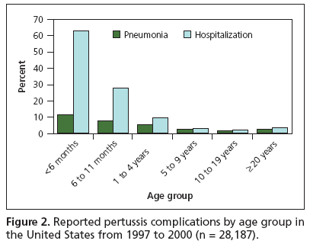
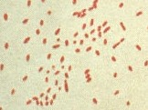
百日咳
肺炎併發症、住院與年齡
資料來源：Gregory DS. Am Fam Physician 2006; 74:420 (CDC data)

Slide 24
百日咳：標準治療
Erythromycin: esp. estolate 40 to 50 mg/kg/day, qid, 14 days.
  Infantile hypertrophic pyloric stenosis: ⬆ 7-10 folds in infants <6 wk of age.
可減輕症狀、縮短病程，避免傳染他人。
在潛伏期與catarrhal初期有效，陣發期(paroxysmal stage)無法改變病程。
  With data on both sides, there continues to be debate about the ability of erythromycin treatment to reduce severity and duration of disease, even when it is started during the paroxysmal phase.*
資料來源：*Mandell Principles and Practice of Infectious Diseases, 6th ed, 2005

Slide 25
Efficiency when treatment started at paroxysmal phase
Controversial results have been reported about its efficiency when treatment was started during the paroxysmal phase.
One German study reported a decrease of coughing intensity, whereas other studies found no effect.
Although expert opinion on this point is somewhat divided because of lack of clinical data, the Red Book summarizes that……
資料來源：Wirsing von König CH. Pediatr Infect Dis J 2005; 24:S66

Slide 26
百日咳
Alternative therapy
New macrolide antibiotics:
  Erythromycin estolate 40 mg/kg/day qid, 7 days
  Clarithromycin 15–20 mg/kg/day bid, 7 days
  Azithromycin 10-12 mg/kg/day qd, 5 days（1月以下優先使用，QT間隔延長者小心使用）
Trimethoprim-sulfamethoxazole: alternative

Slide 27
百日咳
Symptomatic treatment
Steroid:
  May reduce the number, severity, and duration of cough paroxysms, but should be limited to infants with life-threatening pertussis (systemic).¹
  Not recommended.^{2,3}
  Inhaled steroid: case report.
Salbutamol: β2-adrenergic agonist
  Conflicting data about its efficacy.¹
  Not recommended.^{2,3}
Cough suppressants, antihistamines: not effective.¹⁻³
Pertussis immune globulin, specifically those preparations containing anti-PT antibodies, may be useful.¹⁻³
  Nonspecific IG: not useful.
資料來源：¹Mandell Principles and Practice of Infectious Diseases, 6th ed, 2005
²Rillay V. Cochrane Database Syst Rev 2003; (4):CD003257
³Nelson Textbook of Pediatrics, 17th ed, 2004

Slide 28
百日咳
Supportive therapy
Infants whose paroxysms repeatedly lead to life-threatening events despite passive delivery of oxygen or whose fatigue leads to hypercarbia require intubation, paralysis, and ventilation.
The benefit of a quiet, dimly lighted, undisturbed, comforting environment cannot be overestimated or forfeited in a desire to monitor and intervene.
資料來源：Nelson Textbook of Pediatrics, 17th ed, 2004

Slide 29
百日咳院內感染的分子生物學調查
2002年12月7日有一名3個月大的男嬰，因急遽咳
嗽合併發紺而入院，經診斷為疑似百日咳個案，
給予紅黴素治療。
另一4個月大的女嬰在91年12月6日因蜂窩性組織
炎住院治療。
  12月12日出院後，自同月31日起持續嚴重咳嗽3個禮拜。
  陪同照顧的母親也有陣發性咳嗽的表現。
  微生物學檢驗從男嬰母親與伯母及女嬰分離出百日咳
  桿菌。
  菌株之脈衝式電泳分子分型：三者的百日咳菌株基因
  圖譜相同，推測此為一起院內感染事件。
資料來源：洪國禎等. 感控雜誌2004; 14:223 (中國醫藥大學)

Slide 30
百日咳的感染管制
Standard precaution
Hand hygiene：接觸血液、體液、分泌物、滲出物、受污染器物之後；脫掉手套後、接觸病人之間。
Personal protective equipment
  Gloves：接觸血液、體液、分泌物、滲出物、受污染器物；接觸黏膜與受損皮膚。
  Gown：衣服或皮膚可能接觸到血液、體液、分泌物、滲出物時。
  Mask、eye protection (goggles)、face shield：可能發生血液、體液、分泌物之潑濺時，尤其抽吸、氣管插管。
資料來源：CDC. Guideline for isolation precautions 2007

Slide 31
百日咳的感染管制
Droplet precaution
避免直接或間接接觸傳染、飛沫傳染
病人
  最好住單人房
  多人病房：病房間隔至少三碼
Droplet precaution：醫護人員戴口罩
資料來源：CDC. Guideline for isolation precautions 2007

Slide 32
百日咳
Chemoprophylaxis
所有家中的親密接觸者都需治療
  Antibiotic (erythromycin or other macrollides) prophylaxis is recommended for prevention of disease in contacts of active cases; although not fully efficacious, this has been shown to be a major factor in controlling household transmission and outbreaks.*
病人隔離：治療後5天，或已經發病3週以上。
資料來源：*Mandell Principles and Practice of Infectious Diseases, 6th ed, 2005

Slide 33
全細胞性百日咳疫苗
Whole-cell pertussis vaccine
非活化之百日咳菌懸浮液
保護效益：三劑以後70-90%
輕度副作用發生率：30-50%
  局部腫痛、發燒、煩燥不安、哭鬧。
嚴重反應：40.5度以上高燒、持續哭鬧3小時以上、低張力與反應狀態、抽搐。

Slide 34
百日咳疫苗與疾病–北歐經驗
百日咳發生率(/100,000)
瑞典：不用DTP
挪威：92%接種率
3劑DTP
資料來源：Gangarosa EJ. Lancet 1998; 351:356
Notes:
Hemophilus influenzae type b infection common in children younger than 3 to 5 years. It may cause severe diseases, including meningitis, sepsis, arthritis and some respiratory tract infections. The vaccine is conjugated to some carrier protein to improve our immune response to the polysaccharide antigen of Hib. The adverse reaction and contraindication are similar to other inactivated vaccines.

Slide 35
百日咳疫苗與疾病–日本經驗
百日咳發生率(/100,000)
1947
DTP開始使用
2名嬰兒注射疫苗後
24小時內死亡，1974
停
用
疫
苗
1981
非細胞性疫苗
資料來源：Gangarosa EJ. Lancet 1998; 351:356
Notes:
Hemophilus influenzae type b infection common in children younger than 3 to 5 years. It may cause severe diseases, including meningitis, sepsis, arthritis and some respiratory tract infections. The vaccine is conjugated to some carrier protein to improve our immune response to the polysaccharide antigen of Hib. The adverse reaction and contraindication are similar to other inactivated vaccines.

Slide 36
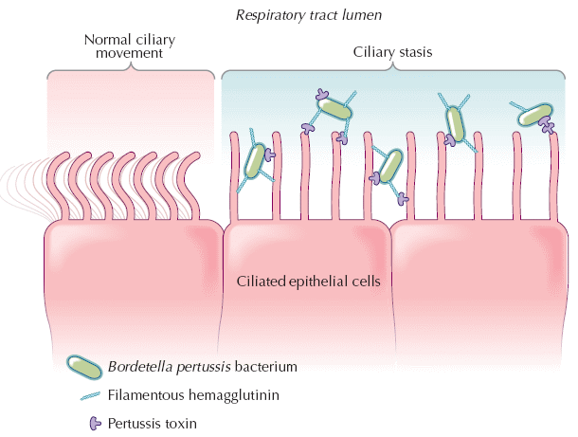
Attachment of Bordetella pertussis
Others: pertactin, fimbriae
資料來源：Tozzi AE, et al. Can Med Assoc J 2005; 172 (4):509.

Slide 37
非細胞性百日咳疫苗
Acellular pertussis vaccine
純化具保護效力之抗原，去除不必要之菌體成份。
含pertussis toxin (PT)、filamentous hemagglutinin (FHA) 等最多5種抗原
  日本化血研：PT、FHA
  GSK: PT、FHA、pertactin
  Sanofi-Aventis: PT、FHA、pertactin、fimbriae type 2 and 3
保護效果
  AAP 2006: 雖然成分不同，但保護效力似乎差不多。
  WHO 2005:¹
    Whole cell與acellular最佳保護效益大約85%
    保護期限：6-12 years (whole cell ≈ acellular ≈ natural infection)
資料來源：¹Anonymous. Wkly Epidemiol Rec 2005; 80(4):29

Slide 38
Duration of pertussis immunity
Natural infection
Overall estimate: 7-20 years
Study site Study year Estimate of protection
U.S. 1902 nearly lifelong
Not applicable 1951 nearly lifelong
Germany 1995 20 years
U.K. 1997 7-10 years
Netherlands 2002 3.5-12 years
資料來源：Wendelboe AM. Pediatr Infect Dis 2005; 24:S58

Slide 39
Duration of pertussis immunity
Whole-cell pertussis vaccine
Overall estimate: 4-12 years
Study site Study year Estimate of protection
U.S. 1965 12 years
U.K. 1988 4 years
U.S. 1993 4-6 years
U.K. 1993 8 years
Denmark 1994 10 years
Finland, Switzerland 1996 5-10 years
U.K. 1999 5-14 years
Australia 2003 6-9 years
資料來源：Wendelboe AM. Pediatr Infect Dis 2005; 24:S58

Slide 40
Duration of pertussis immunity
Acellular pertussis vaccine
Overall estimate: ≤ whole-cell vaccine
Study site Study year Component Estimate of protection
Senegal 1997 4 shorter than wP
Sweden 1999 2 5.5 years
Italy 2001 3 6 years
Germany 2002 4 6 years
資料來源：Wendelboe AM. Pediatr Infect Dis 2005; 24:S58

Slide 41
成人型三合一疫苗 dTpa for adults
台灣預防接種諮詢小組建議於入小學時接種
成分
  d: 減量白喉疫苗
  pa: 減量非細胞性百日咳疫苗
    GSK: pertussis toxin, filamentous hemagglutinin, pertactin
    Sanofi-Aventis: pertussis toxin, filamentous hemagglutinin, pertactin, fimbriae 2 & 3.

Slide 42
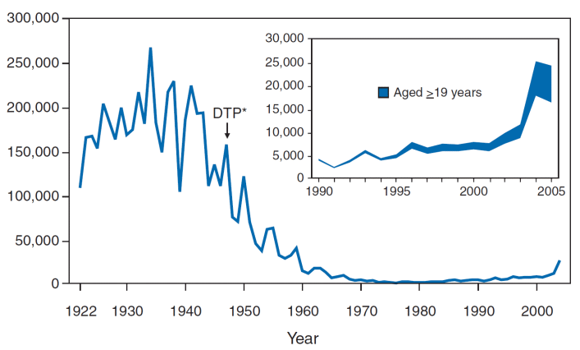
Tdap for adults
2010, ACIP, CDC, USA
2009: 16,858 pertussis cases and 12 infant deaths.
資料來源：ACIP. MMWR 2006; 55:RR-17 ACIP. MMWR 2011; 60(1):13

Slide 43
Routine Tdap vaccination
2010, ACIP, CDC, USA
Close contact of infants < 12 mo
All pregnant women
  Optimal timing: 27 and 36 weeks gestation.
  If not vaccination, give Tdap immediately postpartum.
Health-care personnel
Adults aged 19-64 years
Adults Aged 65 years and older
  Close contact with an infant aged less than 12 months: should receive a single dose of Tdap.
  Other adults ages 65 years and older may be given a single dose of Tdap.
資料來源：¹ACIP. MMWR 2006; 55:RR-17
²ACIP. MMWR 2011; 60(1):13
³ACIP. MMWR 2013; 62(7):131

Slide 44
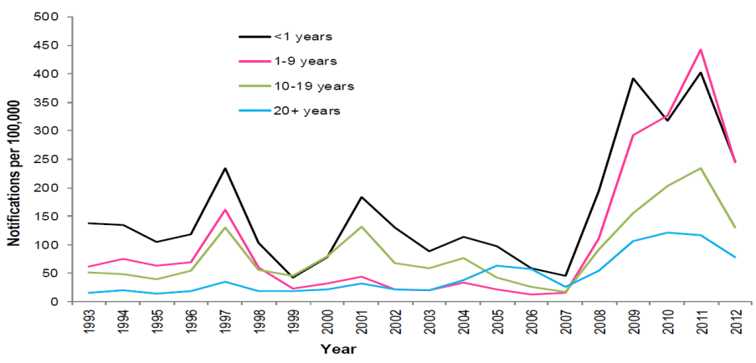
Resurgence of pertussis
Australia
資料來源：http://www.who.int/immunization/sage/meetings/2014/april/presentations_background_docs/en/

Slide 45
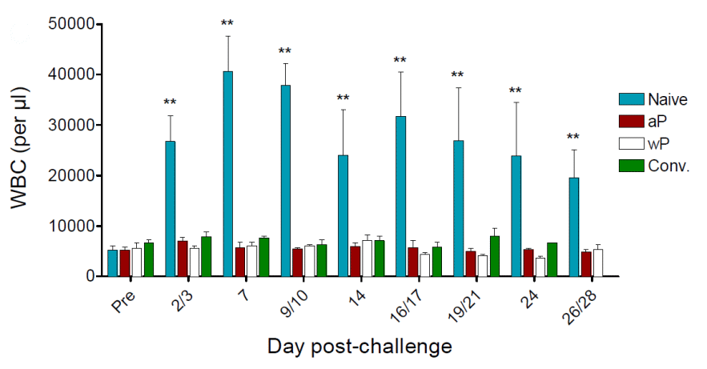
非細胞性百日咳疫苗可預防疾病，
但無法預防感染與傳染Baboon study, 2014, USA(1/5)
全細胞與非細胞疫苗均可預防疾病
（以白血球數代表疾病活力）
資料來源：Warfel JM. PNAS 2014; 111(2):787

Slide 46
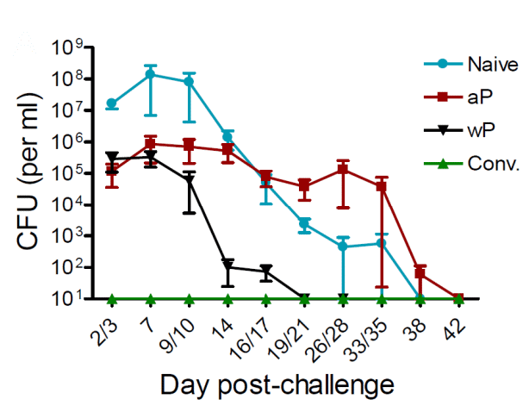
非細胞性百日咳疫苗可預防疾病，
但無法預防感染與傳染Baboon study, 2014, USA(2/5)
非細胞疫苗較慢清除病原
資料來源：Warfel JM. PNAS 2014; 111(2):787

Slide 47
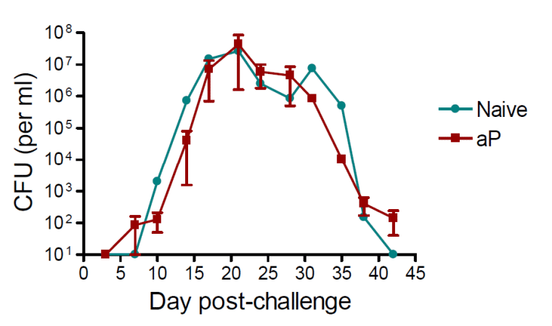
非細胞性百日咳疫苗可預防疾病，
但無法預防感染與傳染Baboon study, 2014, USA(3/5)
非細胞疫苗無法清除移生細菌
資料來源：Warfel JM. PNAS 2014; 111(2):787

Slide 48
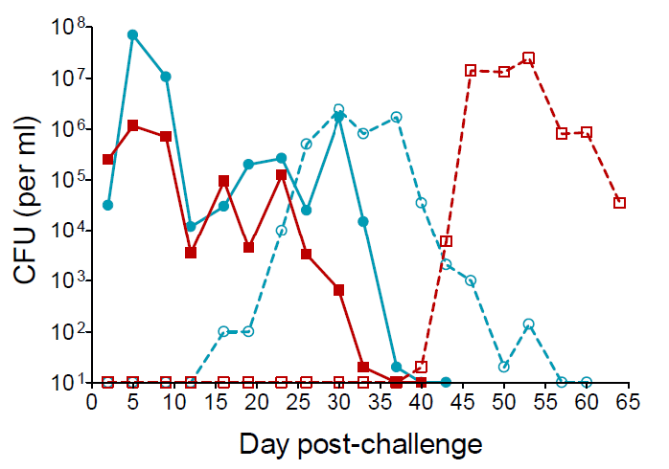
非細胞性百日咳疫苗可預防疾病，
但無法預防感染與傳染Baboon study, 2014, USA(4/5)
非細胞疫苗無法阻止傳染
資料來源：Warfel JM. PNAS 2014; 111(2):787

Slide 49
非細胞性百日咳疫苗可預防疾病，
但無法預防感染與傳染Baboon study, 2014, USA(5/5)
自然感染、全細胞與非細胞百日咳疫苗都可以減少有症狀的疾病
疾病與傳染
  自然感染 > 全細胞疫苗 > 非細胞疫苗
免疫反應
  全細胞疫苗引起Th1與Th17 memory (Th11: bacterial clearance)
  非細胞疫苗引起Th2反應，Th1與Th17反應較弱。
資料來源：Warfel JM. PNAS 2014; 111(2):787

Slide 50
SAGE Meeting on Immunization
WHO, 2014
Licensed aP vaccines have lower initial efficacy, faster waning of immunity, and possibly a reduced impact on transmission.
The use of aP vaccines will result in a resurgence of pertussis after a number of years and this resurgence might also lead to an increased risk of death in those too young to be vaccinated.
The use of aP vaccines should only be considered if large numbers of doses may be included in the national immunization schedules.
資料來源：http://www.who.int/immunization/sage/meetings/2014/april/presentations_background_docs/en/

Slide 51
Pertussis in patients with prolonged cough 台灣
Cough > 1 week: N = 111
Age (years)
1-4 5-9 10-19 ≥20 Total
PT IgG
> 100 EU/ml 0 1 1 3 5
PT IgA
> 20 EU/ml 0 0 1 5 6
PCR 0 0 1 0 1
Culture 0 0 0 0 0
B. pertussis(+): 7% (8/111)
Serology: 33 samples
  Presumed B. pertussis prevalence rate: 21%
資料來源：Hu JJ. J Microbiol Immunol Infect 2006; 39:54

Slide 52
甲國小
1997 台北市
學生：均接種過四劑疫苗，N=33。
  Culture: 1(+)
  IgA: 6(+), IgM: all negative
  PCR: 28(+)
  Cough: 18; spamodic cough: 3
老師：culture (-), PCR(+), spasmodic cough(+)
學生家屬：1/3 culture and PCR(+), no cough
百日咳病例：1  4

Slide 53
乙國小
1997 台北市
學生：N=31，27名接種過四劑疫苗，4名接種三劑。
  Culture(+): 2
  IgA(+): 16, IgM: all negative
  PCR(+): 20
  Cough: 17, spasmodic: 10
老師：N=4, culture(-), PCR(+): 1, IgA(+): 1, spasmodic cough: 1
學生家屬：N=4, culture(+): 1, PCR(+): 3, IgA/IgM: all (-), spasmodic cough: 1
百日咳病例：1  12

Slide 54
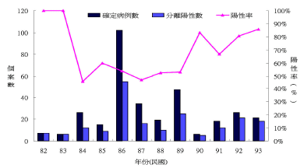
台灣地區百日咳報告與確定病例
1993-2004
資料來源：李佳琳. 疫情報導 2006; 22:682

Slide 55
百日咳
診斷要點
咳嗽很久且呼吸音正常
陣發性連續咳嗽
大多無發燒
群聚史、接觸史
淋巴球增多

Slide 56
百日咳
An underdiagnosed disease
某醫院住院醫師
  無spasmodic cough?
  “Ghost-like appearance”
某醫院感控小組
  內科演講
  No. of cases: 4
    Culture: 1(+)
    IgA: 2(+), IgM: all negative; PCR: 2(+)
    Spasmodic cough: 4
某診所醫師：”現在是什麼時代了…….”

Slide 57

課程結束

