Slide 1
細菌藥物敏感性試驗規範－
聚焦在主要抗藥性菌種
主講人：林進福
臺中榮總病理檢驗部微生物科

Slide 2
課程大綱
1.抗藥性菌株現況
2.抗藥菌株檢測規範
  2-1 MRSA, VISA, VRSA
  2-2 VRE
  2-3 ESBL, CRE
  2-4 XDRPA
  2-5 CRAB, XDRAB
3.總結

Slide 3
1.抗藥性菌株現況

Slide 4
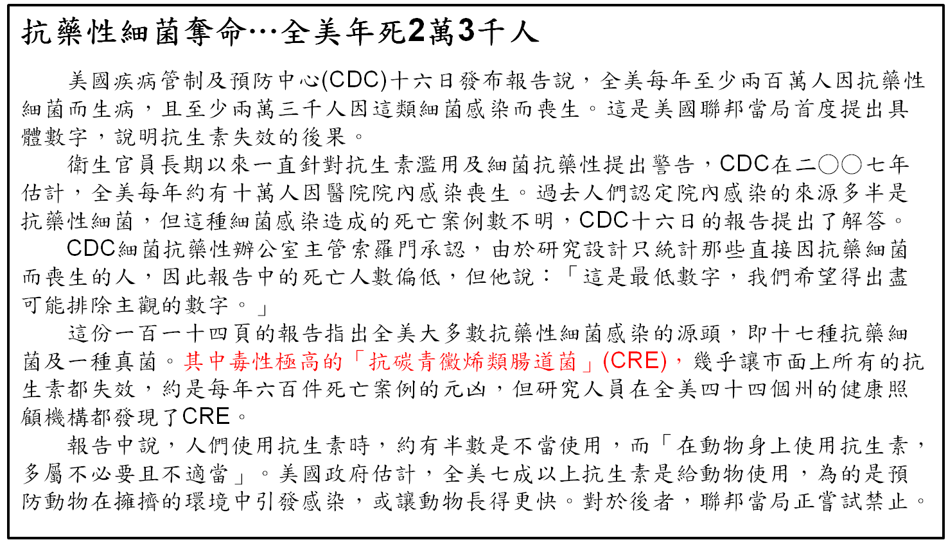

抗藥性細菌奪命…全美年死2萬3千人
美國疾病管制及預防中心(CDC)十六日發布報告說，全美每年至少兩百萬人因抗藥性細菌而生病，且至少兩萬三千人因這類細菌感染而喪生。這是美國聯邦當局首度提出具體數字，說明抗生素失效的後果。
衛生官員長期以來一直針對抗生素濫用及細菌抗藥性提出警告，CDC在二○○七年估計，全美每年約有十萬人因醫院院內感染喪生。過去人們認定院內感染的來源多半是抗藥性細菌，但這種細菌感染造成的死亡案例數不明，CDC十六日的報告提出了解答。
CDC細菌抗藥性辦公室主管索羅門承認，由於研究設計只統計那些直接因抗藥細菌而喪生的人，因此報告中的死亡人數偏低，但他說：「這是最低數字，我們希望得出盡可能排除主觀的數字。」
這份一百一十四頁的報告指出全美大多數抗藥性細菌感染的源頭，即十七種抗藥細菌及一種真菌。其中毒性極高的「抗碳青黴烯類腸道菌」(CRE)，幾乎讓市面上所有的抗生素都失效，約是每年六百件死亡案例的元凶，但研究人員在全美四十四個州的健康照顧機構都發現了CRE。
報告中說，人們使用抗生素時，約有半數是不當使用，而「在動物身上使用抗生素，多屬不必要且不適當」。美國政府估計，全美七成以上抗生素是給動物使用，為的是預防動物在擁擠的環境中引發感染，或讓動物長得更快。對於後者，聯邦當局正嘗試禁止。
資料來源：馮克芸(2013/09/18)。抗藥性細菌奪命…全美年死2萬3千人。聯合報。取自：http://udn.com/NEWS/WORLD/WOR6/8170555.shtml

Slide 5
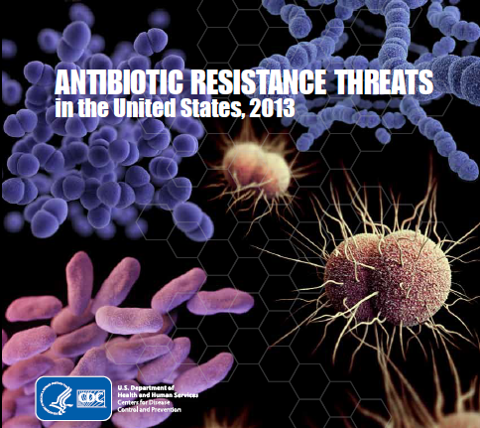
抗藥性細菌的威脅–美國的報告
資料來源：CDC, USA

Slide 6
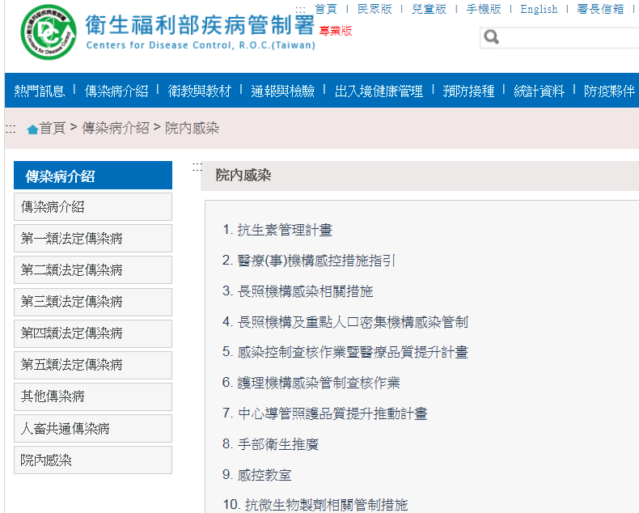
疾病管制署對於抗藥性細菌的策略
資料來源：CDC, Taiwan

Slide 7
Global Resistance Burden
Gram-Positive Bacteria
Methicillin-resistant Staphylococcus aureus (MRSA)
Glycopeptide-intermediate Staphylococcus aureus (GISA) or (VISA)
Vancomycin-resistant Staphylococcus aureus (VRSA)
Penicillin-resistant Streptococcus pneumoniae
Vancomycin-resistant enterococci(VRE)
Macrolide-resistant streptococci
Multidrug-resistant Mycobacterium tuberculosis

Slide 8
Global Resistance Burden
Gram-Negative Bacteria
Ampicillin-resistant Haemophilus influenzae
Extended-spectrum β-lactam-resistant Enterobacteriaceae (ESBL, AmpC, etc)
Carbapenem-resistant Enterobacteriaceae
Ceftazidime-resistant Pseudomonas aeruginosa
Carbapenem-resistant Acinetobacter baumannii
Multidrug-resistant non-typhi Salmonella

Slide 9
Antimicrobial Drug Resistance in Taiwan(1/2)
Community-acquired
Penicillin-resistant S. pneumoniae
MDR and extensively drug-resistant (XDR) P. aeruginosa and A. baumannii
ESBL-producing Klebsiella pneumoniae
Penicillin and fluoroquinolone-resistant Neisseria gonorrhoeae
Azole-resistant Candida species
資料來源：S-S Jean, P-R Hsueh., J Formos Med Assoc. 2011; p.4–13

Slide 10
Antimicrobial Drug Resistance in Taiwan(2/2)
XDR Mycobacterium tuberculosis
Methicillin-resistant Staphylococcus aureus of unique sequence type (ST 59)
Transposon-harboring carbapenemase XDR P. aeruginosa
資料來源：S-S Jean, P-R Hsueh., J Formos Med Assoc. 2011; p.4–13

Slide 11
2.抗藥菌株檢測規範

Slide 12
2-1 MRSA, VISA, VRSA

Slide 13
MRSA, VISA, VRSA
Methicillin-resistant S. aureus (MRSA)
Glycopeptide-intermediate S. aureus (GISA) or (VISA)
Vancomycin-resistant S. aureus (VRSA)

Slide 14
Mechanism of MRSA
Inactivation by β-lactamase enzymes
PBPs with ↓ penicillin-binding capacity
Acquisition of mecA gene: most common
  Encodes a penicillin-binding protein (PBP2a) with decreased affinity for β-lactam antibiotics
  Part of a mobile genetic element : SCCmec (staphylococcal cassette chromosome mec)

Slide 15
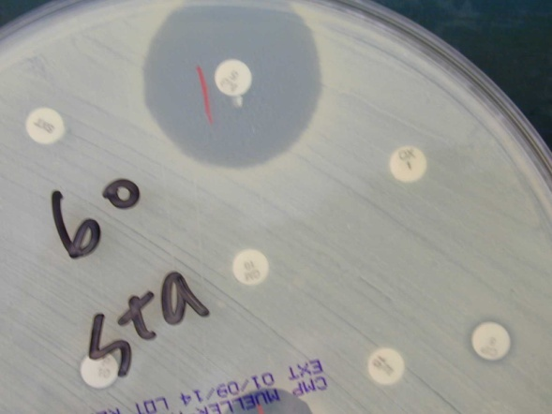
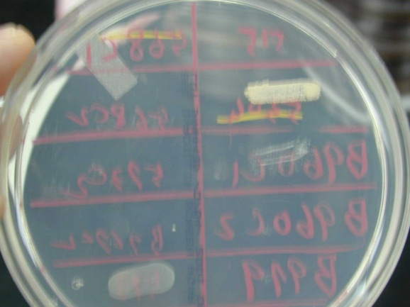
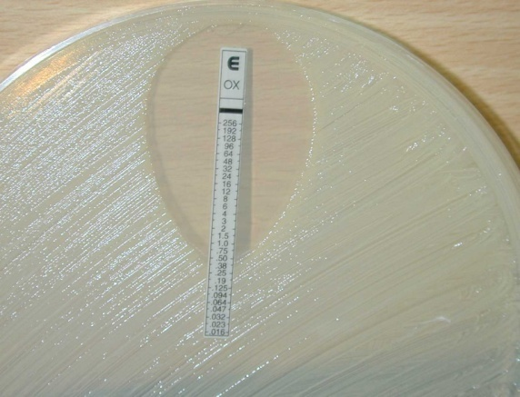
Laboratory Detection for MRSA
Cefoxitin disk screen test
Latex agglutination test for PBP2a
MRSA screening agar (containing 6 μg/mL of oxacillin in M-H agar with 4% NaCl)
MIC method for oxacillin detection
Molecular detection method: mecA gene
資料來源：台中榮民總醫院

Slide 16
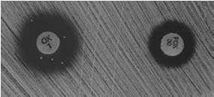
Detection of MRSA in CLSI
Organisms Antimicrobial Agent | Disk Content | Zone Diameter Breakpoints, nearest whole mm |  |  | MIC Interpretive Standard (μg/mL)
 |  | S | I | R | S | I | R
Oxacillin | 30 μg Cefoxitin (surrogate test for oxacillin) | - ≥ 22 | - - | - ≤ 21 | ≤ 2 (oxacillin) ≤ 4 (cefoxitin) | - - | ≥ 16 (oxacillin) ≥ 8 (cefoxitin)
※Eliminate OX disk diffusion test for S. aureus and S. lugdunensis
※OX disk testing is not reliable. For disk testing reporting OX when using FOX as a surrogate test.
FOX detects mecA mediated
MRSA better than OX
資料來源：CLSI M100-S23. Table 2C；CLSI M100-S24. Table 2C

Slide 17
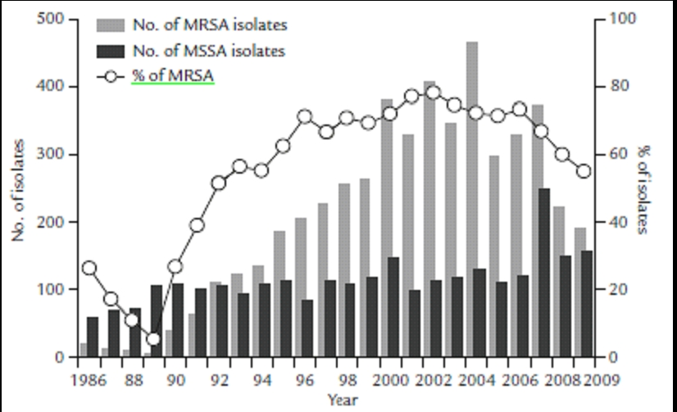
MRSA in NTUH – 1986-2009
資料來源：S-S Jean, P-R Hsueh., J Formos Med Assoc. 2011; p.4–13

Slide 18
Epidemiology of VRSA and VISA
1996
1997
2002
1st report of S. aureus with reduced susceptibility to vancomycin (VISA) from Japan
1st report of hetero-VISA (hVISA) from Japan
1st report of VRSA from US have 13 cases until 2012
Not always confined to MRSA
資料來源：J Antimicrob Chemother 1997; 40:135
Lancet 1997; 350:1670
MMWR 2002; 51:565

Slide 19
Mechanism of Resistance:VRSA
VanA-resistant gene
  Interspecies transfer of vanA transposon from VRE strain
  Cell wall synthesis
    Altered muropeptide (D-ala-D-lactate instead of D-ala-D-ala)
    ↓ Affinity for vancomycin →allow peptidoglycan assembly
資料來源：International Journal of Antimicrobial Agents 2007; 30: 398–408

Slide 20
Breakpoints of S. aureus
Vancomycin | Susceptible |  | Intermediate | Resistant
 | 30 μg disk (mm) | MIC (μg/mL) | MIC (μg/mL) | MIC (μg/mL)
Pre-2006 | ≥ 15 | ≤ 4 | 8-16 | ≥ 32
2006-2008 | ≥ 15 | ≤ 2 | 4-8 | ≥ 16
2009~ | Not applicable | ≤ 2 | 4-8 | ≥ 16
MIC tests should be performed to determine all isolates of staphylococci to VA.
Disk diffusion zone sizes do not correlate with VA MICs for staphylococci.
資料來源：CLSI M100

Slide 21
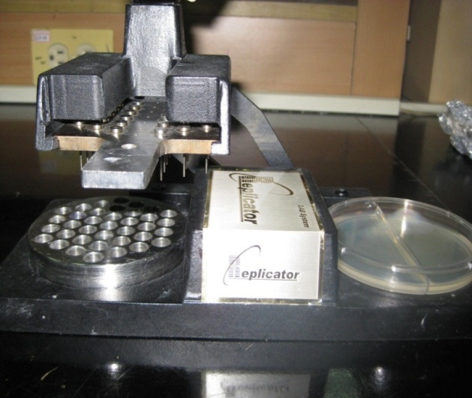
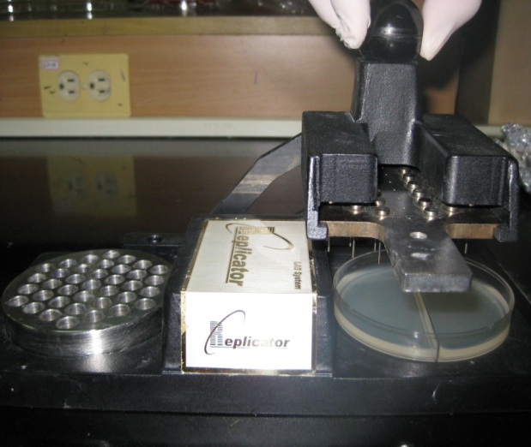
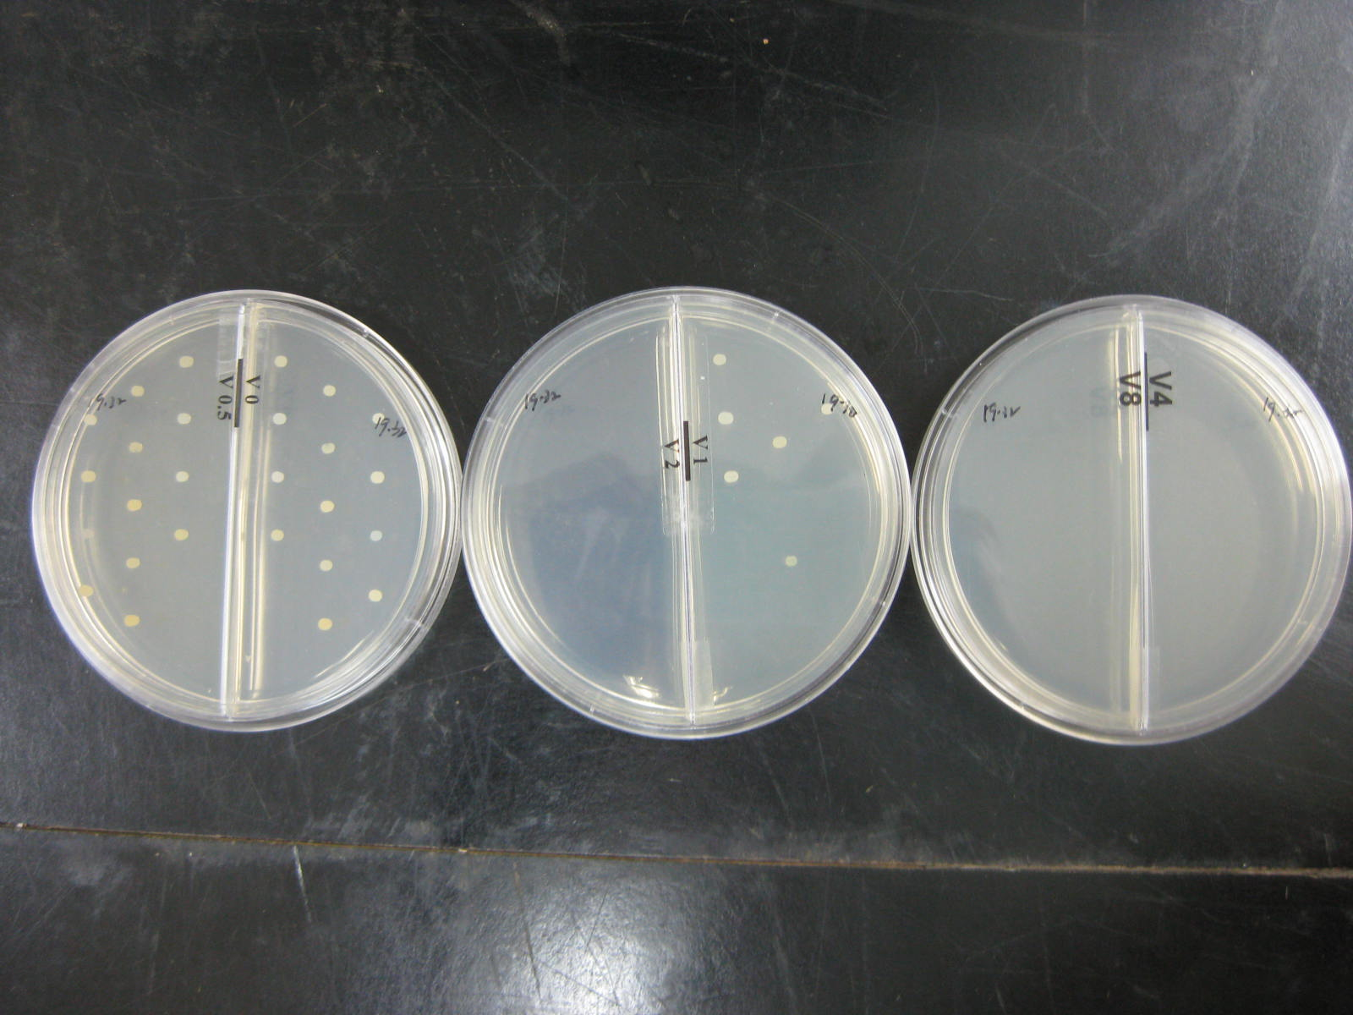
Agar Dilution Method for Vancomycin of S. aureus
資料來源：台中榮民總醫院

Slide 22
2-2 VRE

Slide 23
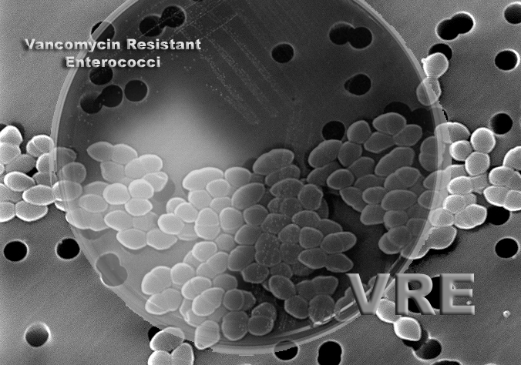
VRE
Vancomycin-resistant enterococci
資料來源：http://www.eod-gear.com/products/vancomycin-resistant-enterococcus-vre-online-training.html

Slide 24
Typical Patterns of Enterococci
E. faecalis
  Usually (S) to AM and P.
  Can acquire (R) to VA, (usually due to vanA or vanB).
  Occasionally produce β-lactamase.
E. faecium
  Often (R) to AM and P.
  Can acquire (R) to VA, (usually due to vanA or vanB).
E. gallinarum and E. casseliflavus
  Intrinsic low level (R) to VA, due to the vanC gene.
E. raffinosus, E. avium and E. durans
  Can acquire (R) to VA, (usually due to vanA or vanB) or, less frequently, the vanD, vanE, or vanG genes.

Slide 25
Mechanism of VRE
Acquired Resistance
  By acquisition of vanA or vanB or less frequently vanD, vanE or vanG genes.
  E. faecium is more likely to be VRE than E. faecalis.
Intrinsic Resistance
  Low-level resistance usually is due to vanC, non-transferable resistance; strains have low pathogenicity. (E. gallinarum or E. casseliflavus)
  Usually is not a concern for infection control.
  Laboratory must differentiate VRE to species.

Slide 26
CLSI Breakpoints
Enterococcus spp. - Vancomycin
Drug | Susc | Int | Res
Vancomycin – MIC (µg/mL) | ≤4 | 8-16 | ≥32
Vancomycin – Disk 30 µg zone (mm) | ≥17 | 15-16 | ≤14
Plates should be held a full 24 hrs, examined using transmitted light; the presence of a haze or any growth within the zone of inhibition indicates resistance.
Organisms with intermediate zones should be tested by an MIC method.
In contrast to other enterococci, E. casseliflavus and E. gallinarum with vancomycin MICs of 8-16 μg/mL (intermediate) differ from VRE for infection control purposes.
資料來源：CLSI M100-S23. Table 2D

Slide 27
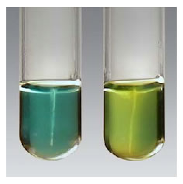
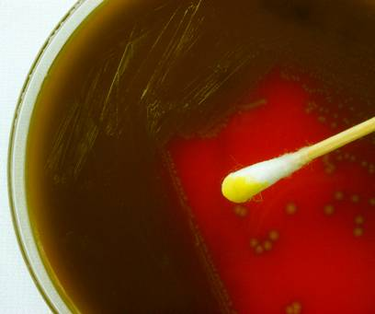
Enterococcus spp.
Species | Genotype | Motility | MGP* | Infx. Cntrl Significance?
E faecalis | vanA or vanB | - | - | yes
E. faecium | vanA or vanB | - | - | yes
E. casseliflavus** | vanC | + | + | no
E. gallinarum | vanC | + | + | no
*Acidification of methyl-a-D-glucopyranoside
**Yellow pigment
Rapid MGP
NEG
POS
資料來源：Clinical Microbiology Procedure Handbook (2010). 3th

Slide 28
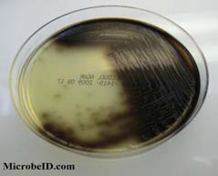
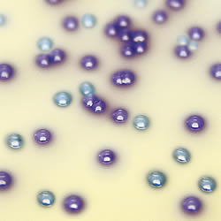
VRE Screening
Screening for patients colonized by VRE provides about potential sources of illness.
Peri-rectal/anal swabs or stool specimens.
If p’t not previously been positive VRE, confirmed by CLSI MIC method.
Screening agar
  Bile esculin azide agar containing 6 µg/mL of vancomycin (BEAV) – to ID species and
  confirmed VA susceptibility test.
  CHROMagar – confirm as Enterococcus spp.
BEAV medium
資料來源：Clinical Microbiology Procedure Handbook (2010). 3th

Slide 29
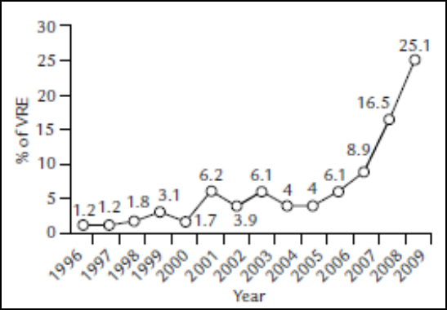
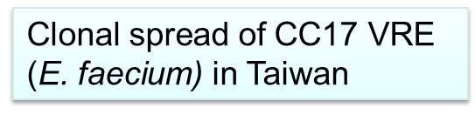

VRE in VGHTC
Rectal are excluded
VRE in NTUH
資料來源：臺中榮總院內統計資料；S-S Jean, J Formos Med Assoc. 2011

Slide 30
VRE Increasing in E. faecium
資料來源：Yang. (2012) 15th Annual Meeting of Antimicrobial Drug Resistance in Taiwan Symposium

Slide 31
2-3 ESBL, CRE

Slide 32
ESBL, CRE
Extended-Spectrum β-Lactamases (ESBLs)
Carbapenem Resistance in Enterobacteriaceae (CRE)

Slide 33
Extended-Spectrum β-Lactamases(ESBLs)
Hydrolyze oxyimino-cephalosporins and monobactams
  Anti-penicillin, 1st, 2nd, 3rd-gen cephalosporins, aztreonam.
  But not the cephamycins e.g., cefotetan and cefoxitin and carbapenems.
Inhibited by β-lactamase inhibitors
  Clavulanic acid, sulbactam, and tazobactam.
β-lactamase: most in functional group 2be

Slide 34
Enterobacteriaceae
Cephalosporin
Test /Report Group | Antimicrobial Agent | Disk Content | Zone Diameter Breakpoints, nearest whole mm |  |  | MIC Interpretive Standard (μg/mL)
 |  |  | S | I | R | S | I | R
B | Cefotaxime or ceftriaxone | 30 μg | ≥ 26 ≥ 23 | 23-25 20-22 | ≤ 22 ≤ 19 | ≤ 1 ≤ 1 | 2 2 | ≥ 4 ≥ 4
 |  |  | ≥ 23 ≥ 21 | 15-22 14-20 | ≤ 14 ≤ 13 | ≤ 8 ≤ 8 | 16-32 16-32 | ≥ 64 ≥ 64
C | Ceftazidime | 30 μg | ≥ 21 | 18-20 | ≤ 17 | ≤ 4 | 8 | ≥ 16
 |  |  | ≥ 18 | 15-17 | ≤ 14 | ≤ 8 | 16 | ≥ 32
O | Ceftizoxime | 30 μg | ≥ 25 | 22-24 | ≤ 21 | ≤ 1 | 2 | ≥ 4
 |  |  | ≥ 20 | 15-19 | ≤ 14 | ≤ 8 | 16-32 | ≥ 64
C | Aztreonam | 30 μg | ≥ 21 | 18-20 | ≤ 17 | ≤ 4 | 8 | ≥ 16
 |  |  | ≥ 22 | 16-21 | ≤ 15 | ≤ 8 | 16 | ≥ 32
2010
2009
2010
2009
2010
2009
2010
2009
資料來源：Change from M100-S20 (JAN-2010)

Slide 35
CLSI for Cephalosporins
When using the current interpretive criteria (CLSI-2013), routine ESBL testing is no longer necessary before reporting results (i.e. it is no longer necessary to edit results for cephalosporins, ATM, or penicillins from susceptible to resistant).
For laboratories that have not implemented the current interpretive criteria (CLSI-2013), ESBL testing should be performed.

Slide 36
ESBL Detection
CLSI: Klebsiella pneumoniae, K. oxytoca, E. coli, Proteus mirabilis.
  Screening test
  Phenotypic confirmatory test
Report
  For all confirmed test: the test interpretation should be reported as resistant for all penicillins, cephalosporins, and aztreonam.

Slide 37
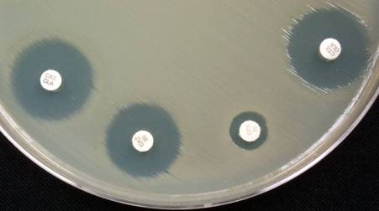
ESBL Confirmatory Test
ESBLs hydrolyze all P, ATM, and all cepha. (but not cephamycins e.g., FOX and cefotetan).
ESBL genes commonly are located on transmissible plasmids that often encode other resistant determinants (e.g., SXT).
QC of ESBL tests
K. pneumoniae ATCC 700603 (positive control)
E. coli ATCC 25922 (negative control)
>=5mm＝ESBL
CTX/CLA
CAZ/CLA
CAZ
CTX
資料來源：台中榮民總醫院

Slide 38
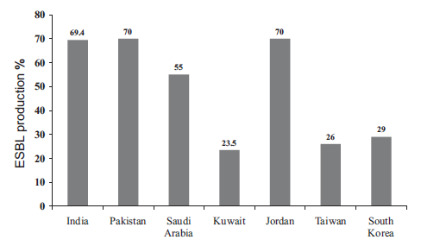
Rates of ESBL- K. pneumoniae
Strains in Asian Countries
資料來源：S.-S. Jean, P.-R. Hsueh / International Journal of Antimicrobial Agents 37 (2011) 291–295

Slide 39
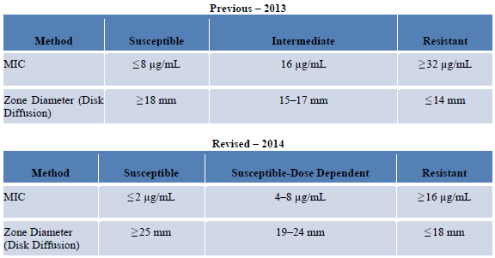

Cefepime Breakpoint Change for Enterobacteriaceae
資料來源：CLSI M100-S24

Slide 40
Enterobacteriaceae
Carbapenems
Antimicrobial Agent | Disk Content | Zone Diameter Breakpoints, nearest whole mm |  |  | MIC Interpretive Standard (μg/mL)
 |  | S | I | R | S | I | R
Doripenem | 10 μg | ≥ 23 | 20-22 | ≤ 19 | ≤ 1 | 2 | ≥ 4
 |  | - | - | - | - | - | -
Ertapenem | 10 μg | ≥ 22 | 19-21 | ≤ 18 | ≤ 0.5 | 1 | ≥ 2
 |  | ≥ 19 | 16-18 | ≤ 15 | ≤ 2 | 4 | ≥ 8
Imipenem | 10 μg | ≥ 23 | 20-22 | ≤ 19 | ≤ 1 | 2 | ≥ 4
 |  | ≥ 16 | 14-15 | ≤ 13 | ≤ 4 | 8 | ≥ 16
Meropenem | 10 μg | ≥ 23 | 20-22 | ≤ 19 | ≤ 1 | 2 | ≥ 4
 |  | ≥ 16 | 14-15 | ≤ 13 | ≤ 4 | 8 | ≥ 16
2010
2009
2010
2009
2010
2009
2010
2009
資料來源：Change from M100-S20-U (June-2010)

Slide 41
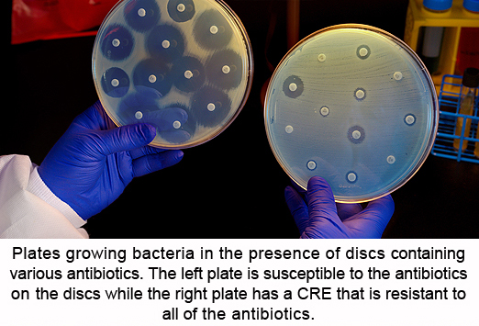
Carbapenem Resistance in Enterobacteriaceae (CRE)
Nonsusceptible to one of DOR, MEM, or IPM and Resistant to all of CRO, CTX, and CAZ.
Two mechanisms of resistance
  Carbapenemase
  Cephalosporinase combined with porin loss
    Cephalosporinases (e.g., AmpC-type β-lactamses or certain ESBLs i.e. CTX-M) have a low-level carbapenemase activity.
    Porin loss limits entry of the carbapenem into the periplasmic space.
資料來源：US CDC 2012 CRE Toolkit

Slide 42
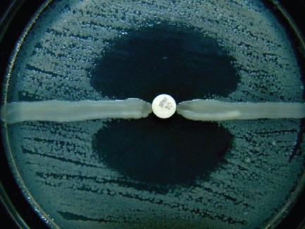
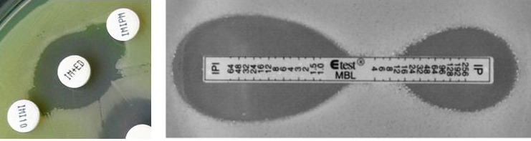
Carbapenemases in Enterobacteriaceae
CRE
KPC (Klebsiella pneumoniae carbapenemase)
NDM (New Delhi Metallo-β-lactamase).
VIM, IMP, and OXA-48
MHT detecting KPC-
type sensitivity and
Specificity >90% in
US isolate
MHT detecting NDM-type sensitivity
is low (i.e. 11%) Phenotype :
IPM/IPM+EDTA and gene detection
Metallo-β-lactamase
資料來源：CLSI M100-S23. Table 2A. Supplemental Table 2-3

Slide 43
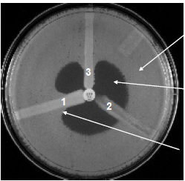
MHT for KPC
Using “old” criteria
E. coli ATCC® 25922
Screen criteria
Disk | Dilution
ETP: 19–21 mm MPM: 16–21 mm | ETP: 2 μg/mL IPM: 2–4 μg/mL MPM: 2–4 μg/mL
Inhibition of E. coli ATCC® 25922
by ertapenem
Enhanced growth
Initial screen test | Phenotypic confirmatory test
The following applies ONLY when using interpretive criteria for carbapenems described in M100-S20 (January 2010). | Positive screening test and resistance to one or more agents in cephalosporin subclass III (e.g., cefoperazone, cefotaxime, ceftazidime, ceftizoxime, and ceftriaxone).
Using “new” criteria
※Infection control or epidemiological investigations may require.
※Intermediate or resistant to one or more carbapenems, and usually test resistant to one or more agents in cephalosporin subclass III.
資料來源：CLSI M100-S23. Table 2A. Supplemental Table 2-3

Slide 44
Report of Carbapenemase Production in Enterobacteriaceae
Using “new” current criteria | Using “old” interpretive criteria
Enhanced growth = positive for carbapenemase production. No enhanced growth = negative for carbapenemase production.
MHT (+), perform MIC tests of carbapenem results. | Disk screen (+) AND MHT (+), perform MIC of carbapenem results.
※Report results of MHT information. ※No change in the interpretation of carbapenem susceptibility test results for MHT-positive isolates. | ※ MHT positive ETP MIC of 2–4 μg/mL, IPM MIC of 2–8 μg/mL, or MEM MIC of 2–8 μg/mL, report all carbapenems as resistant. ※If the MHT is negative, interpret the carbapenem MICs using “old” CLSI interpretive criteria.
資料來源：CLSI M100-S23. Table 2A. Supplemental Table 2-3

Slide 45
Protocol for Detection of CRE from Rectal Swabs
Step 1 Day One | Rectal swab place 10 μg ETP or MPM disc in 5 ml TSB. Incubate overnight at 35 ± 2ºC, ambient air.
Step 2 Day Two | Vortex and subculture 100 μl of broth culture onto MacConkey agar plate. Incubate overnight at 35 ± 2ºC, ambient air.
Step3 Day Three | Examine MacConkey for lactose-fermenting (pink-red) colonies. Subculture colonies of each morphology type to non-selective media and/or for susceptibility testing. Using Modified Hodge Test (MHT) or susceptibility method and follow the CLSI guidelines for identification of carbapenemase-producing Enterobacteriaceae.
Step 4 Day Four | For CRE and/or MHT-positive isolates, perform species-level identification.
資料來源：http://www. cdc. gov/HAI/pdfs/labSettings/Klebsiella_or_Ecoli.pdf

Slide 46
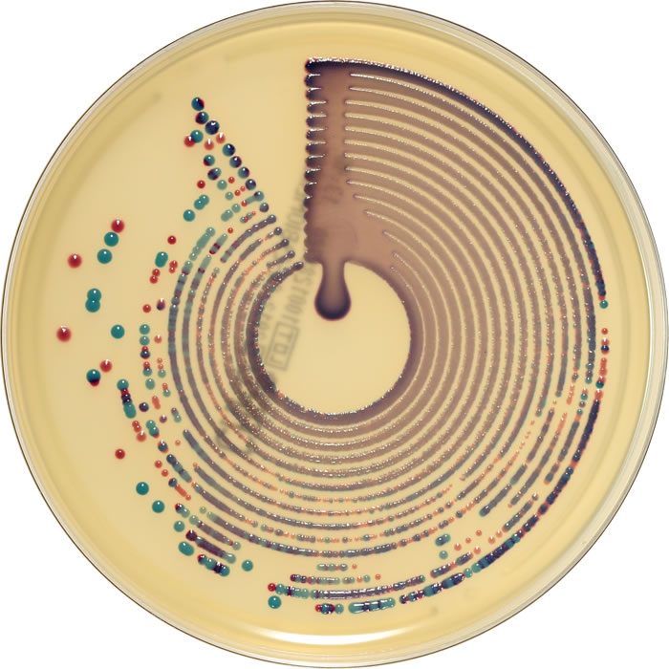
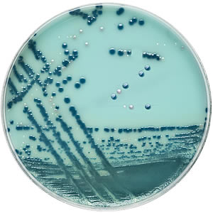
CRE Screening Agar
Including with NDM-1 mechanism of resistance.
E. coli (pink colonies) and Klebsiella, Enterobacter, Serratia or Citrobacter (KESC) organisms (blue colonies).
This medium does not replace conventional susceptibility test methods.
資料來源：台中榮民總醫院

Slide 47
2-4 XDRPA

Slide 48
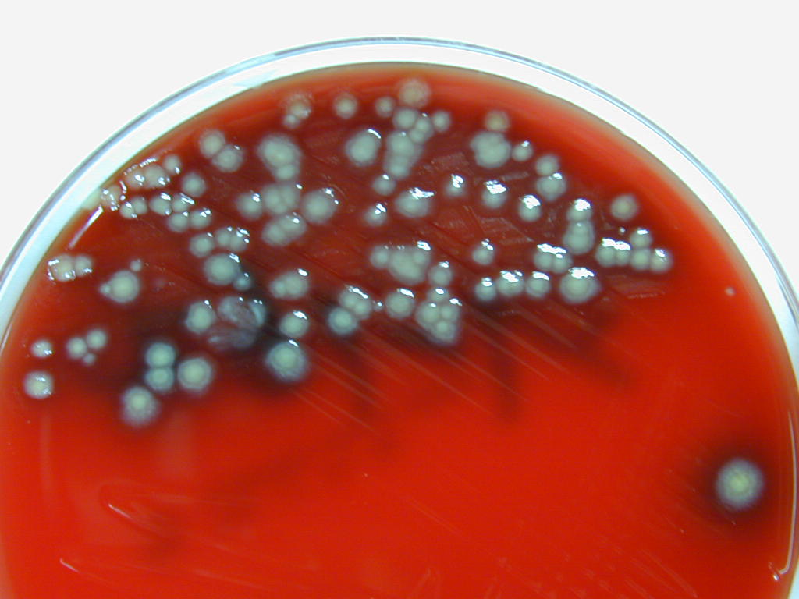
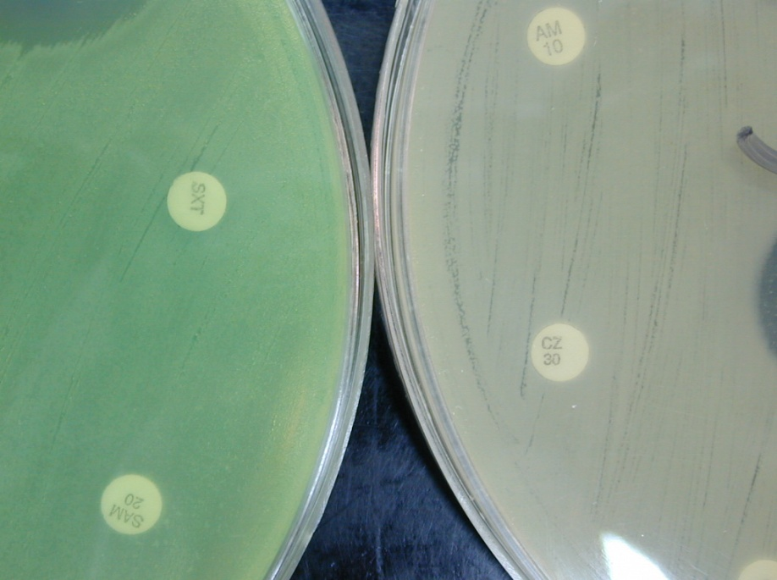
XDR Pseudomonas aeruginosa
資料來源：台中榮民總醫院

Slide 49
Pseudomonas aeruginosa (1/2)
Great concern as a nosocomial pathogen.
Intrinsically resistant to narrow-spectrum penicillins, 1st and 2nd cepha. and SXT.
Antipseudomonal :TZP, CAZ, FEP, carbapenems, aminoglycosides, fluoroquinolones.
Resistance to only amikacin is highly unusual.
XDR P. aeruginosa strains.
  Resistant to all common antipseudomonal agents except colistin.
資料來源：S-S Jean, P-R Hsueh., J Formos Med Assoc. 2011; p.4–13

Slide 50
Pseudomonas aeruginosa (2/2)
Carbapenems
Antimicrobial Agent | Disk Content | Zone Diameter Breakpoints, nearest whole mm |  |  | MIC Interpretive Standard (μg/mL)
 |  | S | I | R | S | I | R
Doripenem | 10 μg | - | - | - | - | - | -
 |  | ≥ 19 | 16-18 | ≤ 15 | ≤ 2 | 4 | ≥ 8
Imipenem | 10 μg | ≥ 16 | 14-15 | ≤ 13 | ≤ 4 | 8 | ≥ 16
 |  | ≥ 19 | 16-18 | ≤ 15 | ≤ 2 | 4 | ≥ 8
Meropenem | 10 μg | ≥ 16 | 14-15 | ≤ 13 | ≤ 4 | 8 | ≥ 16
 |  | ≥ 19 | 16-18 | ≤ 15 | ≤ 2 | 4 | ≥ 8
2011
2012
2011
2012
2011
2012
資料來源：CLSI M100-S21 Table 2B-1；CLSI M100-S22 Table 2B-1
Notes:
50

Slide 51
2-5 CRAB, XDRAB

Slide 52
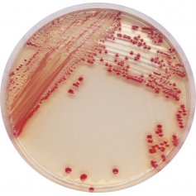
Acinetobacter baumannii
MDR A. baumannii
  Resistant ≥ 3 different classes of antimicrobials.
XDR A. baumannii
  Resistant to all antimicrobial agents except colistin or tigecycline.
CRAB
  Carbapenem-resistant A. baumannii.
MDR A. baumannii have been
persistent worldwide problems.
資料來源：S-S Jean, P-R Hsueh., J Formos Med Assoc. 2011; p.4–13

Slide 53
Acinetobacter spp.
Carbapenems
Antimicrobial Agent | Disk Content | Zone Diameter Breakpoints, nearest whole mm |  |  | MIC Interpretive Standard (μg/mL)
 |  | S | I | R | S | I | R
Doripenem | 10 μg | - | - | - | - | - | -
 |  | ≥ 18 | 15-17 | ≤ 14 | ≤ 2 | 4 | ≥ 8
Imipenem | 10 μg | ≥ 16 | 14-15 | ≤ 13 | ≤ 4 | 8 | ≥ 16
 |  | ≥ 22 | 19-21 | ≤ 18 | ≤ 2 | 4 | ≥ 8
Meropenem | 10 μg | ≥ 16 | 14-15 | ≤ 13 | ≤ 4 | 8 | ≥ 16
 |  | ≥ 18 | 15-17 | ≤ 14 | ≤2 | 4 | ≥ 8
2013
2014
2013
2014
2013
2014
資料來源：CLSI M100-S23 Table 2B-2；CLSI M100-S24 Table 2B-2
Notes:
53

Slide 54
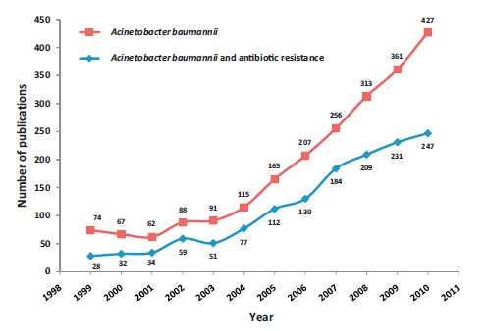
PubMed from 1999-2010
A. baumannii and Antibiotic Resistance
資料來源：M. Kempf, J.-M. Rolain / Inter J of Antimicro Age 39 (2012) 105– 114

Slide 55
Increasing Carbapenem Resistance in Acinetobacter baumannii in Taiwan
XDRAB, extended drug resistant AB (nonsusceptible to aminoglycosides, carbapenem, 3rd & 4th gen cephalosporins, β-lactam/lactamase inhibitors, fluoroquinolones)
資料來源：Yang. (2012) 15th Annual Meeting of Antimicrobial Drug Resistance in Taiwan Symposium

Slide 56
3.總結

Slide 57

Four Core Actions to Prevent Antibiotic Resistance
Preventing infections, preventing the spread of resistance.
Tracking resistance pattern.
Improving use of antibiotics.
Developing new antibiotics and diagnostic tests.
資料來源：ANTIBIOTIC RESISTANCE THREATS in the United States, 2013, US CDC

Slide 58
No Action Today,
No Cure Tomorrow
Antimicrobial
Stewardship
Develop New
Drugs and
Vaccines
Education
Research &
Pubic Policy
Reduce
Resistance
Reservoirs
Improved
Diagnostics
Infection
Prevention
資料來源：WHO Websit, World Health Day 2011: policy briefs

Slide 59
課程結束

